Slide 1
Advanced-LIGO optical lever progress
LIGO-G1000309
Richard Abbott, Eric Black, Tara Chalermsongsak, Craig Conley, Vladimir Dergachev,
Doug Cook, Riccardo DeSalvo, Andrea Lottarini, Gerardo Moreno, Mohana Mageswaran,
Rick Savage, Robert Schofield, Michael Smith, Cheryl Vorvick, Hiro Yamamoto

Slide 2
Initial LIGO Optical Lever Setup
Quadrand Photodiode
mirror
Steering mirror
Collimator
Diode Laser
Fiber optic

Slide 3
AdvLIGO Optical Lever Setup
Quadrand Photodiode
With x-y translational
stage
3) use direct pointing,better support structure
mirror
1) Straight -> Angle cut fiber
2) Laser -> SLED
Superluminescent LED
Fiber optic
3/15/10
LSC meeting in Pasadena
3

Slide 4
How to reconstruct beam position from QPD’s signal
V2
V1
Vsum (S)= V1+V2+V3+V4
Vsum corresponds to the total power of the beam
Right (R) = V1+ V4
Left (L) = V2 + v3
Top (T) = V1+V2
Bottom (B) = V3 + V4
V3
V4
Vx_normalized = (R-L) / S
Vy_normalized = (T-B) / S

Slide 5
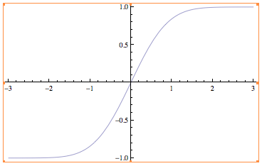
(R-L)/S
Scan the beam across the QPD, the signal (R-L)/S will be
the Error function.
slope at center ~ const/w
Near center
(R-L)/S = const * d
Then the voltage readout
Can be reconstructed to
distance from the center.
angle = d/armlength.
d
(R – L)/S =
Notes:
Once we get the slope, spot size
Can be calculated.

Slide 6
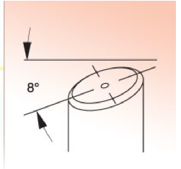
1) Changing from straight cut to angle cut fiber connector
Why?
Vibration on PC (Physical Contact)fiber causes the fluctuation on apparent beam position
Back reflelction -> mode jump in the laser
Angle cut connector,APC, (Angled Physical Contact) reduces the effect of the reflection-> immune to vibration
Notes:
Reflection of light back to the laser and cause it to mode jump

Slide 7
Test of APC and PC fiber
A loud speaker, driven by a function generator, shakes the test fiber.
Fiber ends are strain relieved

Slide 8
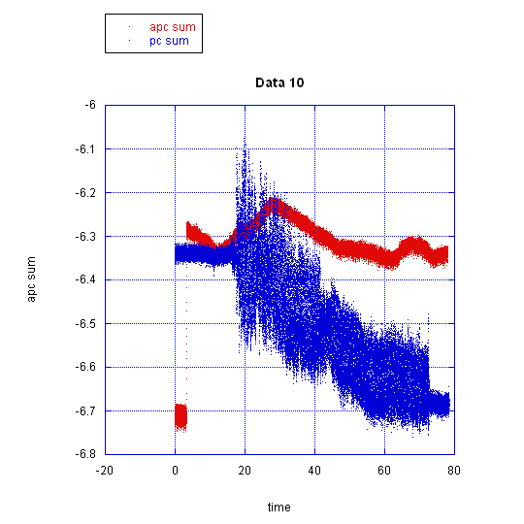
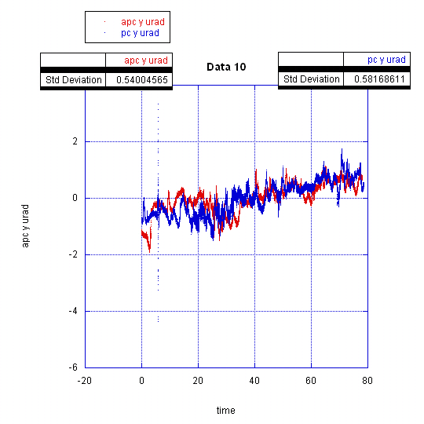
Result 1) the beam at center
APC -- S
PC -- , S
shake
APC Position [micro rad]
PC – Position [micro rad]
S[Volt]
Volt
position micro rad
quiet
Time [s]
Time [s]
3/15/10
draft
8
Notes:
PC sum sees the fluctuation, but its signal does not because it is at the center

Slide 9
Result 2) the beam off center
APC – position micro rad
PC – position micro rad
Plot of reconstructed x-position vs time[s] between PC (red) and APC (blue), 100 micron away from the gap. The APC fiber can maintain power stability much better than the PC fiber during the shake ( 30s < t < 70s.)
position micro rad
quiet
shake
quiet
Time [s]
Quiet shake quiet

Slide 10
Another Instabilities
The oscilloscope is in x-y mode
X axis -> R – L (hirozontal)
Y axis -> T – B (vertical)
At certain areas, the apparent
beam position fluctuates.
The fluctuation subsides as
The beam goes to the center
Or far away in one quad
Notes:
It seems that there is mode hopping in the laser, So we decide to find a new light source.

Slide 11
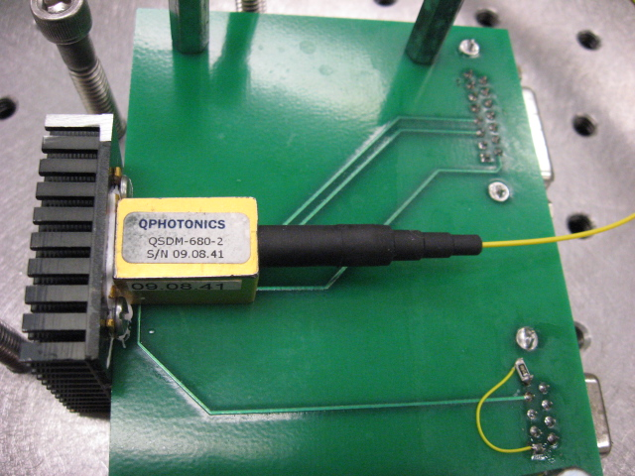
2) SLED as a Light Source
Current/temperature fluctuation -> mode hopping -> position fluctuation
With SLED -> no mode hopping -> no current-fluctuation induced instability
Q-photonics Super-luminescent Diodes, pigtail single mode fiber 14-Pin DIL, typically driven by a ITC502-IEEE remote control - Benchtop Laser Diode and Temperature Controller ±200 mA / 16 W

Slide 12
Current Modulation
Triangular function 32+/- 2mA period of 1000 seconds
collimator
CCD will measure x-y positions and
spot size.

Slide 13
Sum Voltage readout vs Time During Current Modulation
SLED
Diode Laser
Volt
Volt
Time [s]
Time [s]

Slide 14
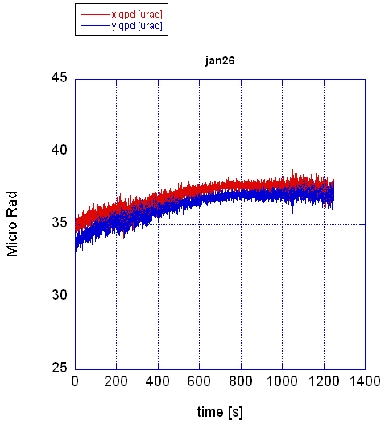
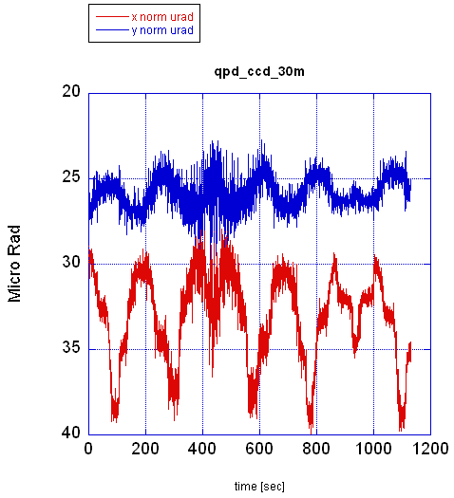
Influence of input current on Normalized Beam Position Data from QPD
SLED
Laser
3/15/10
draft
14

Slide 15
Trace on the Oscilloscope
SLED
Laser
R-L and T-B (un-normalized Voltage) are displayed on x and y axes of
the scope. The spot is off center. The current is modulated by
the triangular function.
Notes:
A perfect gaussian beam should grow linearly with powre, the deviation can beseen when the spot is close to the center, away from the center, the spot grow linearly for both laser and SLED

Slide 16
Trace on the Oscilloscope (laser)

Slide 17
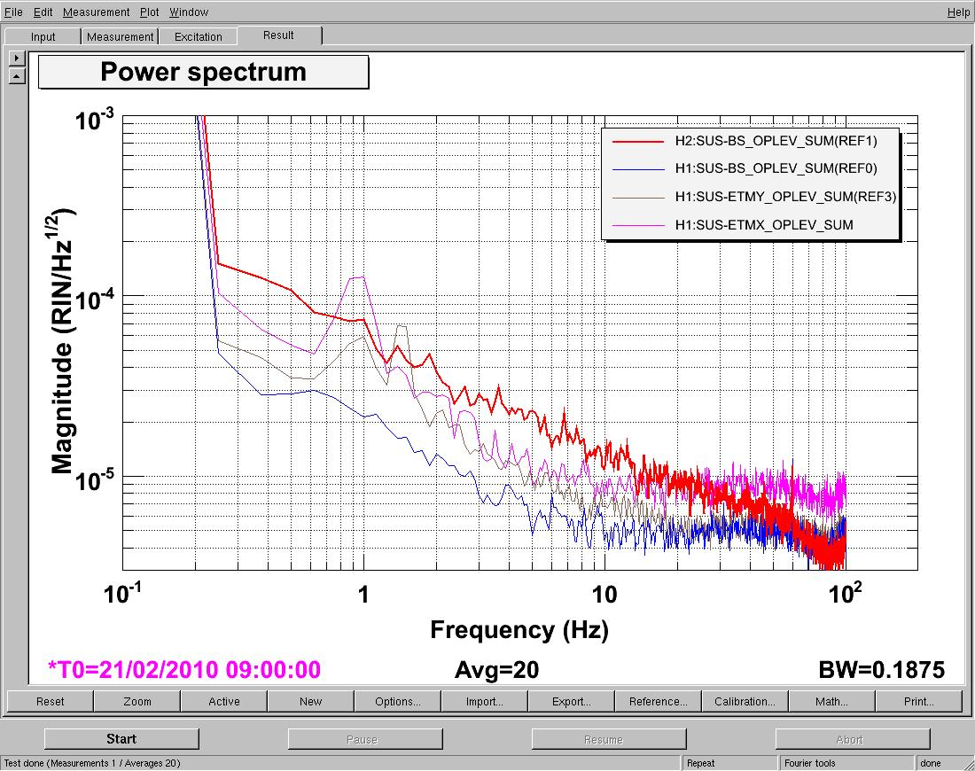
SLED results from LHO
Red is SLED, others are lasers.
Kawabe K, Hanford elog, Feb 23 19:08:05 2010 UTC

Slide 18
SLED results from LHO (2)
free swinging noise read out by the optical levers
Atkinson D. Hanford Elog, Feb22 22:57:46 2010 UTC

Slide 19
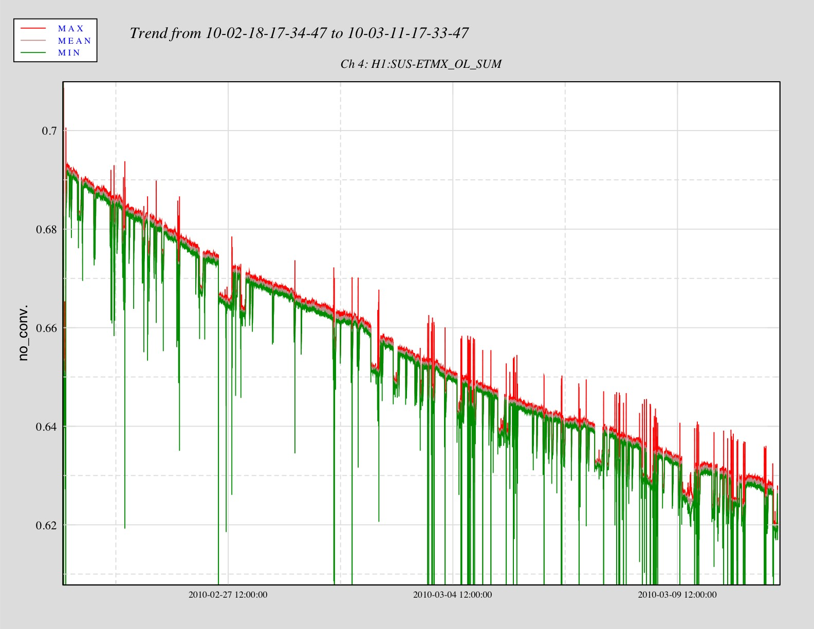
SLED results from LHO (3)
Power decreases
By ~ 7 % over 16 days
Rodruck M. Hanford elog, Mar 11 19:51:47 2010 URC

Slide 20
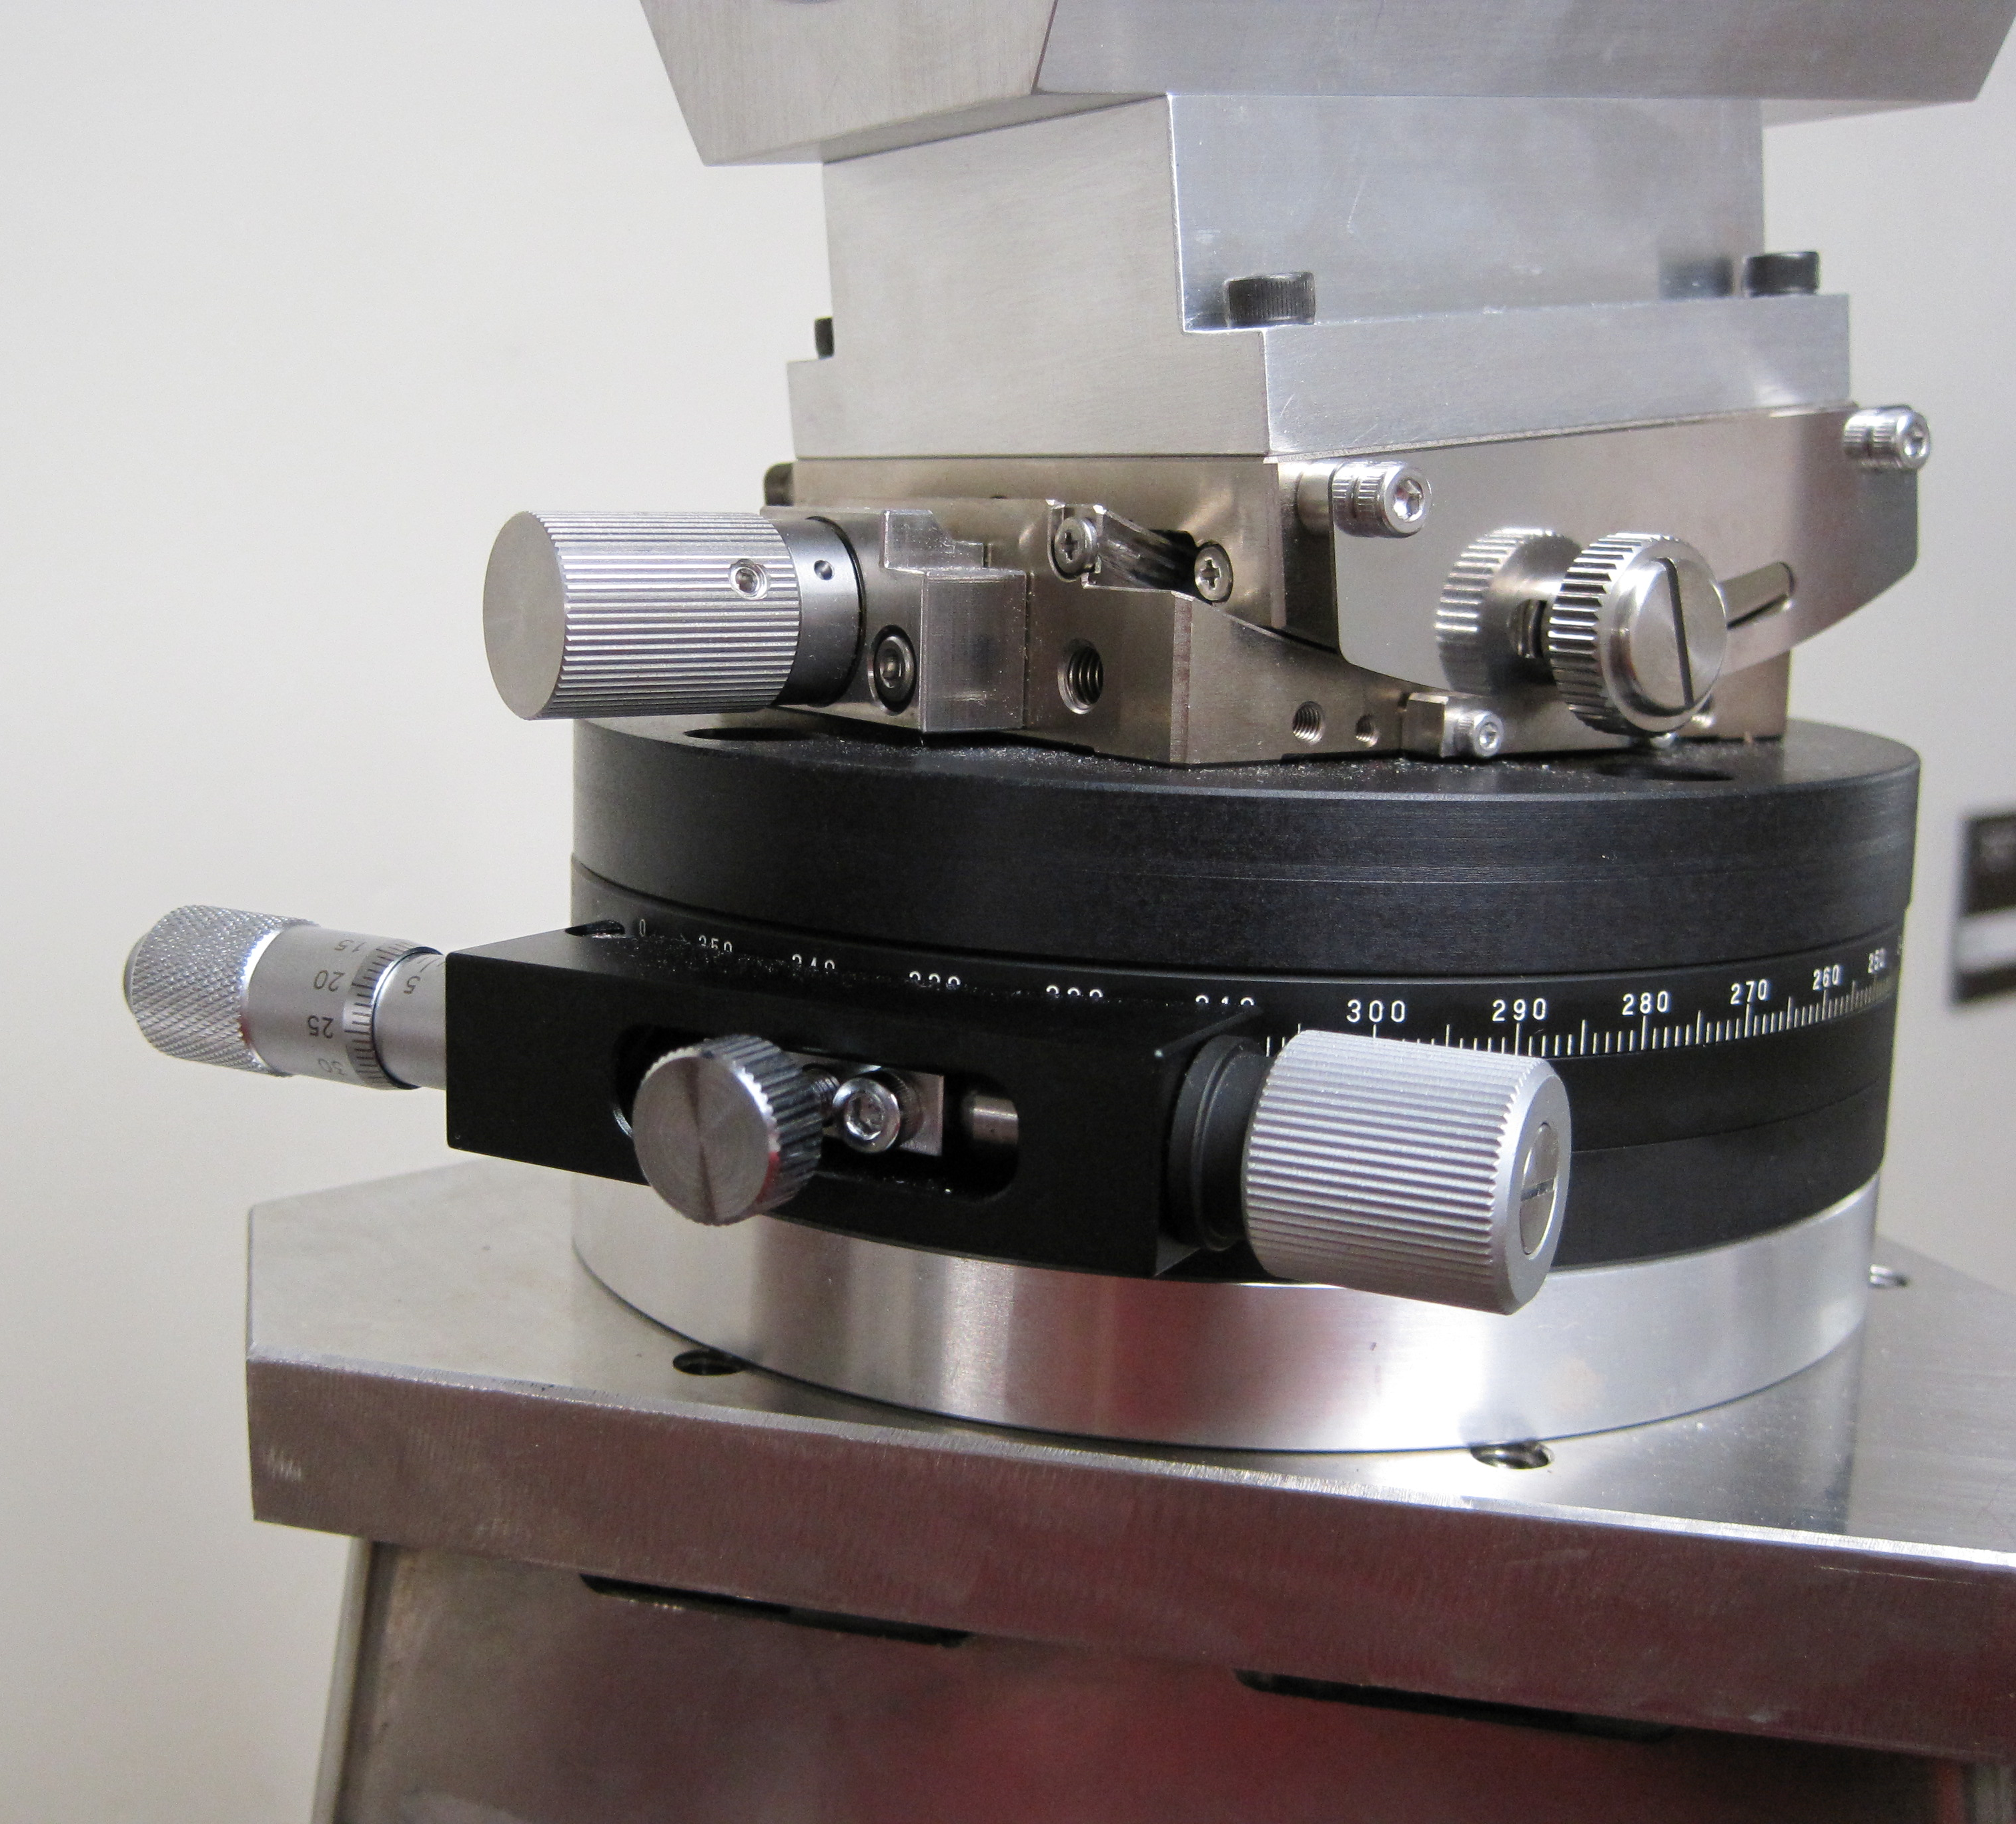
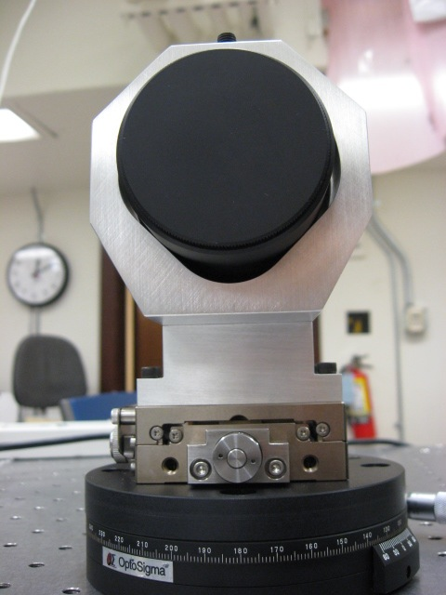
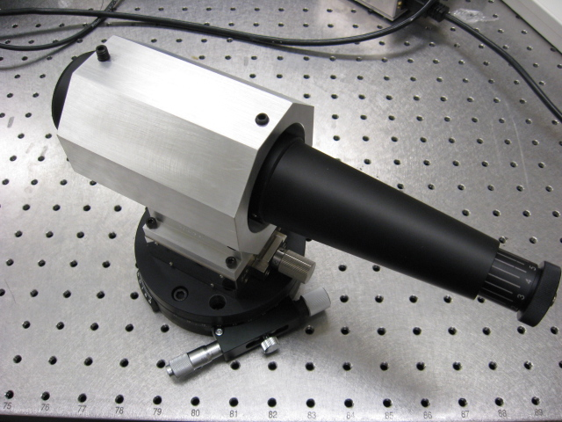
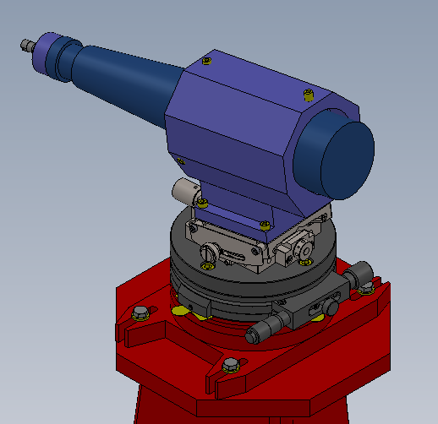
3) Mounting Mechanism
Fifty mm diameter test mass telescope launcher on its yaw-tilt micrometric pointing mechanism; note the locking mechanisms.

Slide 21
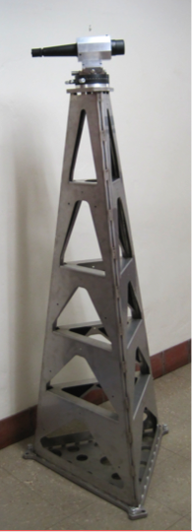
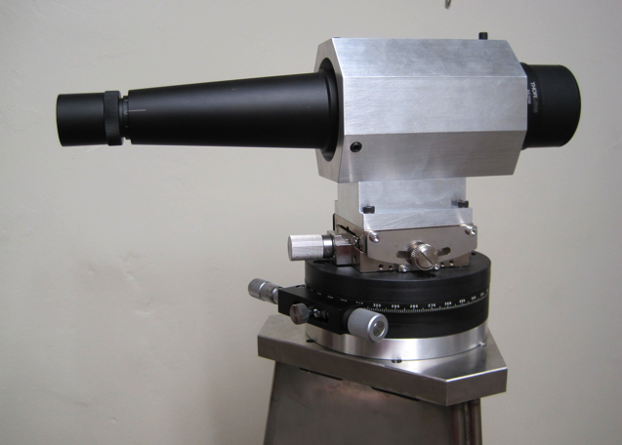
Pylon
The pylon is made with sheet metal laser cut, bent and stitch welded.
The pylon will be grouted and bolted on the ground

Slide 22
Observing Thermal Distortion
Two auxiliary beams
Main beam
Mirror
3/15/10
LSC meeting in Pasadena
22

Slide 23
summary
Use angle cut fiber connector to reduce vibration induced instabilites
Use SLED instead of a diode laser -> no mode hopping effect due to current fluctuation.
More rigid mounting and locking mechanism to ensure better stability.
Add auxiliary beams to monitor ROC of the mirrors. Fitting algorithm and CCDs will be used for obtaining the data

