Slide 1
Image Processing Pipeline for Follow-up Observations with Optical Telescopes
Brenden Simoneaux
RET End Summary
July 2009
Notes:
Locating and Observing Optical Counterparts to Gravitational Wave Bursts

Slide 2
Outline
Multi-Messenger Astronomy and
Project LOOC UP
II. Transients in CCD Images
III. Pre-processing of raw images
IV. Processing approach for
candidate transient identification
V. Future software module development
VI. Educational “Snack” development

Slide 3
GW and Multi-messenger Astronomy
It is expected that gravitational wave bursts will be associated with astrophysical events or processes which are very energetic – and these processes may be accompanied by changes which EM (optical) telescopes can detect.
Examples: Supernovas, Macronovas (result of a double neutron star merger, or black hole/neutron star merger), Gamma Ray Burst Afterglows.
The LSC currently uses Gamma Ray Bursts (GRB’s) and Soft Gamma Ray Repeaters (SGR’s) as external “triggers” for gravitational wave bursts.
Efforts are currently underway to do the opposite – to use suspected gravitational wave triggers in order to locate optical counterparts to gravitational wave bursts (project LOOC-UP).
Potential to provide information such as the position, distance, and source mechanism.

Slide 4
Collaboration Considerations
In search for an astrophysical event using gravitational wave triggers, the LIGO-Virgo network is sensitive to the whole sky, whereas optical telescopes must be pointed to a particular location.
Thus a collaboration with a group of observatories with the following characteristics is desired:
They should be somewhat global
Should have fairly wide field of vision (position determination is imprecise; a few degrees)
Should be automated (many short observations, not scheduled in advance – robotic scopes would be the ideal)

Slide 5
Partnerships
Memoranda of Understanding (MoUs) will be reached with partners who are enthusiastic about participating in the project - and wish to be collaborators in the event of its success.
Potential projects/instruments might include:
ROTSE
TAROT
QUEST
Pi of the SKY
Palomar Transient Factory

Slide 6
From GW Observation…
Data from the LIGO-Virgo network would be analyzed in near real time, and results for triggers are obtained (time lag of 10-30 minutes).
If all 3 detectors are in science mode, the data will include a position determination of the most likely sky position, (within limits of uncertainty).
The events are recorded to disk, along with pertinent information.

Slide 7
…To EM Observation
Observatories are contacted for follow-up optical imaging.
Follow-up observations are only initiated if an event candidate is well localized, in the field of view of the telescope, and above some “significance thresholds.”
The rate will be limited to a few per week, or several per month.
A major goal (in progress) is to establish a credible “False Alarm Rate,” and the proper significance thresholds.
Performing (raw) image analysis on project LOOC-UP’s pilot data – specifically identification of transients in the images – will assist in establishing these significance thresholds, and false alarm rates.

Slide 8
Optical Transients
Given a sequential set of images of a particular sky position, a transient is an object that appears to change in time.
It may not exist in one image but does in another, or it may simply have a significant change in intensity.

Slide 9
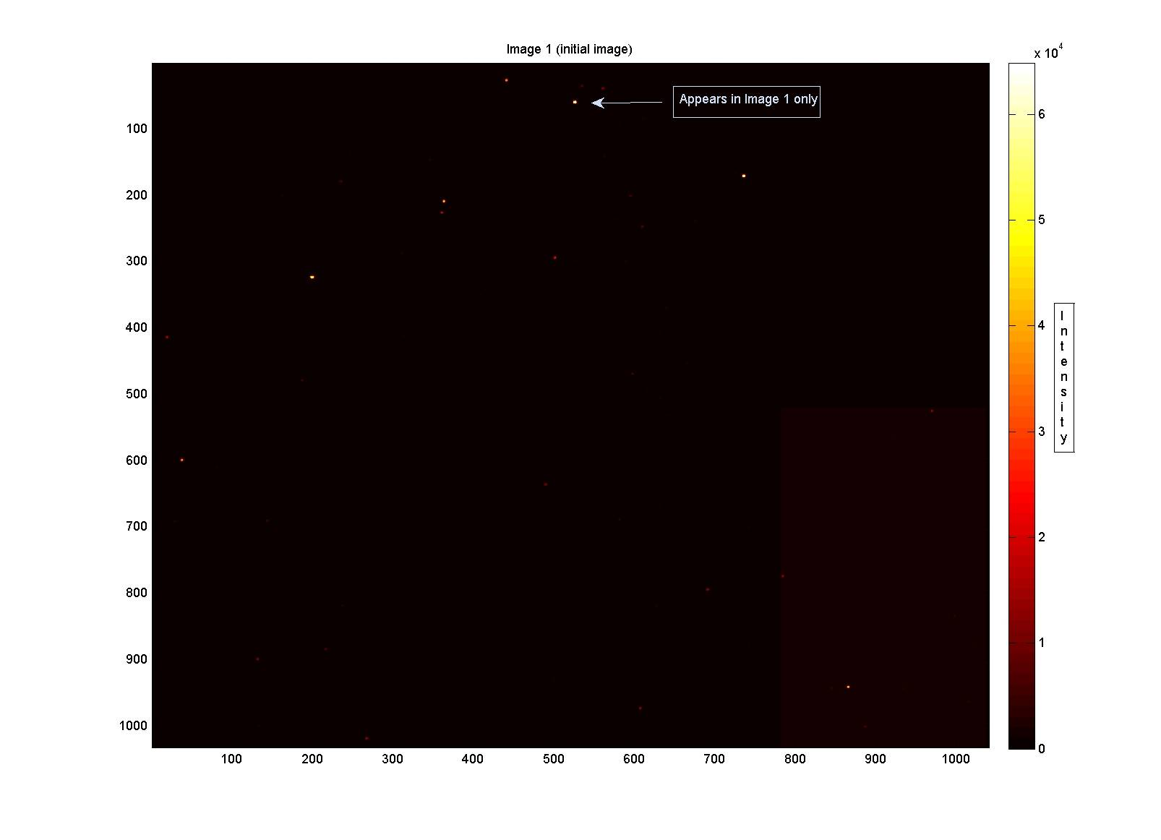

Slide 10
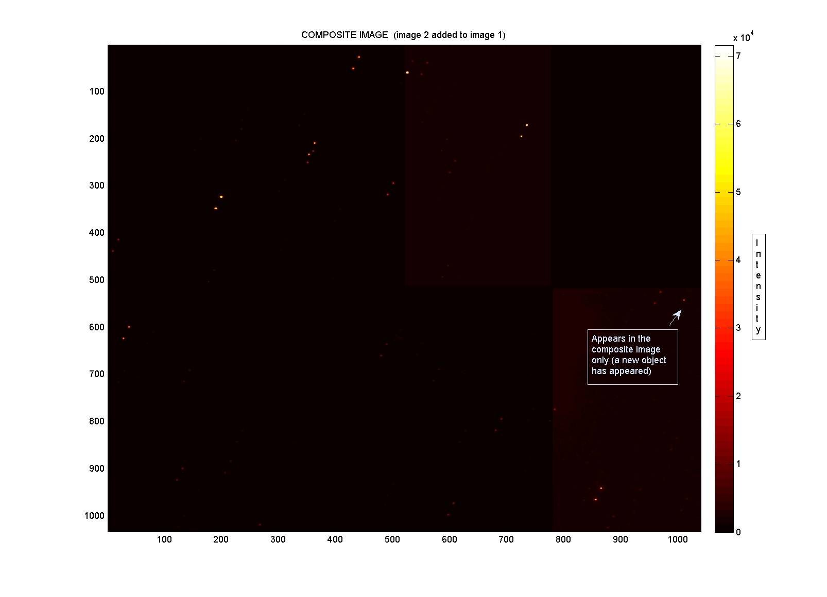

Slide 11
On Transient Identification
Not all transients are events associated with gravitational waves; asteroids, satellites passing into the field of view, meteors, etc. must be excluded – thus the ability to locate and identify transients is required.
While some observatories have image processing capacity, and will return the results of image analysis to the LSC, some will only be able to provide raw images.
With the assistance of Amber Stuver, a large portion of my work this summer as RET has involved developing software that will be used to automate the image analysis in locating transients, utilizing MATLAB.

Slide 12
Steps for Transient Identification
The following steps have been identified thus far for image processing:
FITS File Head Parameter Extraction
CCD Mosaic Assembly
Image Calibration
Dithered Image Assembly
Image Shift Calculation
Image Subtraction
Candidate Transient Identification
Luminosity Curve Calculation
Classification
FAR Estimation

Slide 13
The Images
The images are stored in a FITS file format – a NASA image file standard - which contains important information in a header about the image itself, and how it is stored (for reconstruction).
MATLAB has built in functions to read the data and extract the header parameters like:
Sky coordinates of image
Exposure time
Filters used
Date
Observatory
Etc.

Slide 14
Image Reconstruction and Calibration
Each image is actually a mosaic of CCD’s (8 on the MDM 8K CCD) which must be properly assembled to produce the image.
This step has been completed (Amber) but since the full resolution images are VERY large (~100 MB per image) we used 2x2 pixel averaged images that were also produced by the observatory.
CCD noise and other artifacts can be removed from the images by proper calibration.
These results are incomplete (Amber)– experts must be contacted to clarify some existing issues.

Slide 15
Visualizing the Images
The image data is stored in a matrix variable by MATLAB as a 1032 (row) x 1040 (col) matrix of intensity values which may be mapped to various colormaps.
The range of intensity values typically varies from 0 to approximately 64800; objects which may have had higher intensities map to a “saturated” value of the colormap’s maximum intensity.
Different colormaps are useful for revealing various objects, and image characteristics.

Slide 16
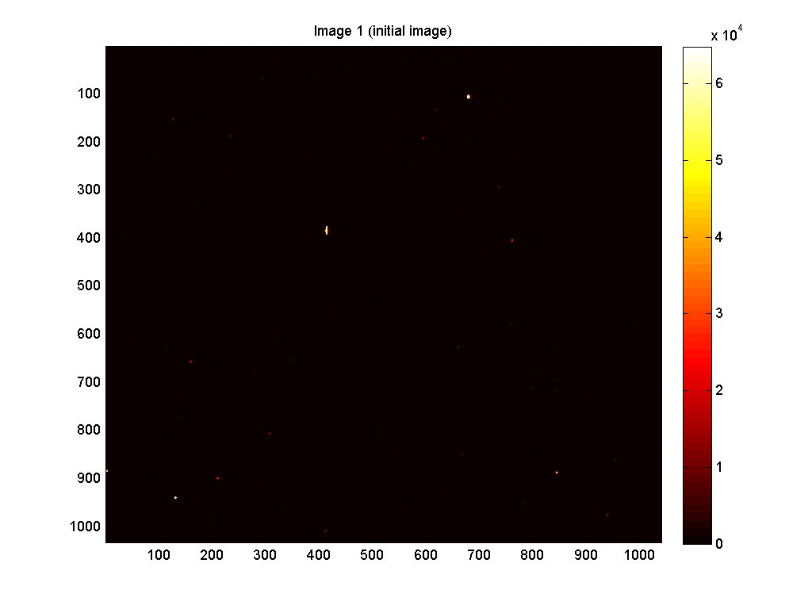
“Hot”
The “hot” colormap is good for getting a sense of relative intensities of objects.

Slide 17
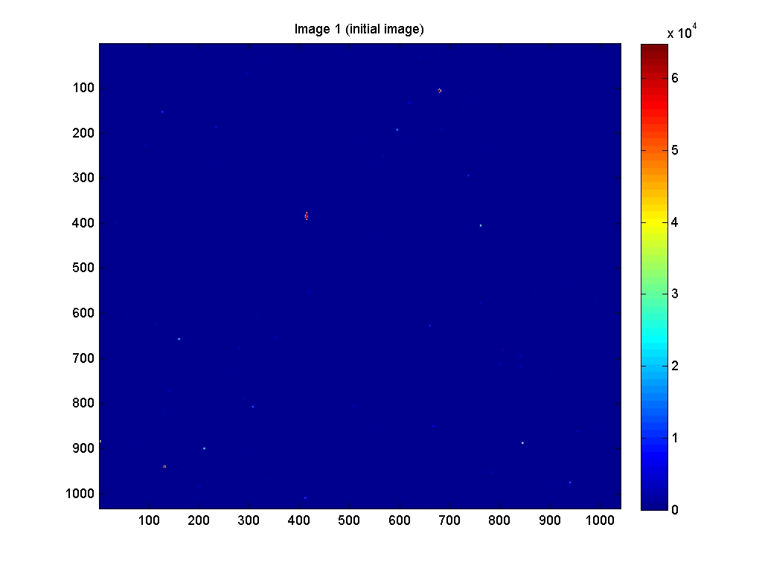
“Jet”
More & fainter objects can be seen utilizing the “jet” colormap.

Slide 18
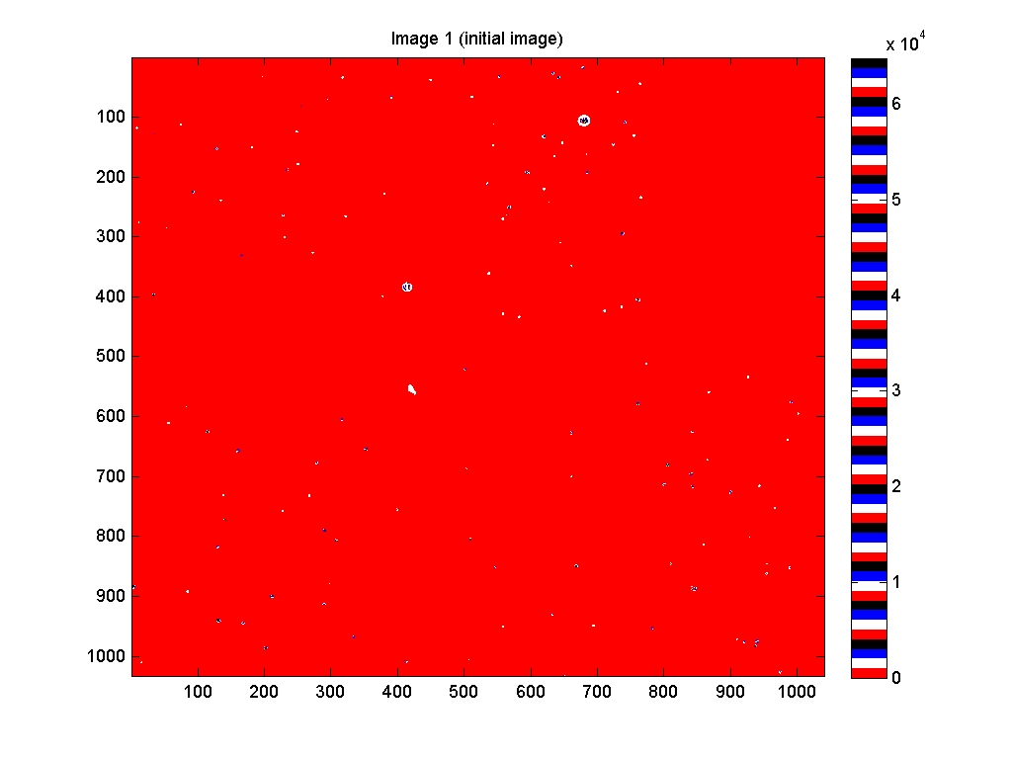
“Flag”
The “flag” colormap reveals that an image may contain many small differences in intensity values not otherwise visible to the eye.

Slide 19
Image Shifts
Since successive observations are not necessarily perfectly aligned, the shift in location (pixels) of stars must be calculated in order to perform a transient search.

Slide 21
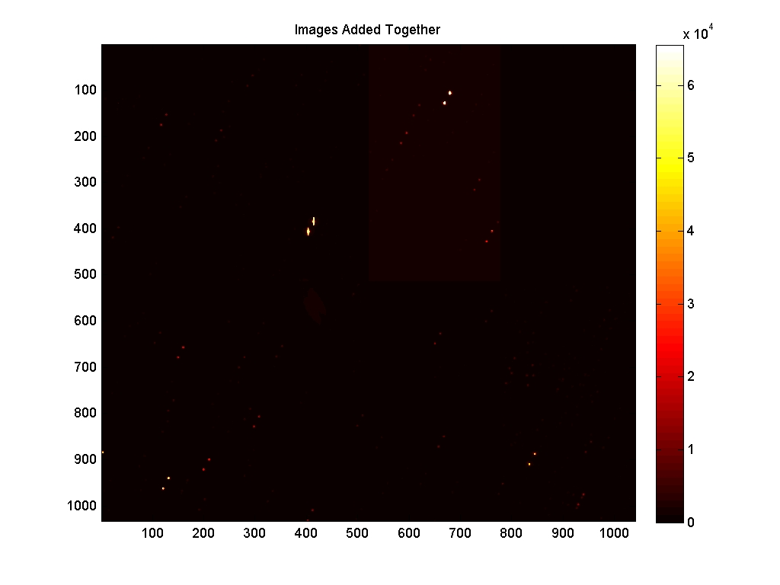

Slide 22
Calculating the Shift
The alignment problem was attacked using a “brute-force” approach: find bright pixels, identify stars as clusters of bright pixels, locating the same objects in a subsequent image.
Also, distances to nearby objects were calculated to verify offset calculations.
Early on, some significant “threshold” limits had to be applied – for example, what constitutes a bright pixel?
Too high of an intensity value, and insufficient pixels would be identified for offset calculations; too low, and correlating stars (clusters of pixels) becomes problematic.
In processing the images tested, an intensity value of 15,000 was chosen as a minimum (on a scale of 1 to 10, this would equal about 2.5 – thus fairly faint stars are being included).

Slide 23
Image Subtraction
The resulting aligned data files are then subtracted (image2 – image1) to produce an image which MAY contain transients.
It is expected that there will be NO transients in most images.
However, some candidate transients emerged in ALL images processed…

Slide 24
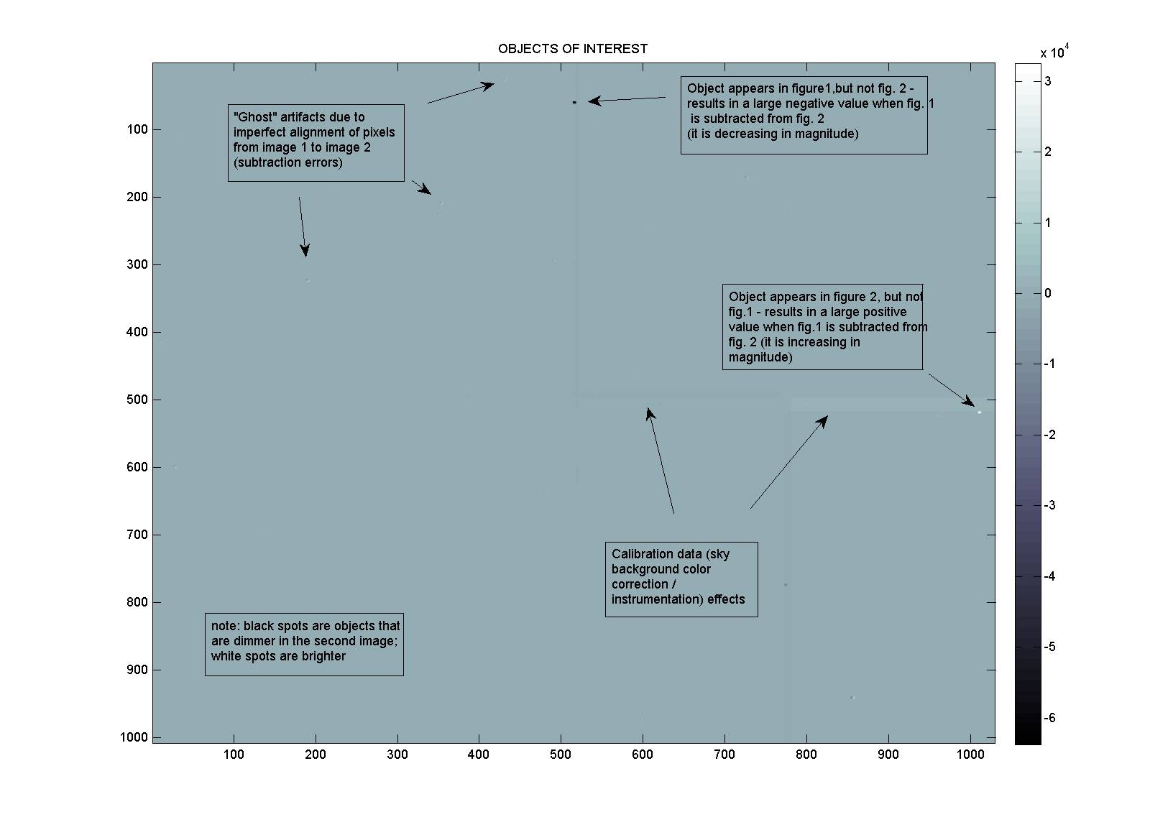

Slide 25
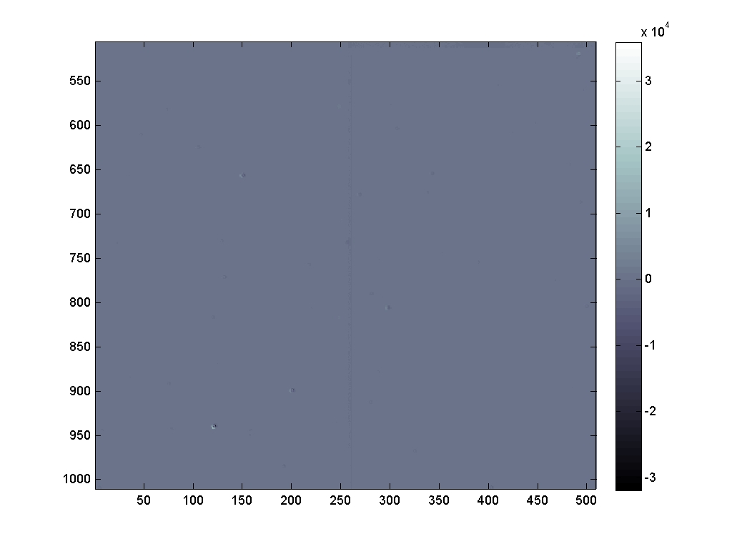
Artifacts due to imperfect pixel subtraction

Slide 26
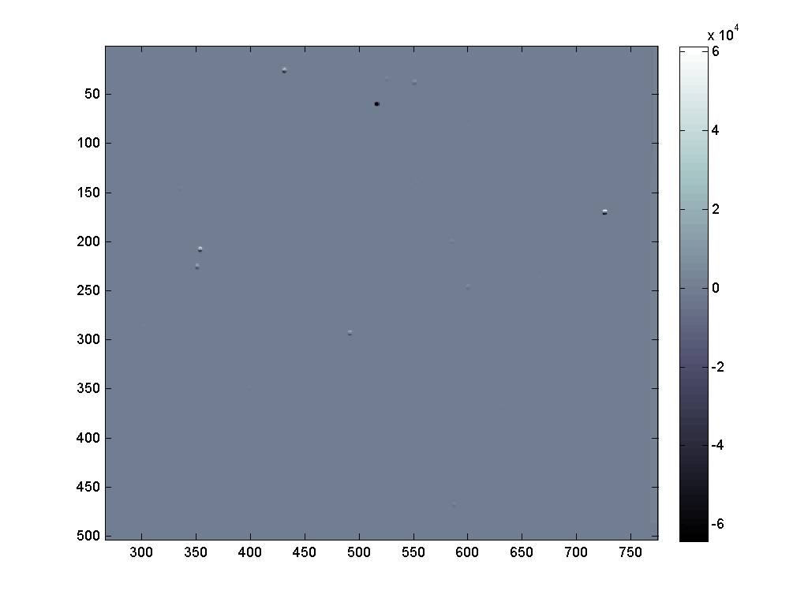
A “Negative” Transient

Slide 27
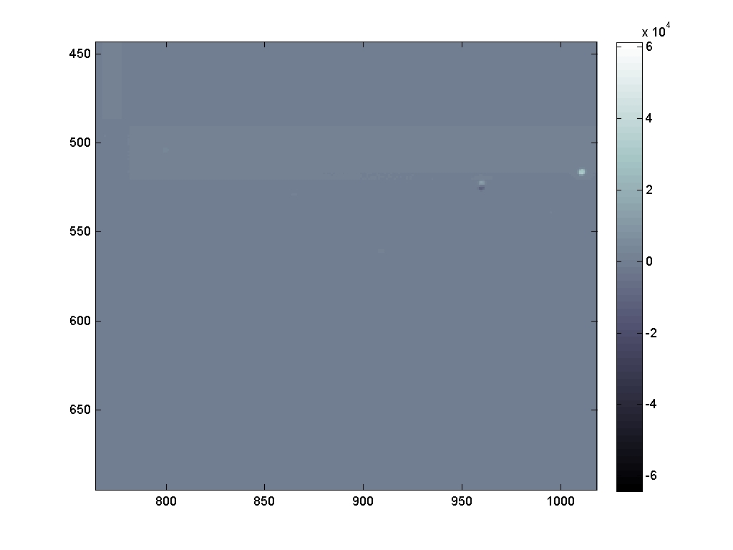
A “Positive” Transient

Slide 28
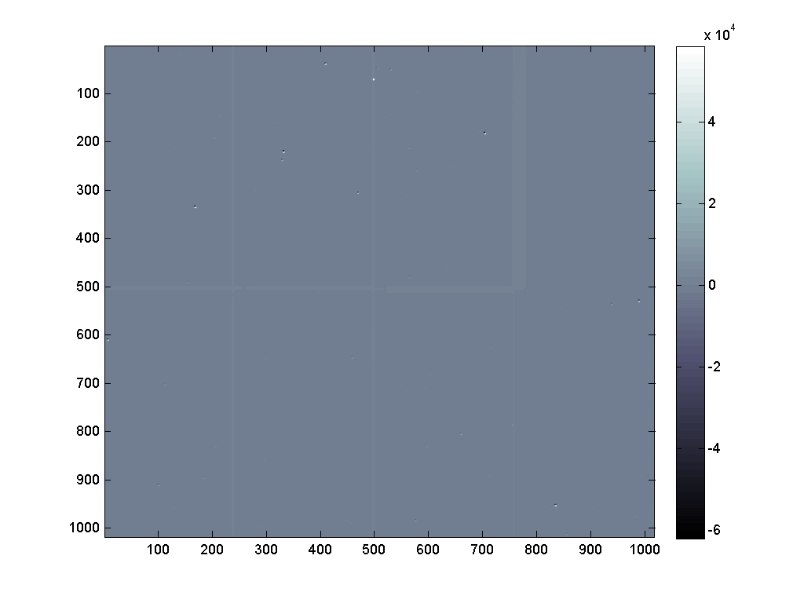
Potential Transients tend to lie near or on mosaic borders…

Slide 29
Identifying the Transients
A module was developed to evaluate subtracted images, and identify transients which are genuine.
Here, another threshold limit must be set – by how much must a pixel’s intensity vary from the background in order to be considered significant, after subtraction? Since the majority of background intensities have very low values (on the scale of tens), and mosaic border values typically range between +/-100 to +/-300, a limiting intensity value in the thousands was found to be appropriate.
Modules which were analogs of those previously developed to locate stars were utilized to locate candidate transients, storing pertinent information in a new matrix variable (intensities, size, X & Y coordinates).

Slide 30
Thresholding Rationale
A threshold cut is then made on transient candidates; only those with an increase or decrease in magnitude of 50% above background intensity are considered genuine. This limit was set high intentionally – the initial image subtraction produced similar transients with large changes in magnitude near mosaic boarders (intensity of 9 on a scale of 1 to 10).
If a lower threshold is used (10%), transient candidates will surface; however upon visual inspection all appear on or near a mosaic border. Further cuts are possible using the size of the cluster of pixels corresponding to transient (when small).

Slide 31
Future Work
Luminosity Curve Generations
For identified transients, how does the luminosity (brightness) change over the observations?
Transient Classification
Is this a real transient? If so, what kind is it (supernova, etc.)? The luminosity curve will be useful here.
False Alarm Rate Estimation
What is the chance that we identify a transient as being a “real” one by accident? A simulation program written by an IREU student (Greg Dooley – Kate’s brother) will help here.

Slide 32
Educational Science “Snack” Development

Slide 33
What’s a “Snack”?
In addition to Image processing software development, I have also constructed two science education “snacks” while at LIGO this summer.
A snack is a small-scale, inexpensive teaching tools similar in concept to the large-scale exhibits the Exploratorium in San Francisco houses and sells; the LIGO Science Education center contains some of these full-scale exhibits. At one time, a “cookbook” was published with construction diagrams for these… hence the smaller versions came to be known as snacks…
While exhibits may cost in excess of $10,000.00 snacks are intentionally as cheap as possible (teachers have little resources).

Slide 34
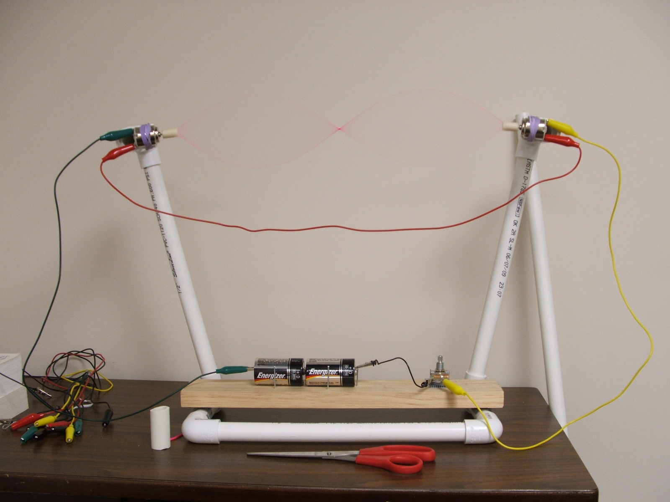
String Machine – and Exploratorium snack
(for demonstrating standing waves)

Slide 35
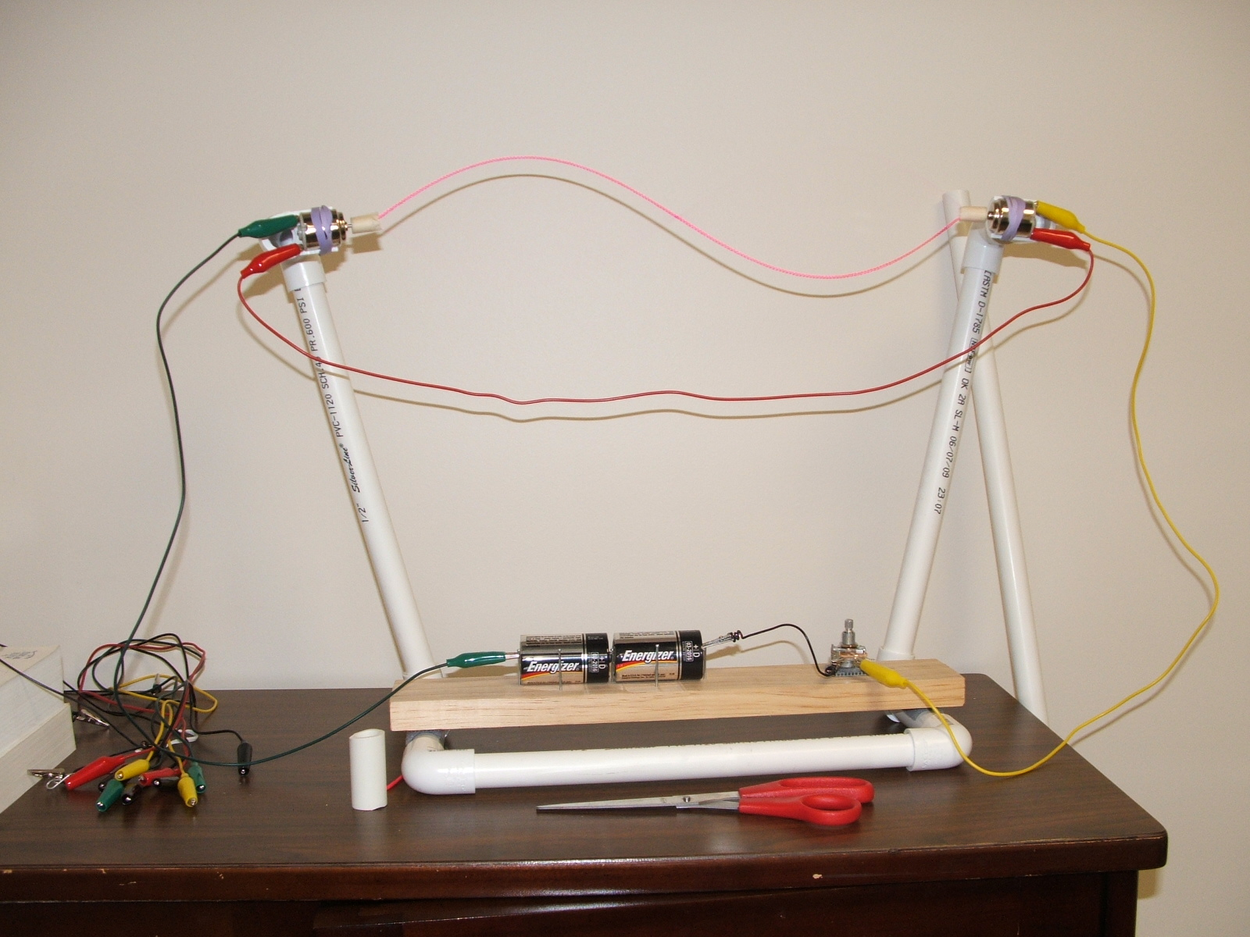

Slide 36
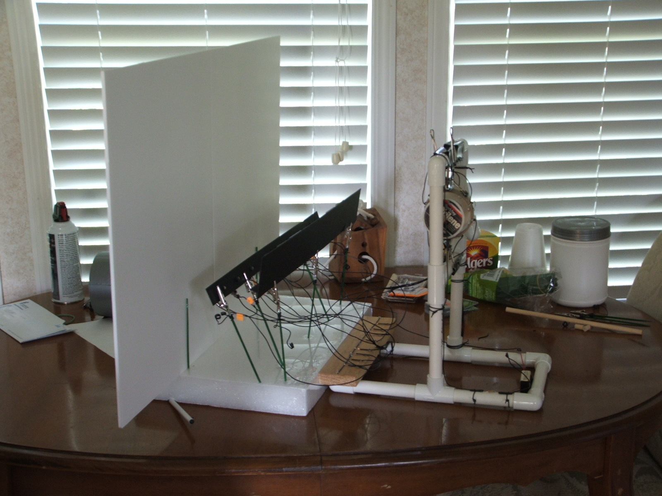
Reflected Motion
Related science topics: light, reflection, diffuse vs. specular reflection, & elementary electronic circuit design (resistors, diodes, series circuits, energy conversion)

Slide 37
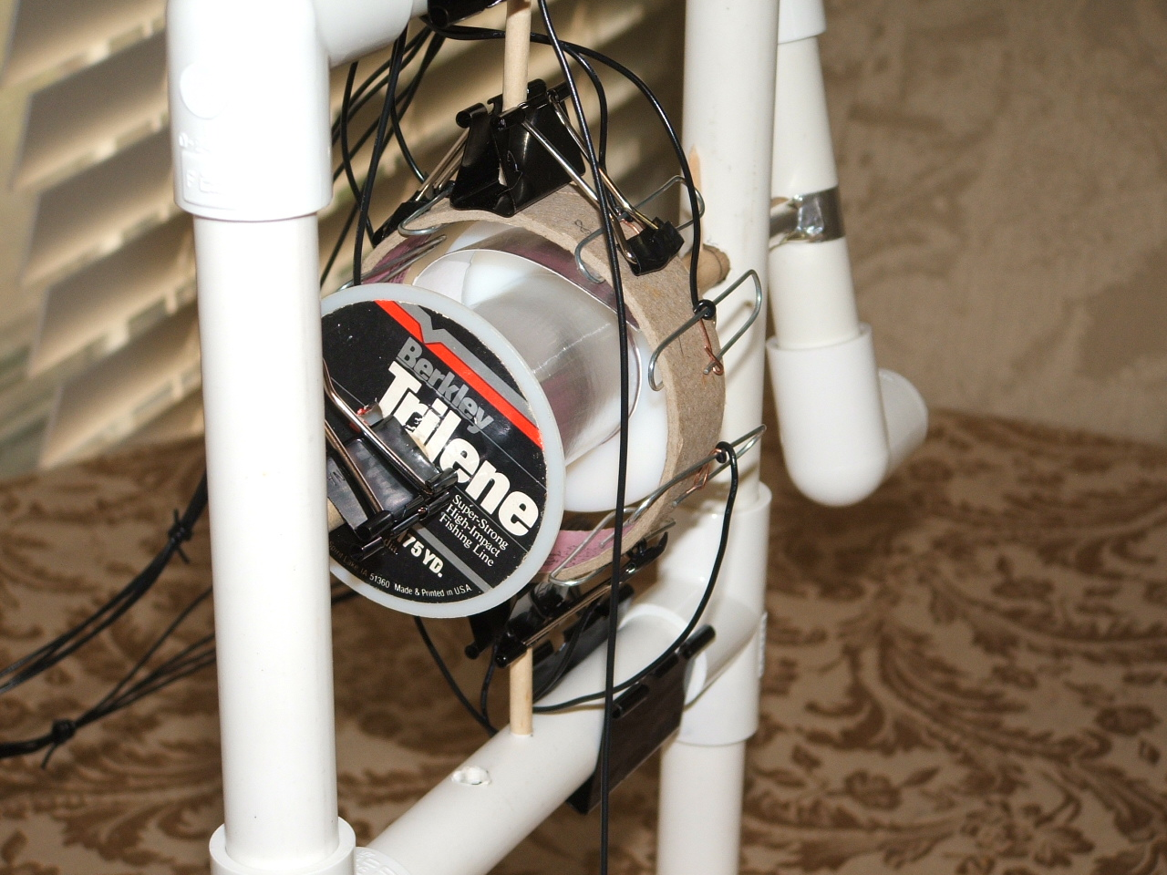

Slide 38
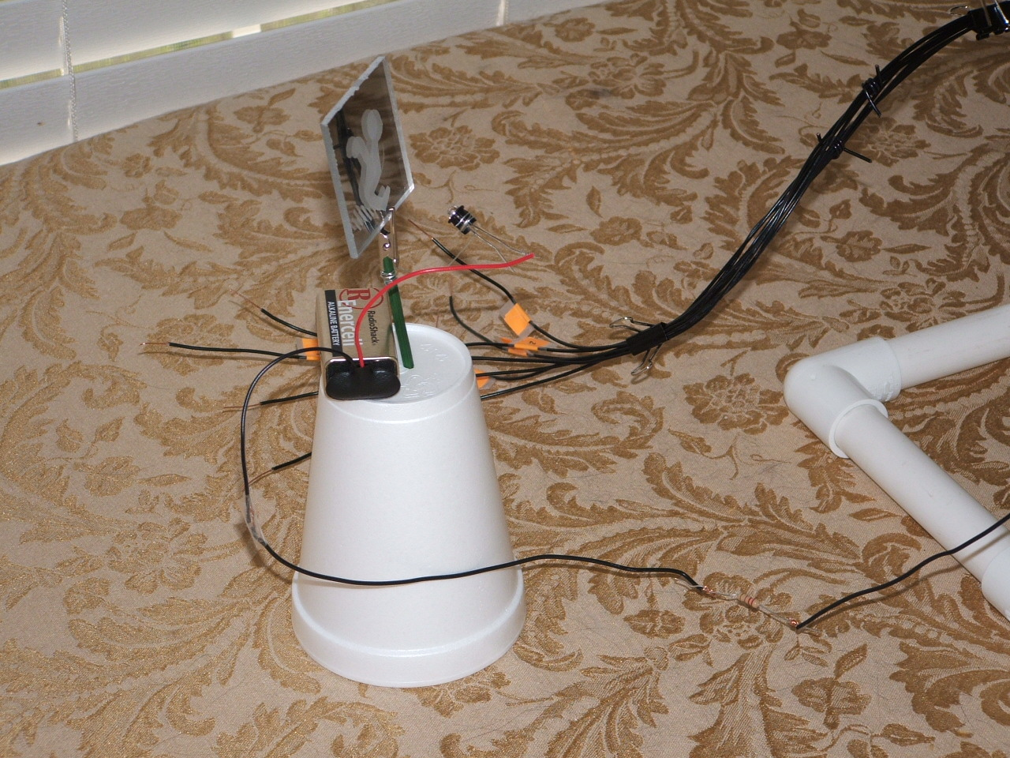

Slide 39
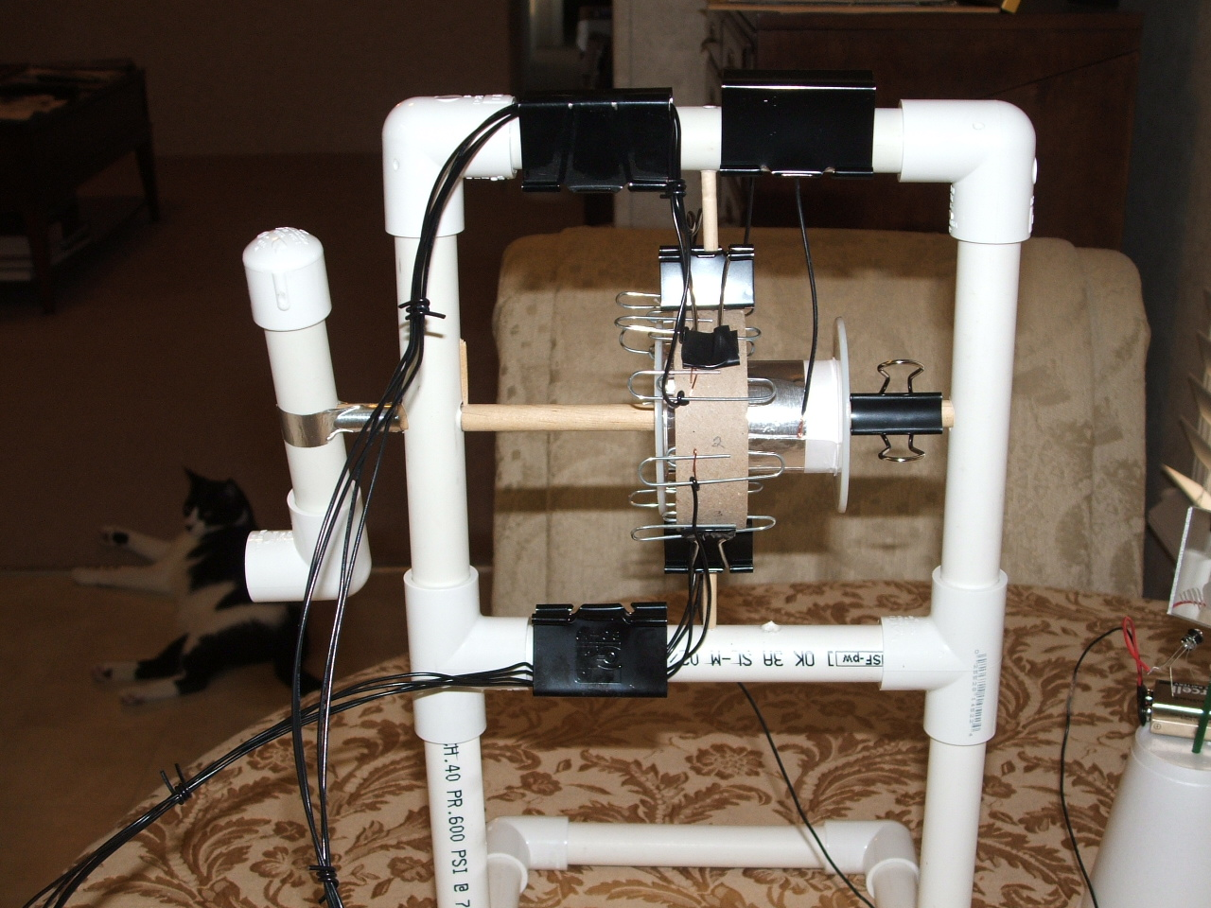

Slide 40
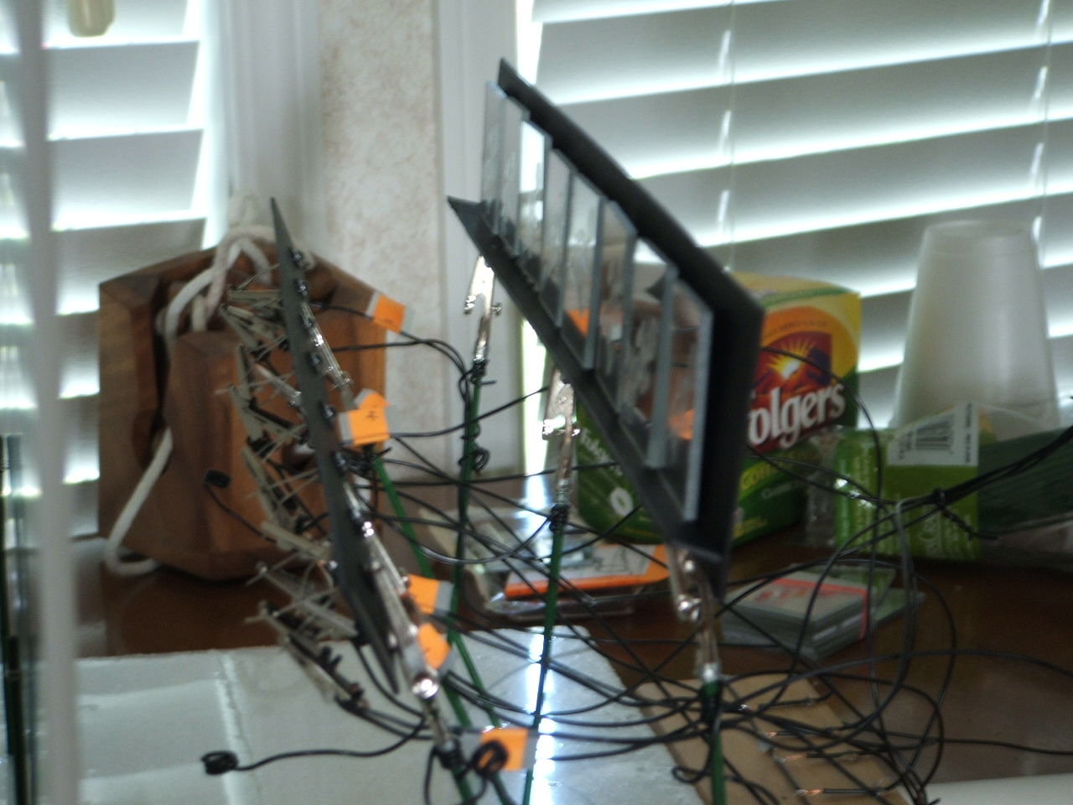

Slide 41
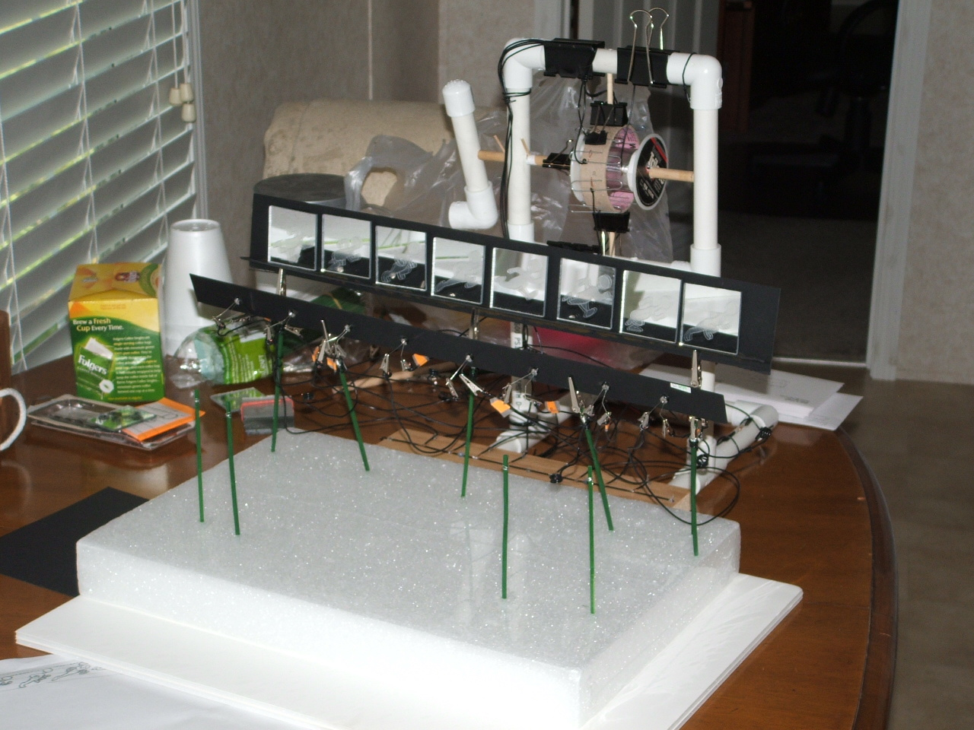

Slide 42
Special thanks to: Gary, Bryan, Augie, and Matt for their assistance!

Slide 43
The figure exhibits wave-like motion.

Slide 44
Summary of Accomplishments
Became familiar with LIGO Science and the LOOC-UP project
Became familiar with the science potential of optical follow-ups of candidate GW events (GRB, SN, etc.)
Became competent in MATLAB programming and algorithm development for LOOC-UP
Worked on developing first astronomical image processing pipeline for LOOC-UP
4a. Defined code requirements
4b. Developed modules to meet requirements
5. Developed educational “snack” prototype, and additional snack for SEC.

Slide 45
Emergency Slides
Thresholding

Slide 46
Results of Thresholding
NGC2976_003 minus NGC2976_002: threshold intensity +/- 12000 or 10%
possible transient found at location
x = 1011
y = 516
Intensity = 14129
Size = 20
possible transient found at location
x = 516
y = 60
Intensity = -29611
Size = 28

