Slide 1
Status of the H1 Squeezer Experiment
Excomm meeting, July 20, 2009
Daniel Sigg, LIGO Hanford Observatory
ANU, AEI, MIT, CIT and LHO collaboration

Slide 2
Highlights
Graduate students Sheila D. (MIT) and Sheon C. (ANU)
OPO development at ANU
6 dB of squeezing observed
Traveling wave bowtie design works
AEI loaner SHG at MIT
In the process of building our own (copy AEI design)
Laser, optical table and clean room installed at MIT
Noise model in development
Electronics design done for RF distribution
Shared with advanced LIGO
Next progress review in August

Slide 3
Block Schematics
Interferometer
S
0
Fiber
Homodyne Detector
Faraday
S
4
Laser
SHG
OPO
S
3
S
1
S
S
5
2
OMC
Auxiliary
Laser
AS Port
Squeezer
DC

Slide 4
ANU Traveling Wave OPO
PZT Actuator
Squeezing
Out
Pump light In
150 mm
Crystal
Oven/
Temperature
Sensor
200 mm

Slide 5
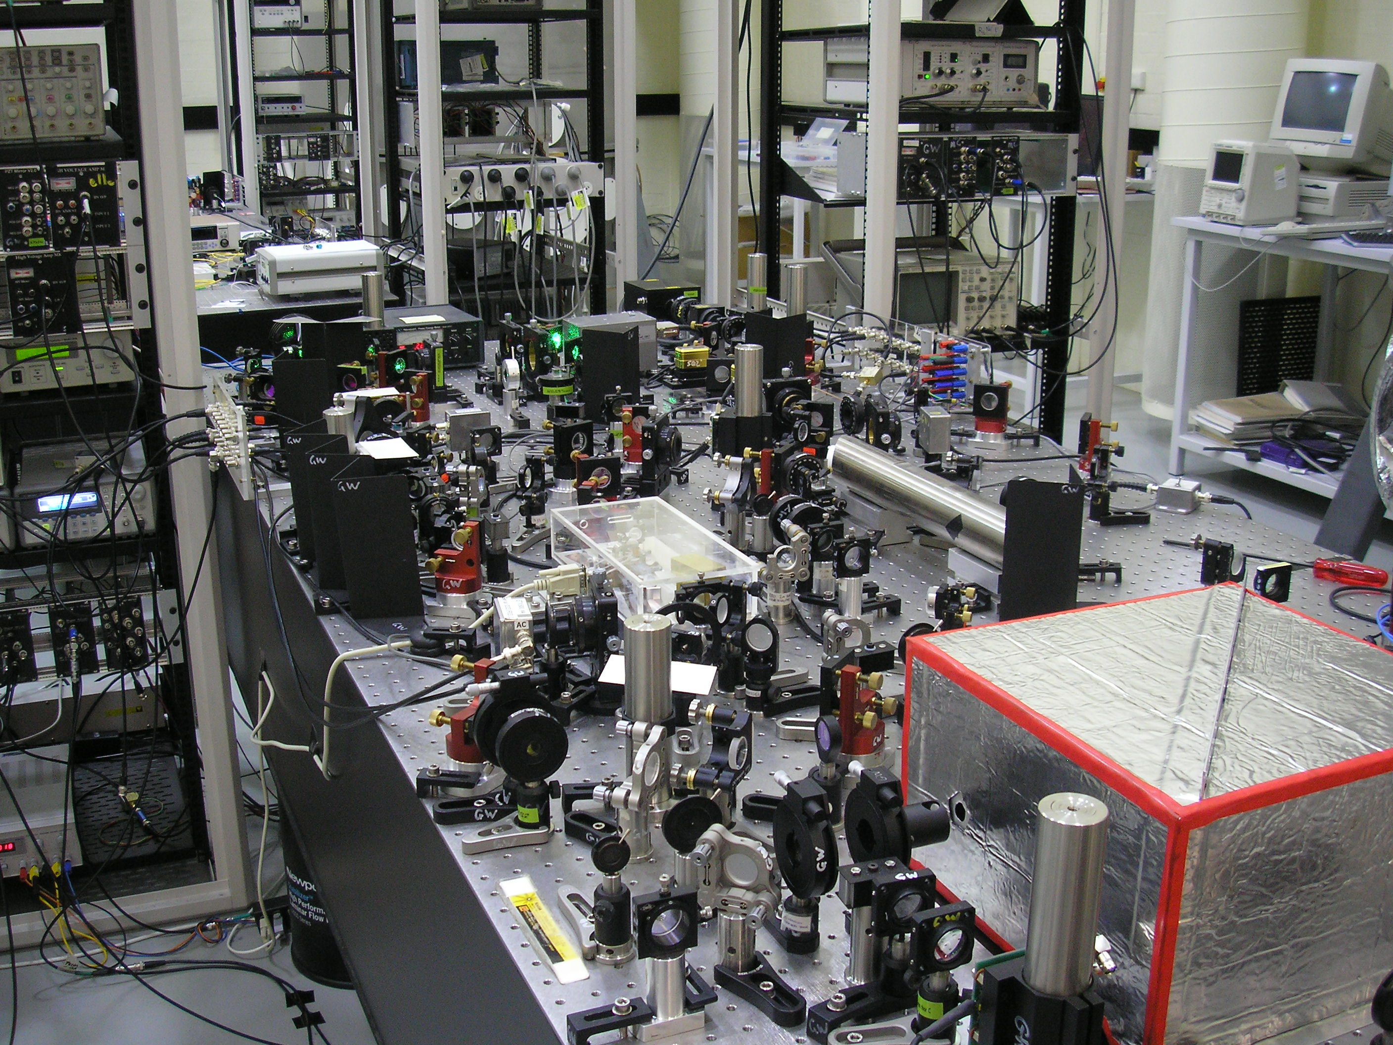
Lab at ANU
Main Laser
SHG
Main-Aux
Phase lock
OPO
Homodyne
Auxiliary Laser

Slide 6
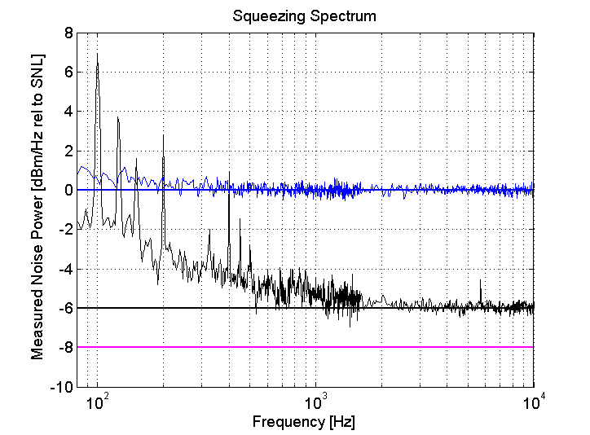
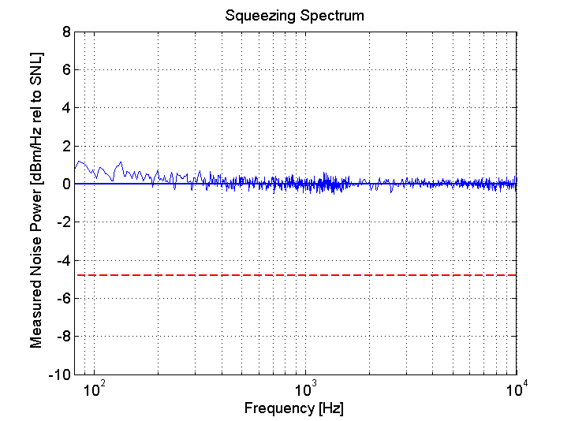
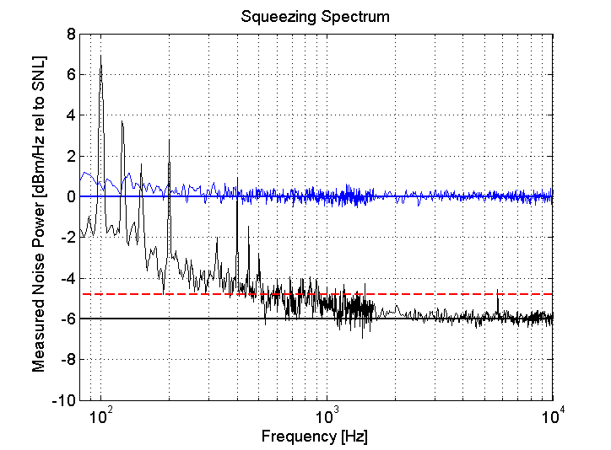
Squeezing Performance
Electronics
Mains harmonics
Cross coupling from Coherent Lock
Quantum noise
Electronic Noise?
Lab environment
Acoustic Noise
6dB
Observed squeezing
8dB
Inferred squeezing

Slide 7
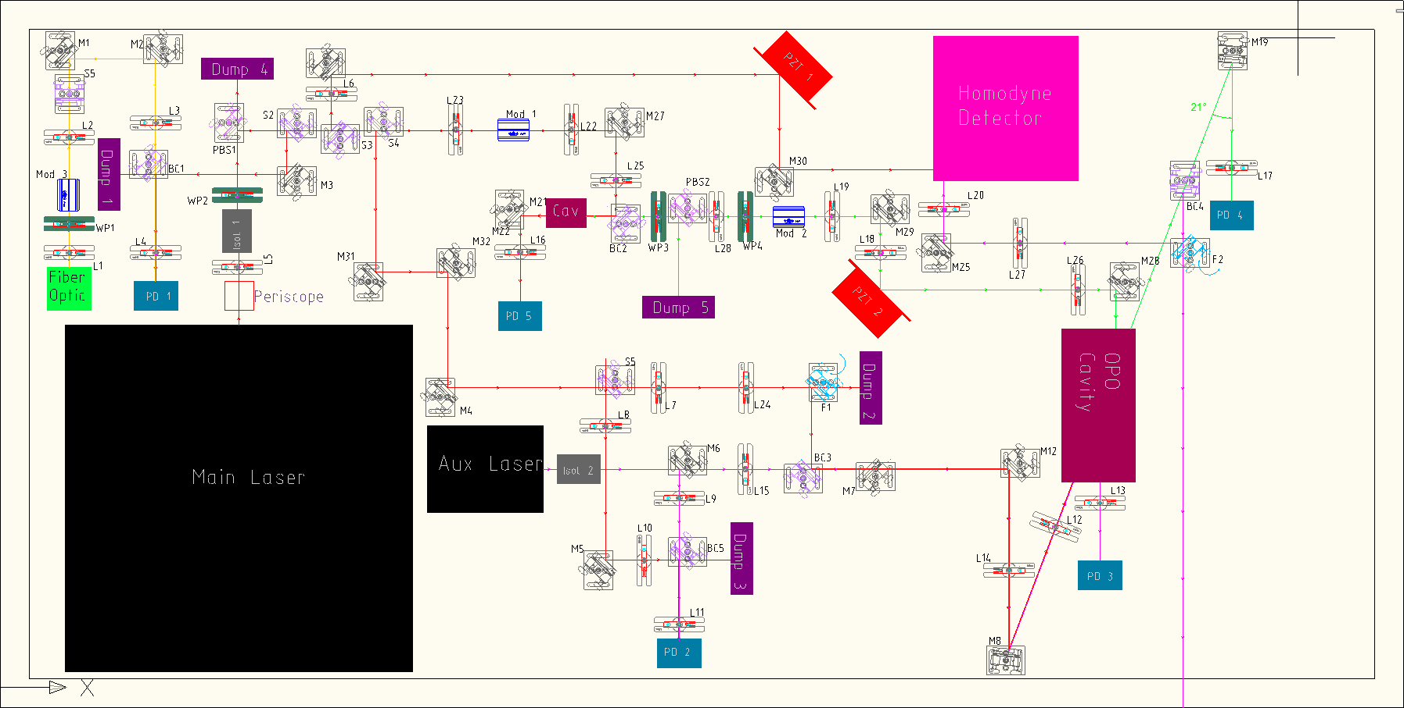
Optical Layout

Slide 8
Schedule
ANU/OPO well on track
Noise model (remaining action item from review) will be completed in a ~month
AEI homodyne detector will be shipped to ANU ahead of schedule
Assembly at MIT
Optical layout on track
Parts late by ~2 months (initial funds almost exhausted)
Electronics production at LHO
Design on track
Procurement late by ~2 months (person power & money & H2 unavailable)

Slide 9
Plan
Need to get the next review done!
Funding is now becoming the holdup
Need get some additional resources for
Electronics production at LHO
Setup at MIT
Procurement
ANU will continue on development of OPO
On track for 2010 delivery
Setup at MIT will continue with SHG & laser locking
Electronics production can go forward for RF, photodetectors, TTFFS and length servos

Slide 10
Summary
Impressive progress on the OPO
Setup at MIT is coming along
No major roadblocks so far
More funding is needed in a very short time
Some additional person-power is required at MIT and LHO for the second half of this year

