Slide 1
Measurements of Thermal Noise in Optimized Coatings
Thermal Noise Interferometer
Akira Villar, Eric Black, Greg Ogin, Tara Chelermsongsak, Riccardo DeSalvo
University of Sannio
Innocenzo Pinto, Vincenzo Pierro, Maria Principe

Slide 2
Advanced LIGO Noise Floor
Coating thermal noise will limit sensitivity around 100 Hz
Reductions in coating noise lead directly to improvements in sensitivity

Slide 3
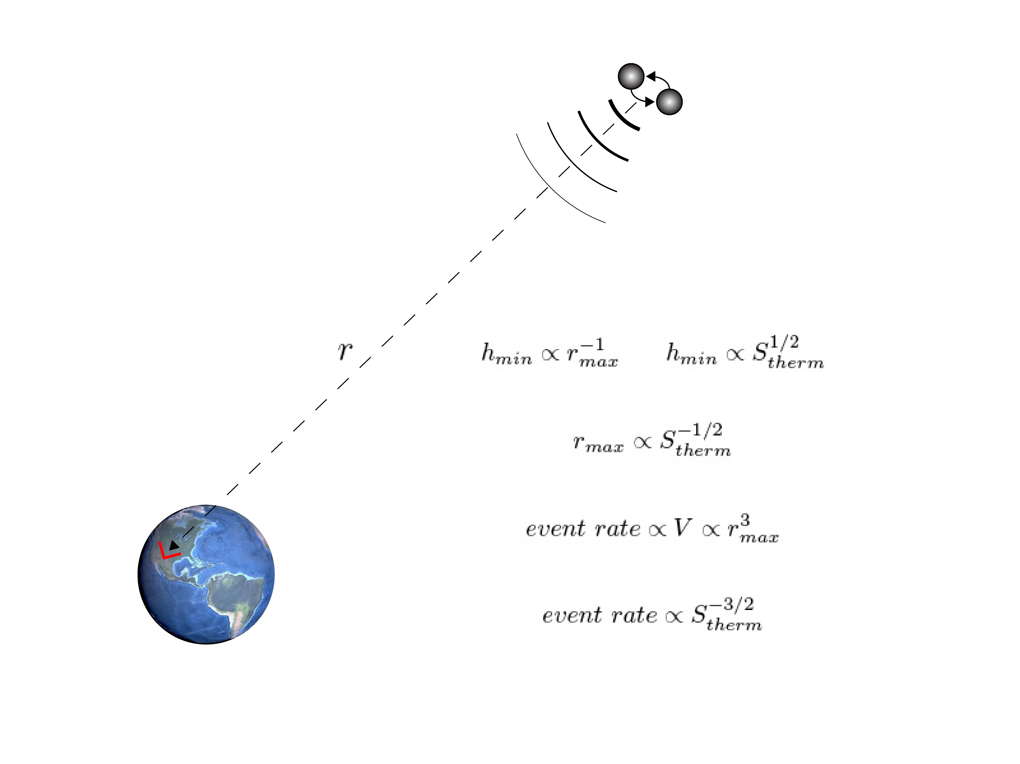
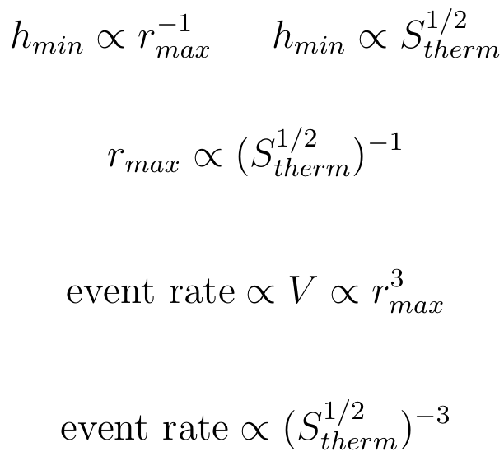
Lower Noise Floor Means More Events
Small improvement in thermal noise floor means big gain in event rate

Slide 4
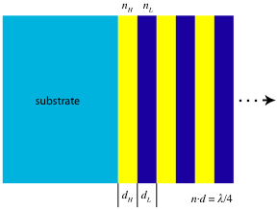
Standard Multilayer Dielectric Coatings
Alternating layers of high and low index materials
Quarter wavelength optical thickness for best reflectivity
Silica low-index, tantala high-index for good performance at 1064nm
Thermal noise arises from internal friction in the coatings

Slide 5
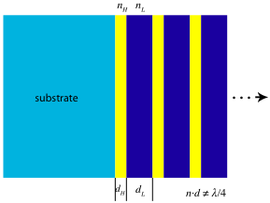
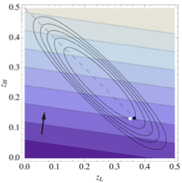
Optimized Coatings
Tantala is more lossy than silica
Reduce the amount of tantala in the coating
QWL
Optimum coating is still a stack of identical “doublets”
Simplify things by making the doublets λ/2 thick

Slide 6
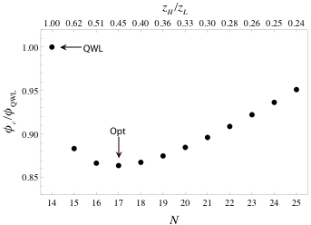
Optimization Strategy
Start from QWL design of N_{QWL} doublets and transmission τ_{QWL}
Add one doublet and adjust layer thickness (keeping z_{H}+z_{L}= 0.5) until τ_{QWL} is recovered
Calculate new ϕ_{eff}
Repeat until minimum noise design is found

Slide 7
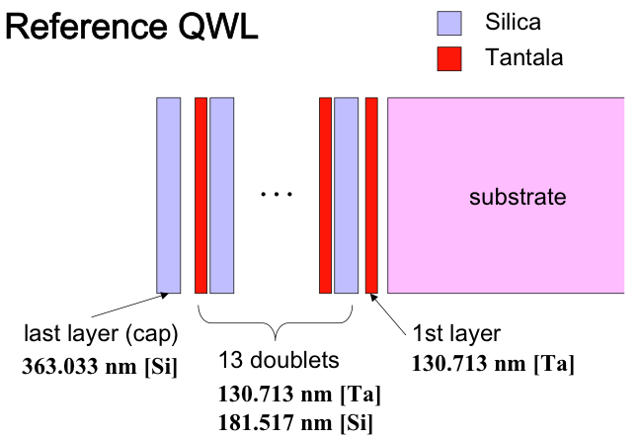
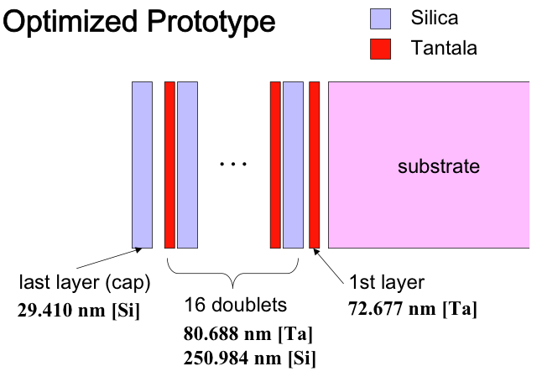
Final Design

Slide 8
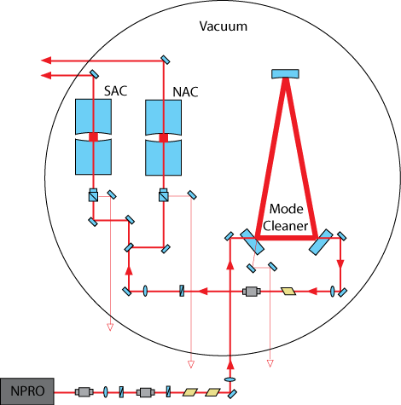
Thermal Noise Interferometer
Test bed interferometer designed to measure thermal noise in optics
Short test cavities reduce laser frequency noise
Small spot size increases thermal noise
Two test cavities permit CMR
Sensitivity is better than 10⁻¹⁸ m/rHz

Slide 9
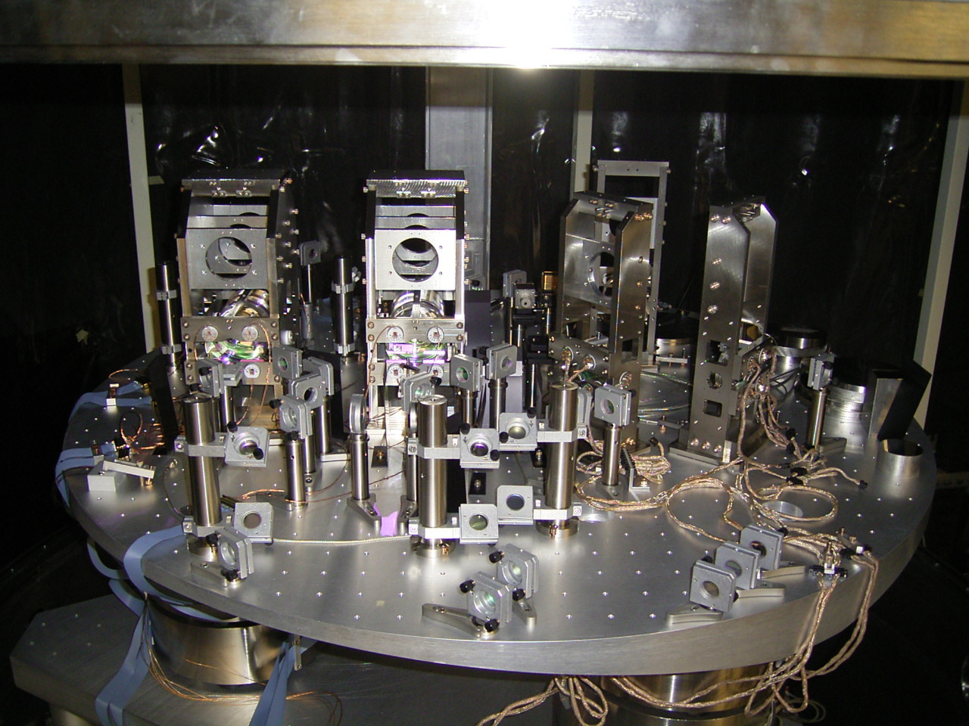
TNI

Slide 10
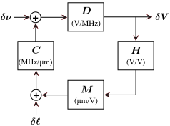
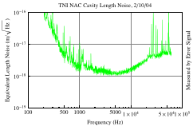
Test Cavity Servo

Slide 11
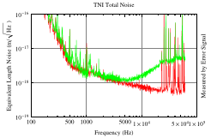
Common Mode Rejection
Laser frequency noise is correlated in both cavities thermal noise is not
CMR allows thermal noise to be visible up to higher frequencies
Noise floor at high frequencies becomes shot noise dominated

Slide 12
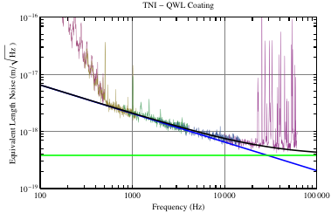
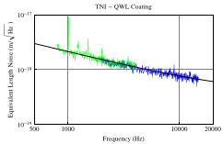
Extracting the Loss Angle
Shot Noise
Fit to data with ϕ as the free parameter

Slide 13
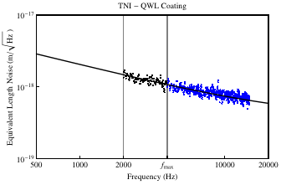
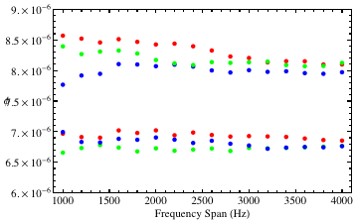
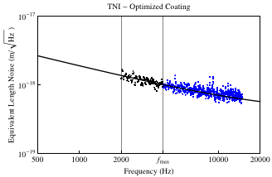
Consistency of Loss Angle
QWL Coating
× 3
QWL
ϕ
Optimized Coating
OPT
× 3

Slide 14
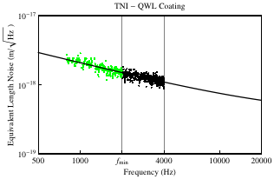
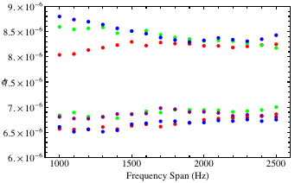
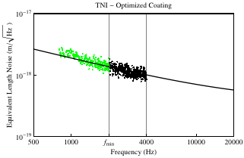
Consistency of Loss Angle
QWL Coating
× 3
QWL
ϕ
Optimized Coating
OPT
× 4

Slide 15
Final Results
Span (Hz)
Measured loss angle ratio:
1500
2000
2500
3000
8.4
8.3
8.2
8.3
6.8
6.9
6.9
6.9
Compare to expected value of:
0.81
0.83
0.83
0.83
(if γ = 7)
17% reduction in loss angle
32% increase in event rate

Slide 16
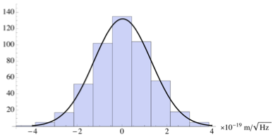
The Scatter Is Normal
Data:
Fit Residuals:
Histogram
And Negligible
Fit uncertainty is not
But rather

Slide 17
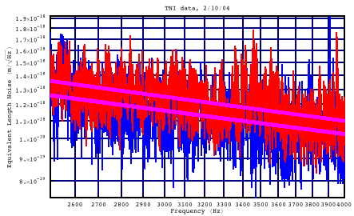
Smoothed Spectra
QWL
OPT
Frequency

Slide 18
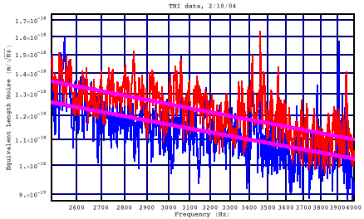
Smoothed Spectra
N=2
QWL
OPT
Frequency

Slide 19
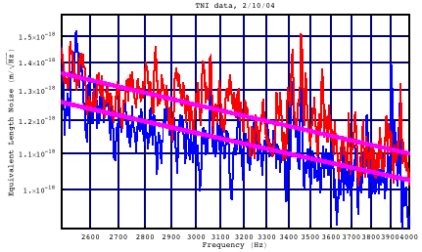
Smoothed Spectra
N=5
QWL
OPT
Frequency

Slide 20
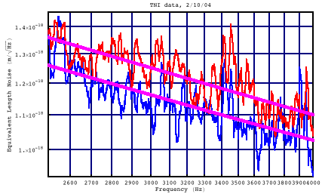
Smoothed Spectra
N=10
QWL
OPT
Frequency

Slide 21
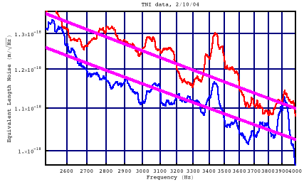
Smoothed Spectra
N=50
QWL
OPT
Frequency

