Slide 1
The 0.1 – few KHz GW Window: Studying the Physics and Dynamics of Matter at Extreme Densities and Energies
Christian David Ott
cott@tapir.caltech.edu
TAPIR, California Institute of Technology, Pasadena, CA, USA
& Niels Bohr Institute, Copenhagen, Denmark
In collaboration with and inspired by
Benjamin J. Owen and Richard O’Shaughnessy
Pennsylvania State University, State College, PA

Slide 2
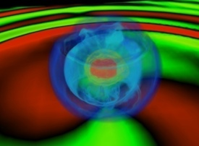
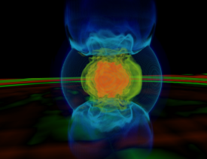
Overview: - 25 Minutes to convince you to invest in high-f sensitivity -
[Thompson et al. 2003, Rampp & Janka 2002, Liebendoerfer et al. 2002,2005]
[Wilson 1985; Bethe & Wilson 1985]
-> Constraining unknown Astrophysics:
Massive Star Collapse: Formation of NSs and BHs; Core-Collapse Supernovae & long-soft Gamma-Ray Bursts
Binary mergers and the progenitors of short-hard GRBs.
Internal structure and composition of NSs.
-> Constraining unknown Nuclear / Elementary Particle Physics:
Equation of state (EOS), composition, and structural properties of hot and cold nuclear matter.

Slide 4
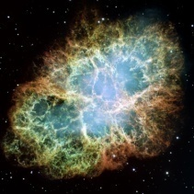
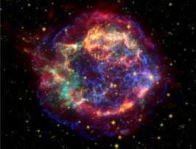
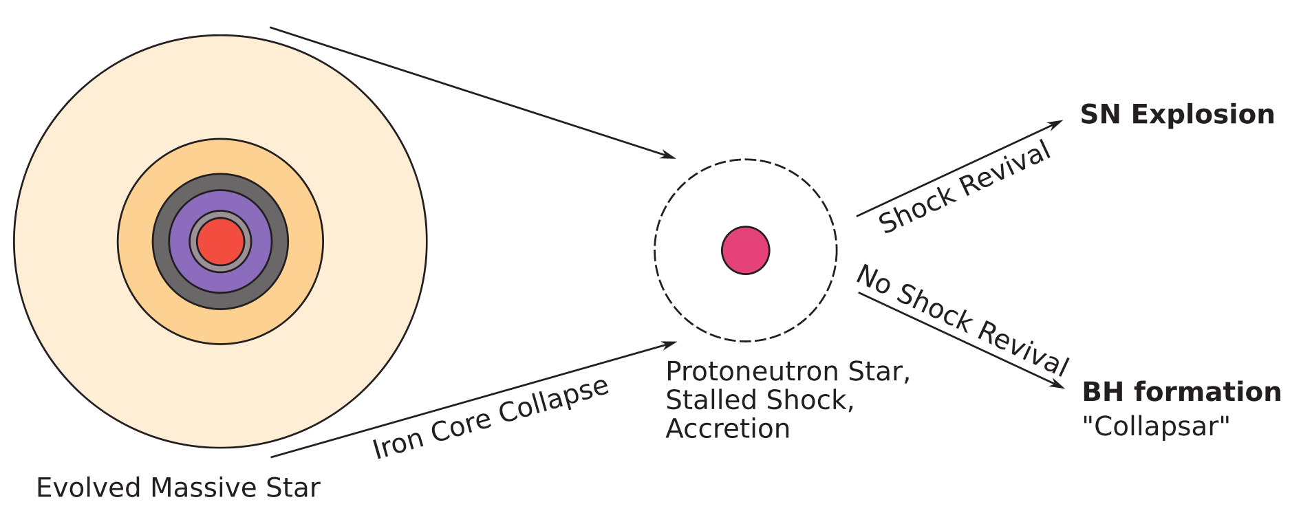
Core-Collapse Supernovae
[Thompson et al. 2003, Rampp & Janka 2002, Liebendoerfer et al. 2002,2005]
[Wilson 1985; Bethe & Wilson 1985]
Energy reservoir: few x 10⁵³ erg (100 [B]ethe)
Explosion energy: ∼1 B
Time frame for explosion: ∼0.3 – 1.5 s after bounce.
BH formation at baryonic PNS mass ≥ 1.8 – 2.5 M_{SUN}.
The Supernova Problem:
What is the mechanism of shock revival?

Slide 5
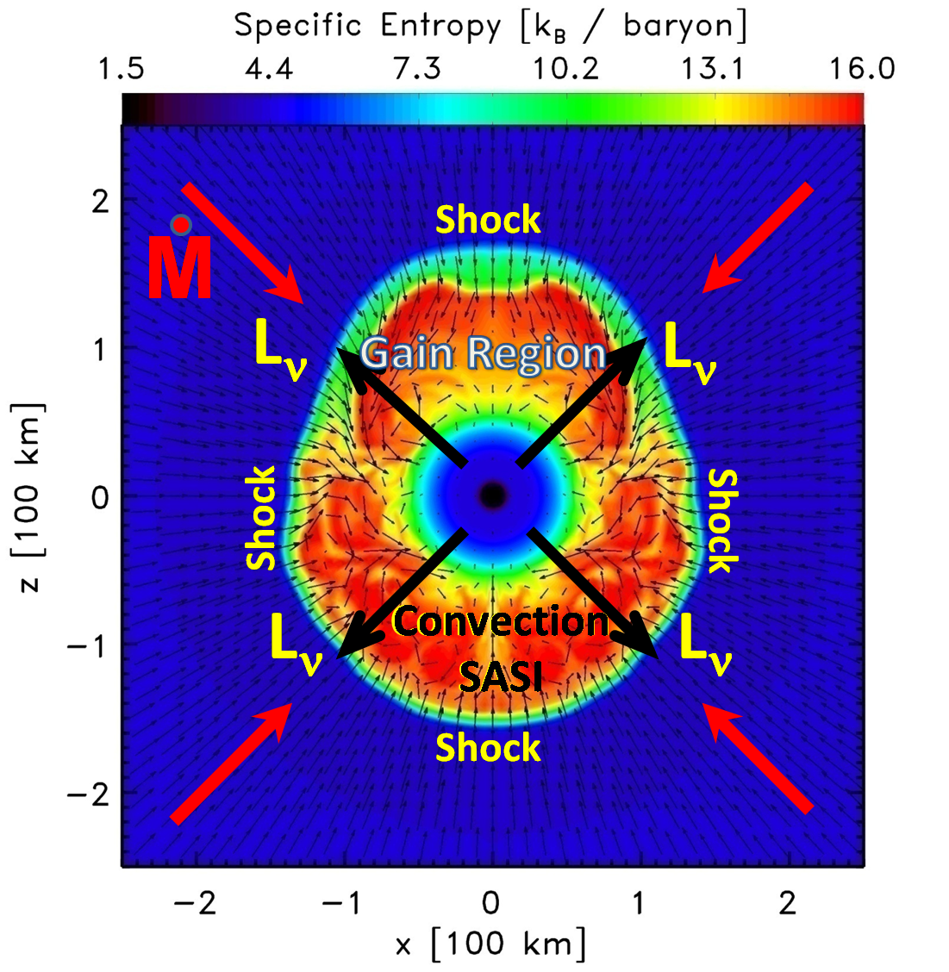
[Ott et al. 2008]
[Ott et al. 2008]
Multi-D Dynamics
Convection / Turbulence
SASI
Rotation
PNS pulsations

Slide 6
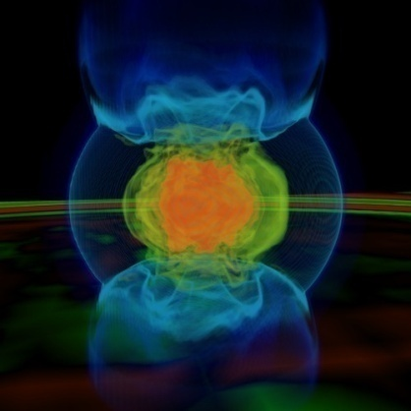
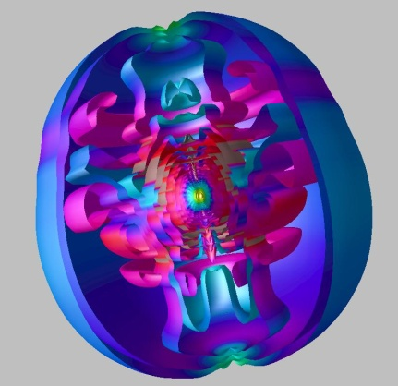
SN Mechanisms and Their Multi-D Features
[Ott 2009]
Dominant Multi-D Processes
Neutrino Mechanism
Convection and SASI
MHD-Jet Mechanism
Rotation
Acoustic Mechanism
Protoneutron Star Pulsations
[Buras et al. 2006ab, Scheck et al. 2007, Burrows et al. 2006, 2007abc, Marek & Janka 2007, Mezzacappa et al. 2006, Fryer & Warren 2004, Bruenn et al. 2007, Swesty & Myra 2006]

Slide 7
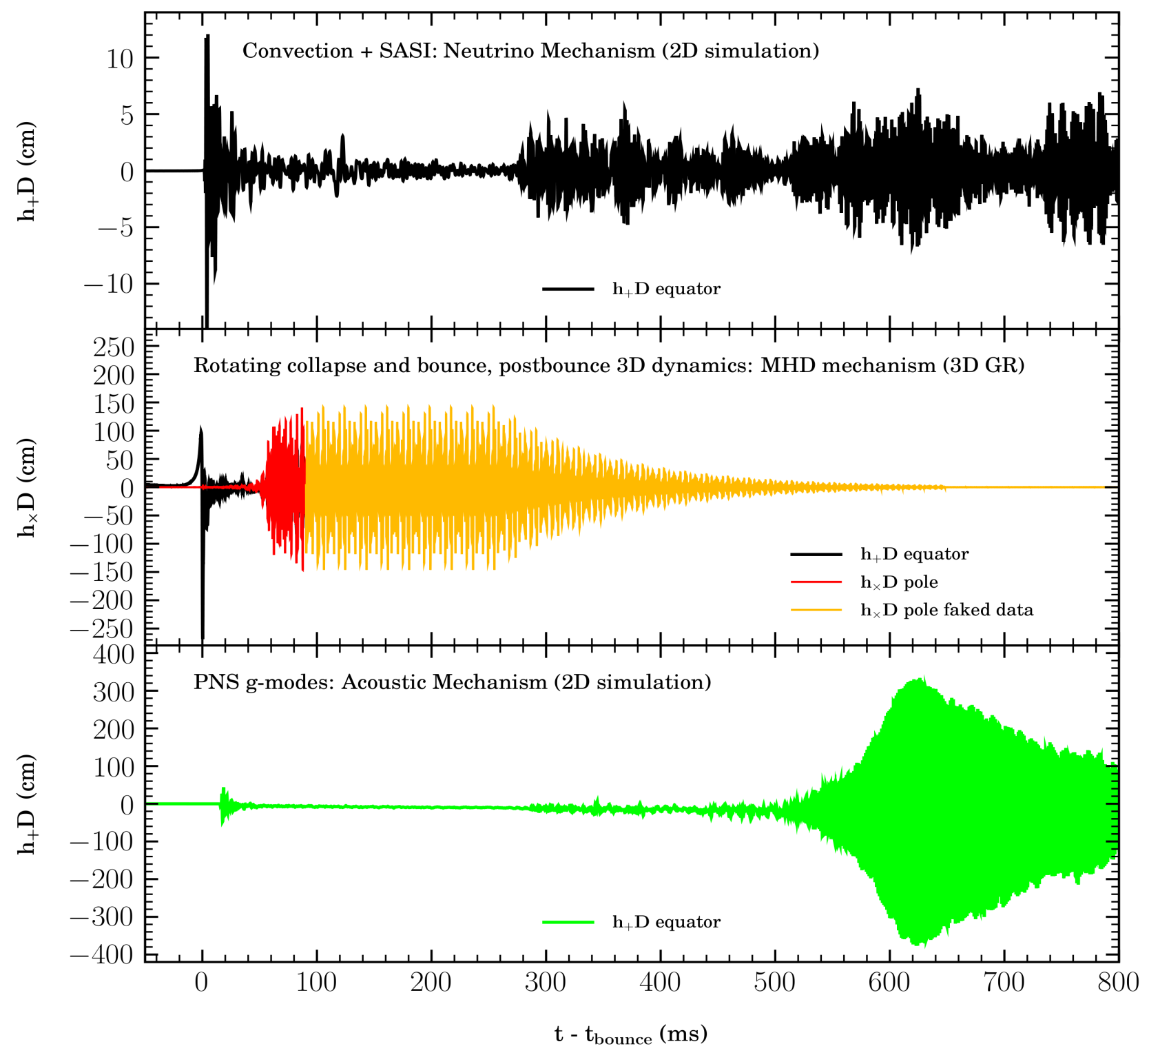
Model GW Signals from Core-Collapse Supernovae
[Ott 2009]

Slide 8
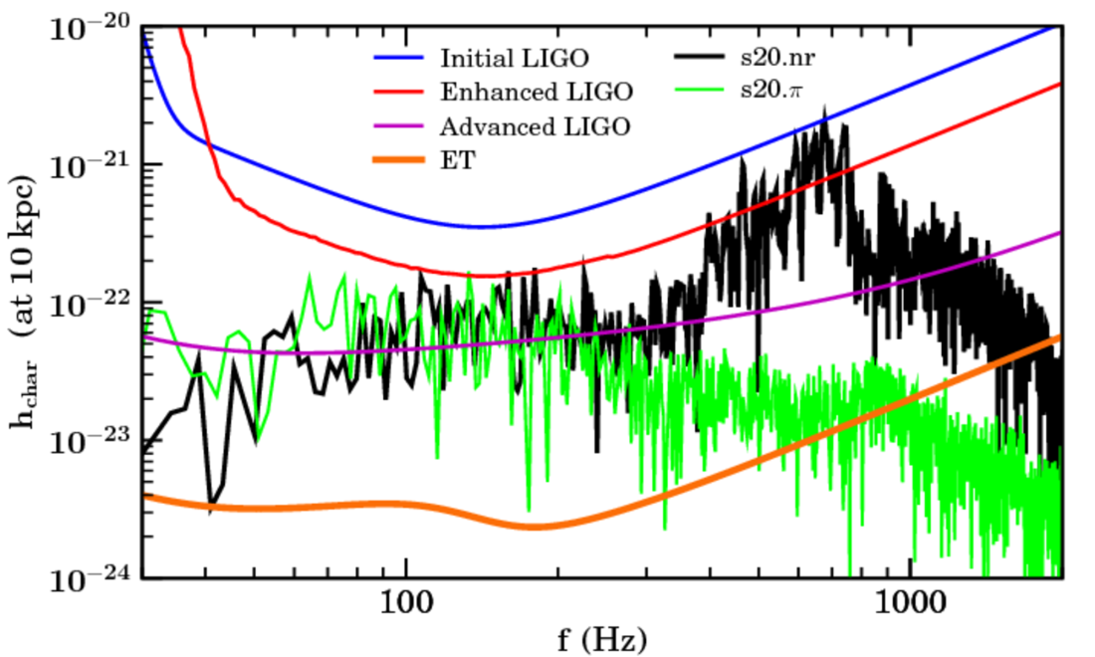
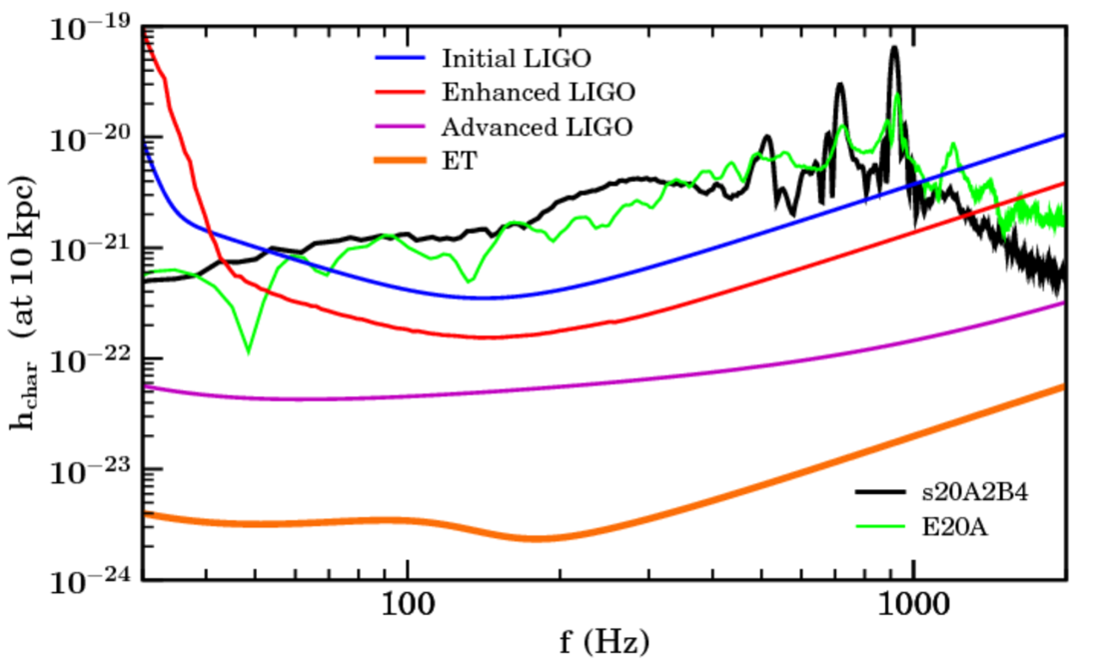
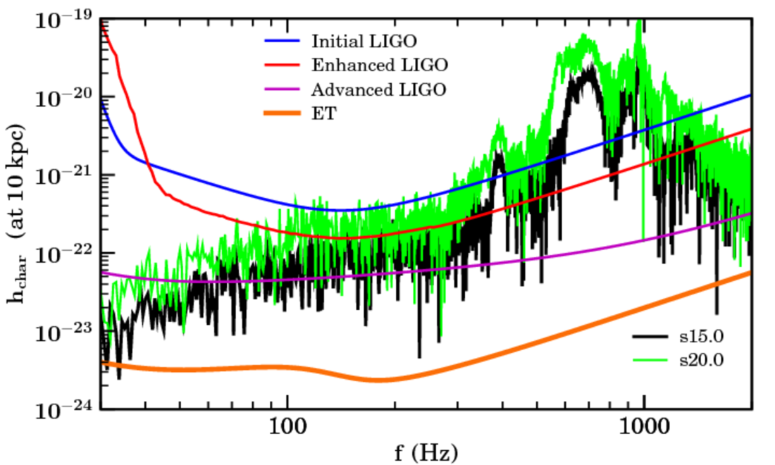
Characteristic Strain Spectra at 10 kpc
Rotating Collapse / MHD
Convection/SASI/Neutrino Mechanism
Acoustic Mechanism

Slide 9
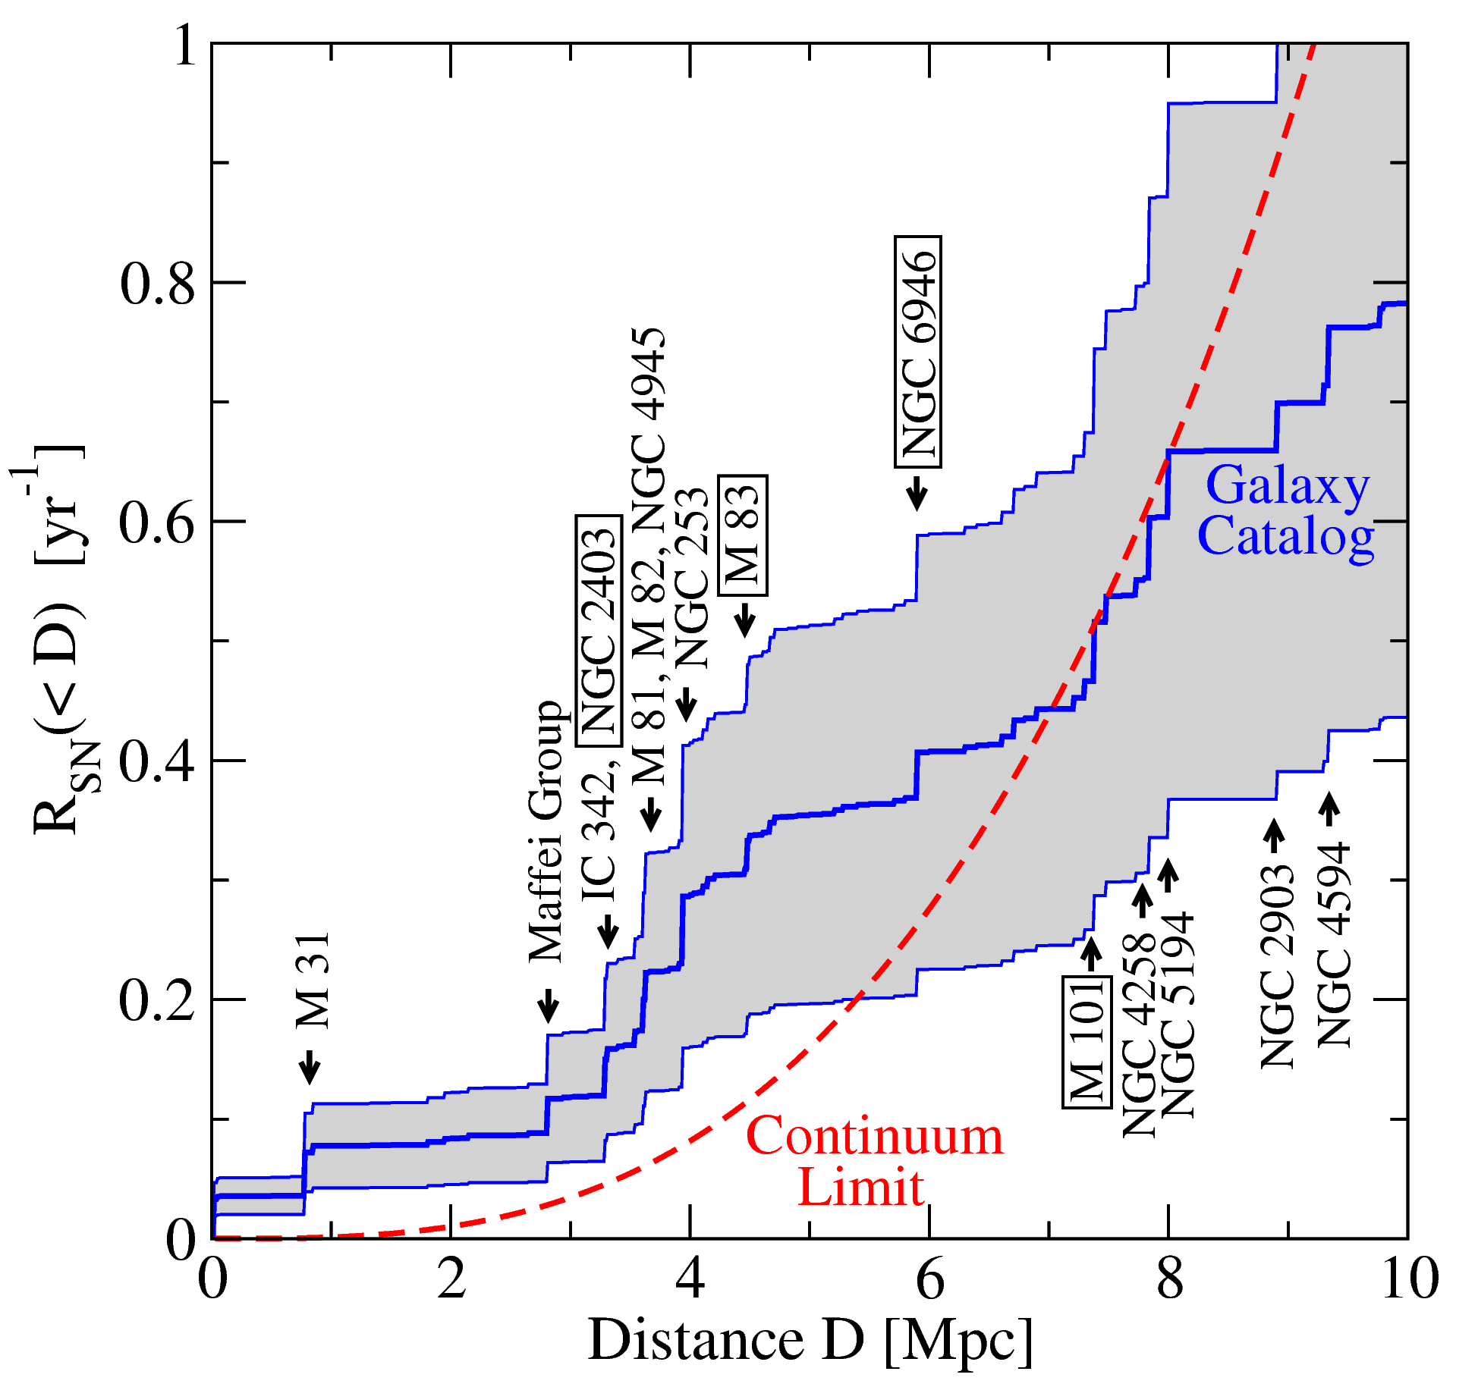
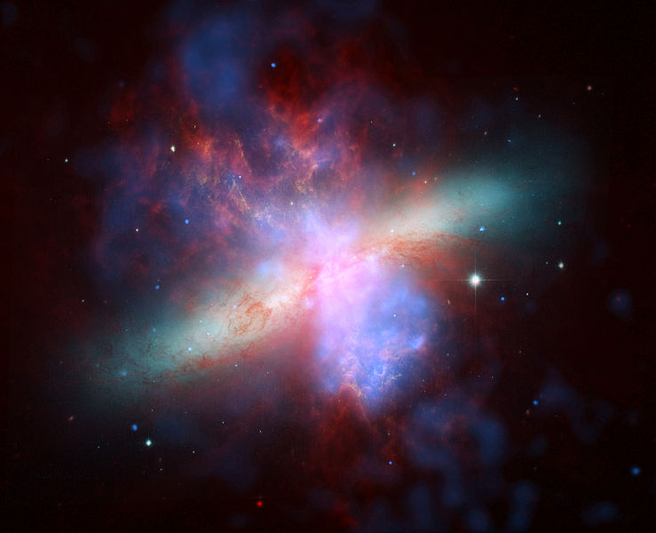
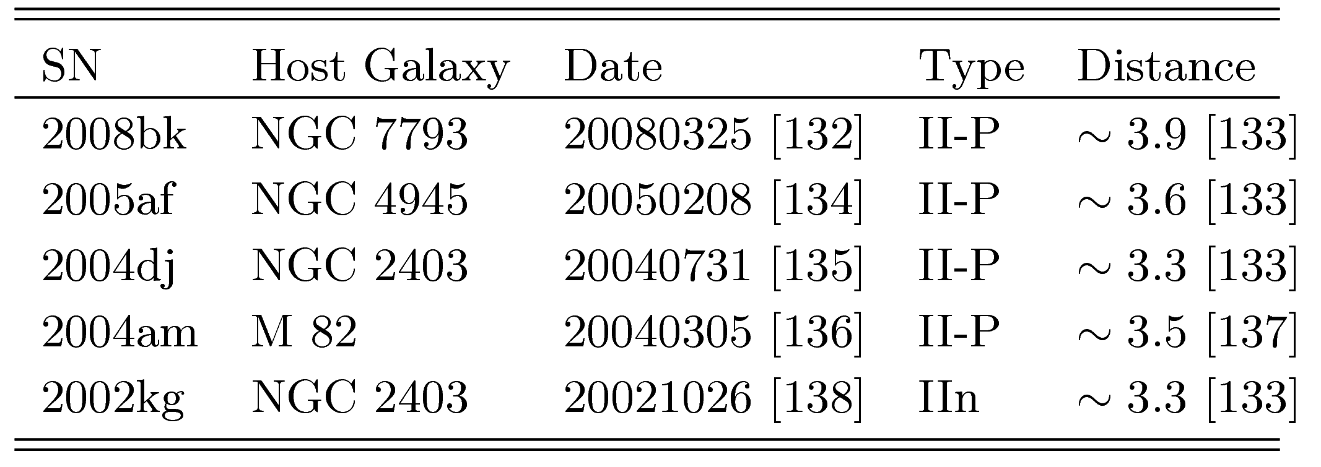
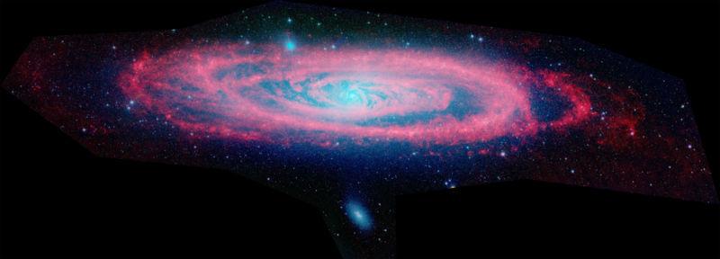
Core-Collapse Supernova Rates
Ando et al. 2005
M82 Chandra/HST/Spitzer composite.
Core-collapse SNe within 5 Mpc since the beginning of LIGO operations:
[Ott 2009]
M31 (Andromeda) Spitzer.

Slide 10
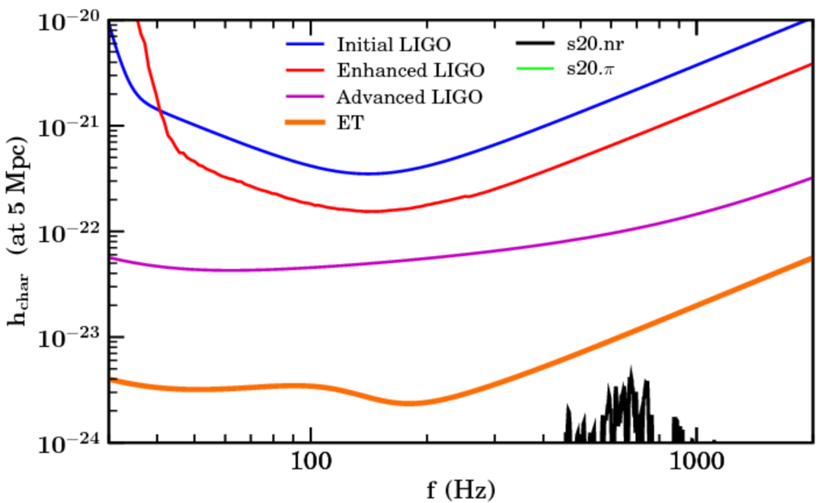
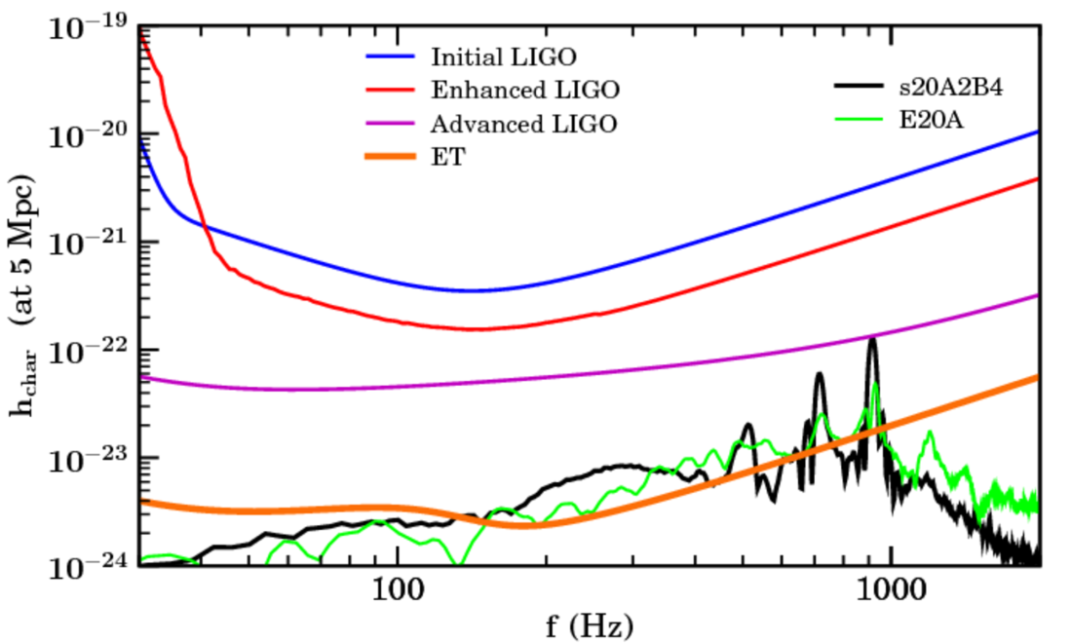
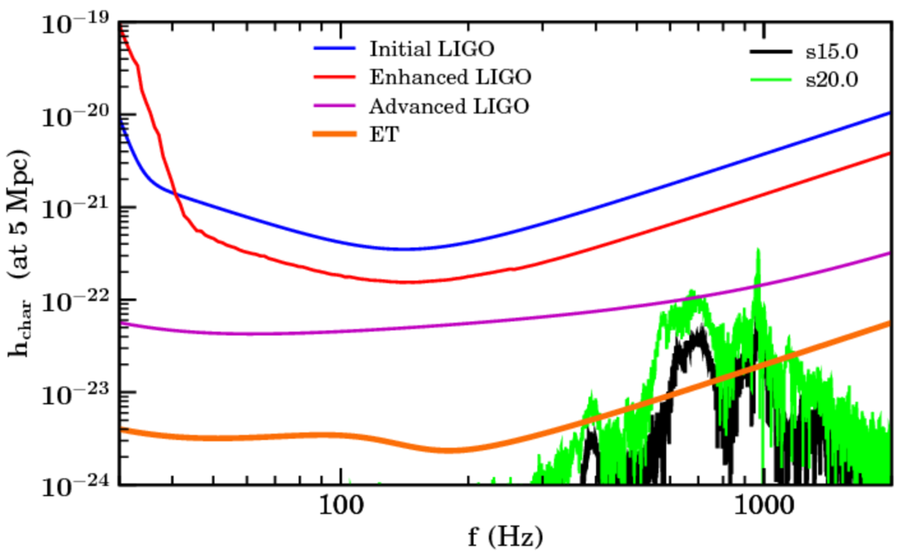
Characteristic Strain Spectra at 5 Mpc: ∼0.5 CC-SNe / year
Rotating Collapse / MHD
Convection/SASI/ Neutrino Mechanism
Acoustic Mechanism

Slide 11
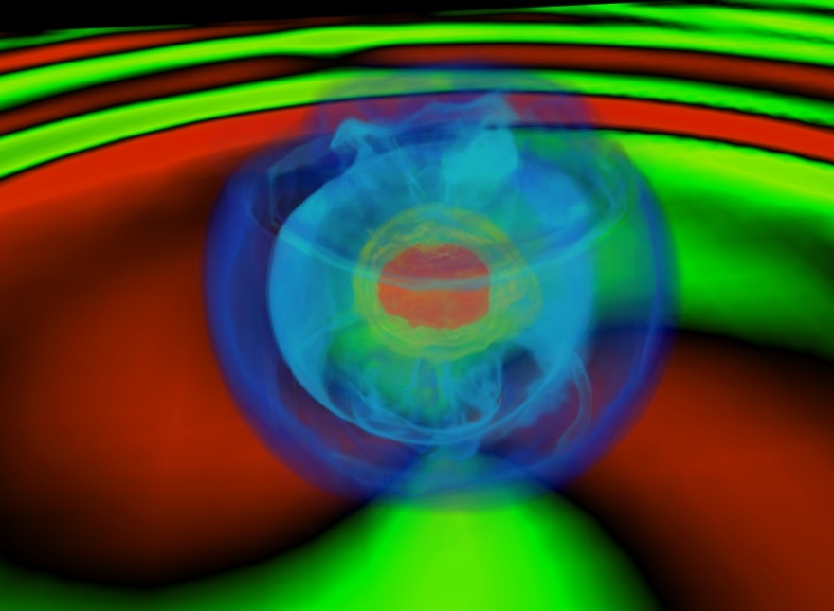
[Thompson et al. 2003, Rampp & Janka 2002, Liebendoerfer et al. 2002,2005]
[Wilson 1985; Bethe & Wilson 1985]
Summary I: SN Physics with GWs
Baade & Zwicky 1934: SN powered by liberation of gravitational energy in collapse of a massive star’s core to a neutron star.
Theoretical efforts every since -> multiple proposed (more or less viable) mediating explosion mechanisms.
Only GWs and neutrinos can carry direct information from SN engine.
GW signatures of various mechanisms are distinct -> use GWs to constrain the explosion mechanism.

Slide 12
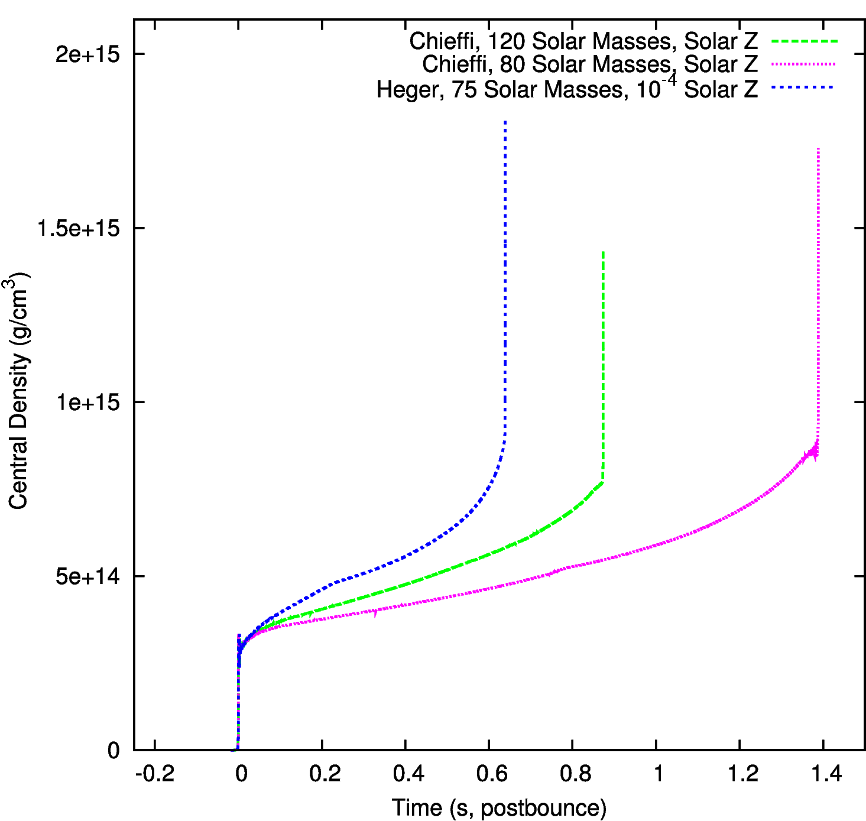
Failing CCSNe & BH Formation
[Thompson et al. 2003, Rampp & Janka 2002, Liebendoerfer et al. 2002,2005]
[Wilson 1985; Bethe & Wilson 1985]
There is no direct/prompt BH formation.
Route 1 to a BH: Collapsar Type I
Explosion fails.
No EM signal, only GWs and neutrinos.
BH forms on accretion timescale. τ_{BH} determined by (1) Stiffness of the nuclear EOS. (2) Accretion rate <- progenitor structure.
Route 2 to a BH: Collapsar Type II
Weak explosion, subsequent fall-back accretion. [Zhang & Woosley 2008]
[Heger et al. 2003]
C. D. Ott @ GWADW 2009

Slide 13
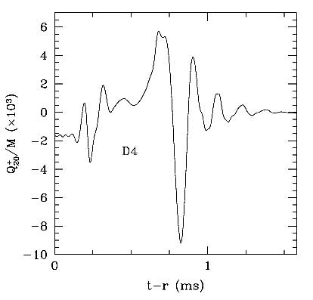
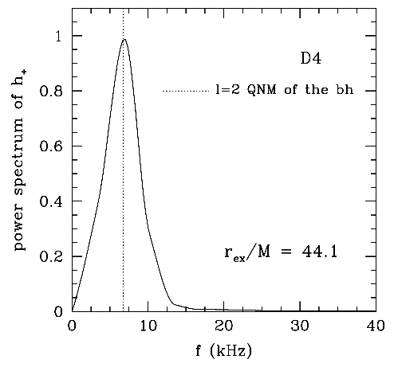
Probing BH Formation with GWs
[Thompson et al. 2003, Rampp & Janka 2002, Liebendoerfer et al. 2002,2005]
[Wilson 1985; Bethe & Wilson 1985]
Nonspherical collapse of a (Proto-)NS to a BH
[Baiotti et al. 2007]
Rotating collapse of 1.86 M_{SUN} NS model;
LIGO h_{c} at 10 kpc:
5.5 x 10⁻²²
[Baiotti et al. 2007]
Emission dominated by BH QNM as BH rings down to Kerr.
M_{NS} = 2 M_{SUN} -> f_{QNM} ∼ 6 KHz; decreases as BH accretes more matter.
[see discussion in Ott 2009]

Slide 14
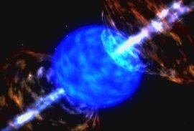
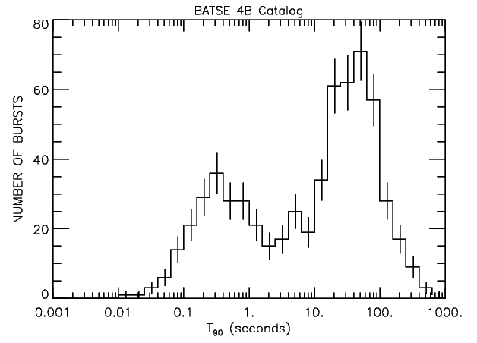
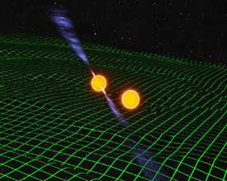
Gamma-Ray Bursts
[Thompson et al. 2003, Rampp & Janka 2002, Liebendoerfer et al. 2002,2005]
[Wilson 1985; Bethe & Wilson 1985]
Short-hard GRBs: Originating from
compact binary mergers (?)
Observations: long-soft GRBs related to core-collapse SNe
(At least) 2 classes of GRBs: Short hard (T₉₀ < 2 s), long soft (T₉₀ > 2s)

Slide 15
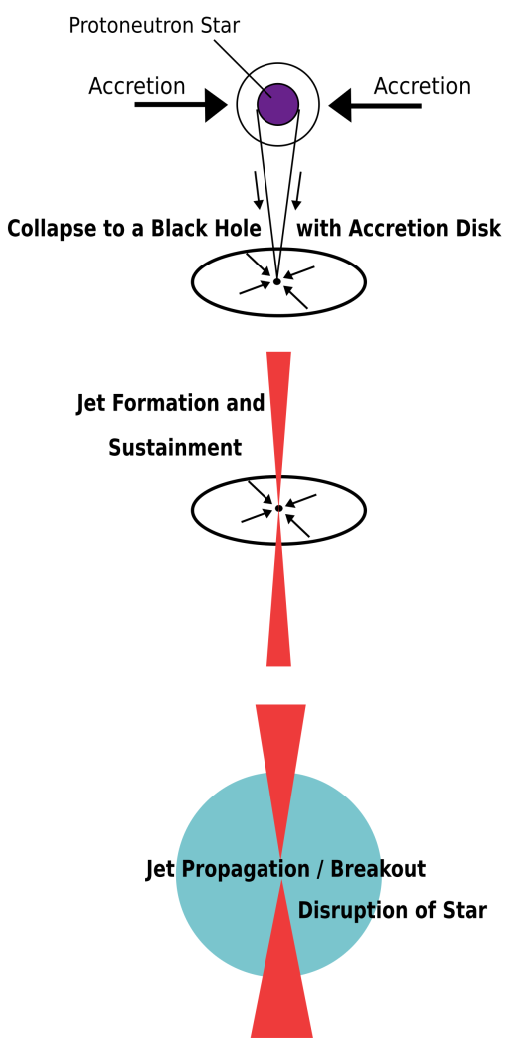
Long-Soft Gamma-Ray Bursts
[Thompson et al. 2003, Rampp & Janka 2002, Liebendoerfer et al. 2002,2005]
[Wilson 1985; Bethe & Wilson 1985]
Highly-beamed EM emission, most likely aligned with axis of rotation. Energies comparable to SN explosion.
Ultimate source of energy: Gravitational collapse. Mediators: Rapid rotation & MHD effects
∼1% of massive stars sufficiently rapidly rotating to make a long-soft GRB. (But: Not all can make GRBs, not all GRBs pointed towards us.) -> GRBs extremely rare in the local universe; closest GRB at ∼40 Mpc.
Variety of theoretical long-soft GRB models; some that are favored:
Collapsar type I (no SN explosion; star blown up by GRB)
MHD Hypernova + Collapsar (explosion before BH)
MHD Hypernova + Millisecond Magnetar
GW emission: Same overall characteristics as in core-collapse SNe.
Collapsar vs. Magnetar smoking gun: BH formation signal and/or shut-off of signal from NS dynamics before/during GRB electromagnetic emission.

Slide 16
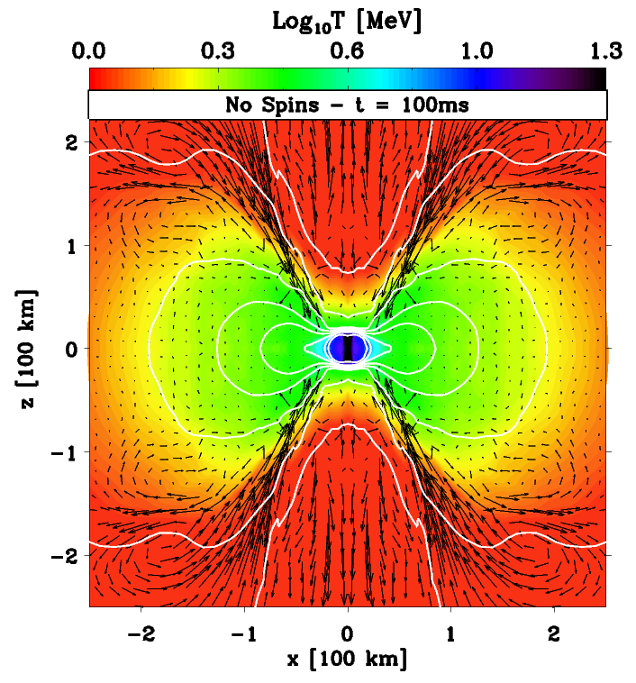
Short-Hard GRBs
[Thompson et al. 2003, Rampp & Janka 2002, Liebendoerfer et al. 2002,2005]
[Wilson 1985; Bethe & Wilson 1985]
Energetics: 10⁴⁸ – 10⁵⁰ erg, need BH with ∼0.01 M_{SUN} disk.
Powered by rotation + MHD and/or neutrino pair annihilation (but: inefficient [Dessart, Ott et al. 2009])
Formation scenarios:
Coalescence & Merger of NS – NS system. Formation of hypermassive NS (may survive for many dynamical times)
Coalescence of BH – NS system. Required: Tidal disruption of NS to have sufficient disk material.
[Dessart et al 2009]

Slide 17
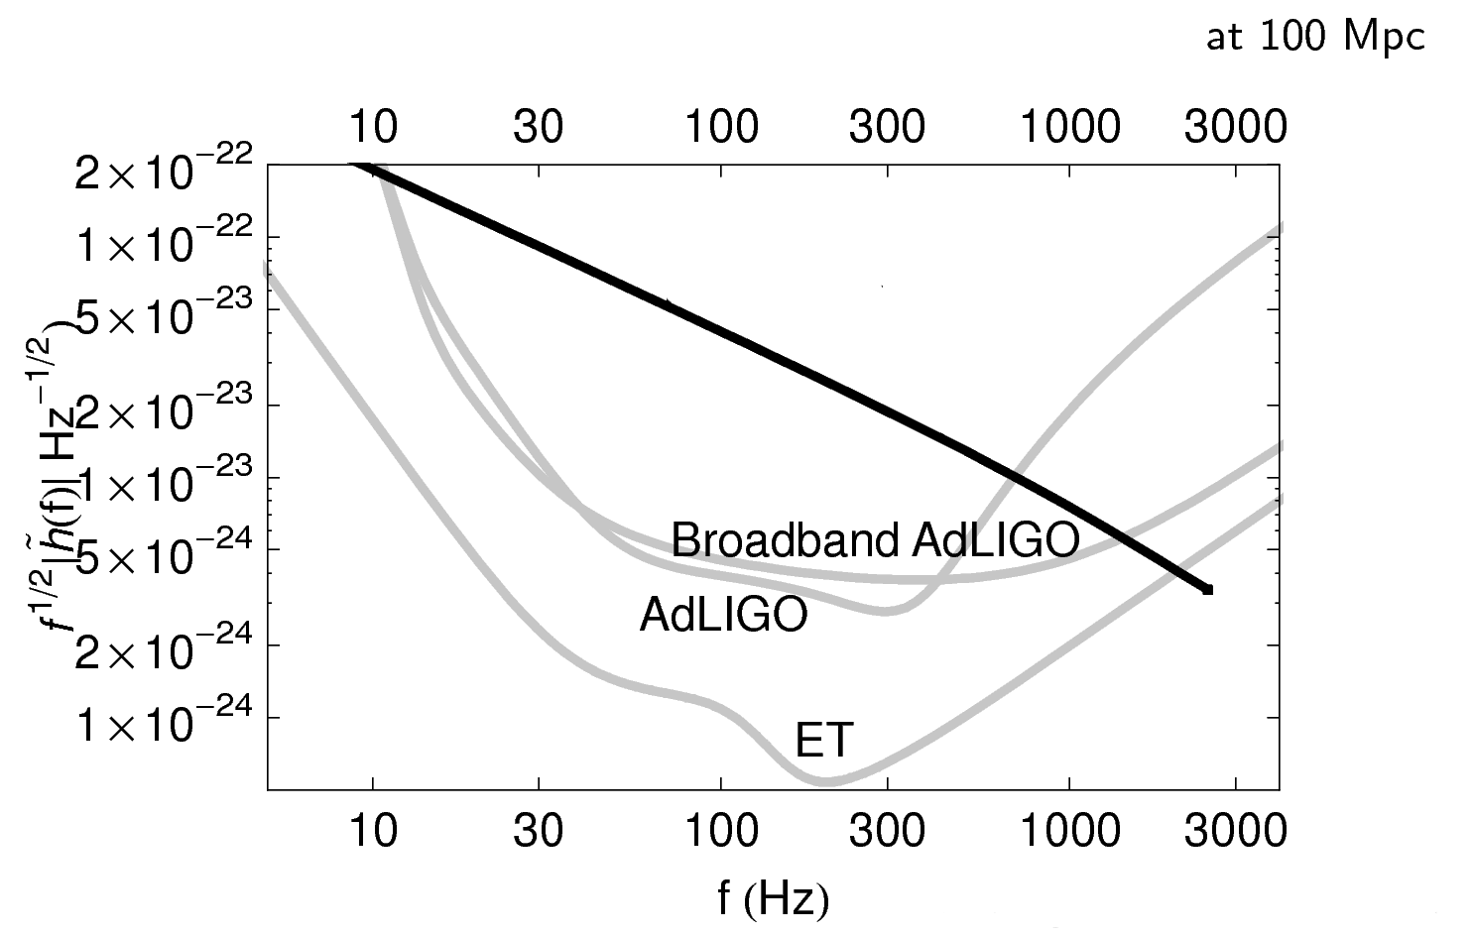
NS-NS Coalescence and Merger
[Thompson et al. 2003, Rampp & Janka 2002, Liebendoerfer et al. 2002,2005]
[Wilson 1985; Bethe & Wilson 1985]
[Jocelyn Read, UWM/AEI]
Post-Newtonian Point Particle (PP) Approx.
Deviation from PP in intermediate/ late inspiral
Merger:
BH Formation/ HMNS instability
[Read et al. 2008. 2009]
Finite size effects: Tidal deformation, effect on phase of GW signal. [Flanagan & Hinderer ‘08]
Merger: GW burst from final plunge, HMNS dynamics, BH formation: f ∼ few KHz.
Tidal deformation and “survival time” of HMNS constrain nuclear EOS.

Slide 18
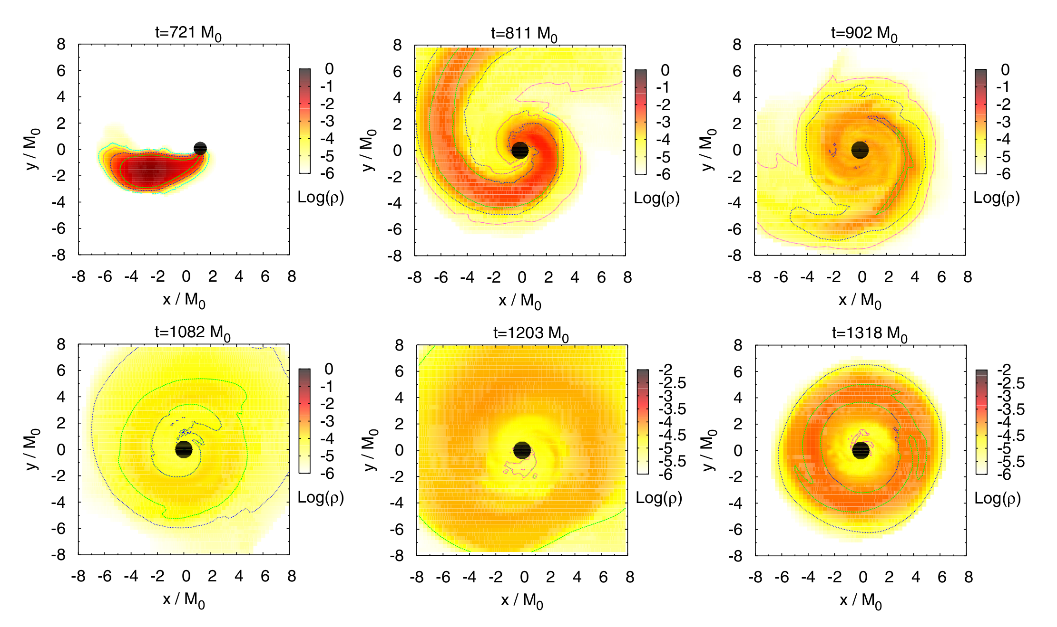
BH-NS Merger
[Thompson et al. 2003, Rampp & Janka 2002, Liebendoerfer et al. 2002,2005]
[Wilson 1985; Bethe & Wilson 1985]
[Shibata et al. 2009]
M_{BH} = 2 M_{NS}
As NS-NS: Finite-size effects in late inspiral.
Tidal disruption of NS necessary for disk formation; likely to happen for M_{BH} < 4 M_{SUN}; M_{NS} ∼ 1.3-1.6 M_{SUN}.
NS structure / EOS encoded in GW signal / frequency of disruption. f ∼ few KHz.

Slide 19
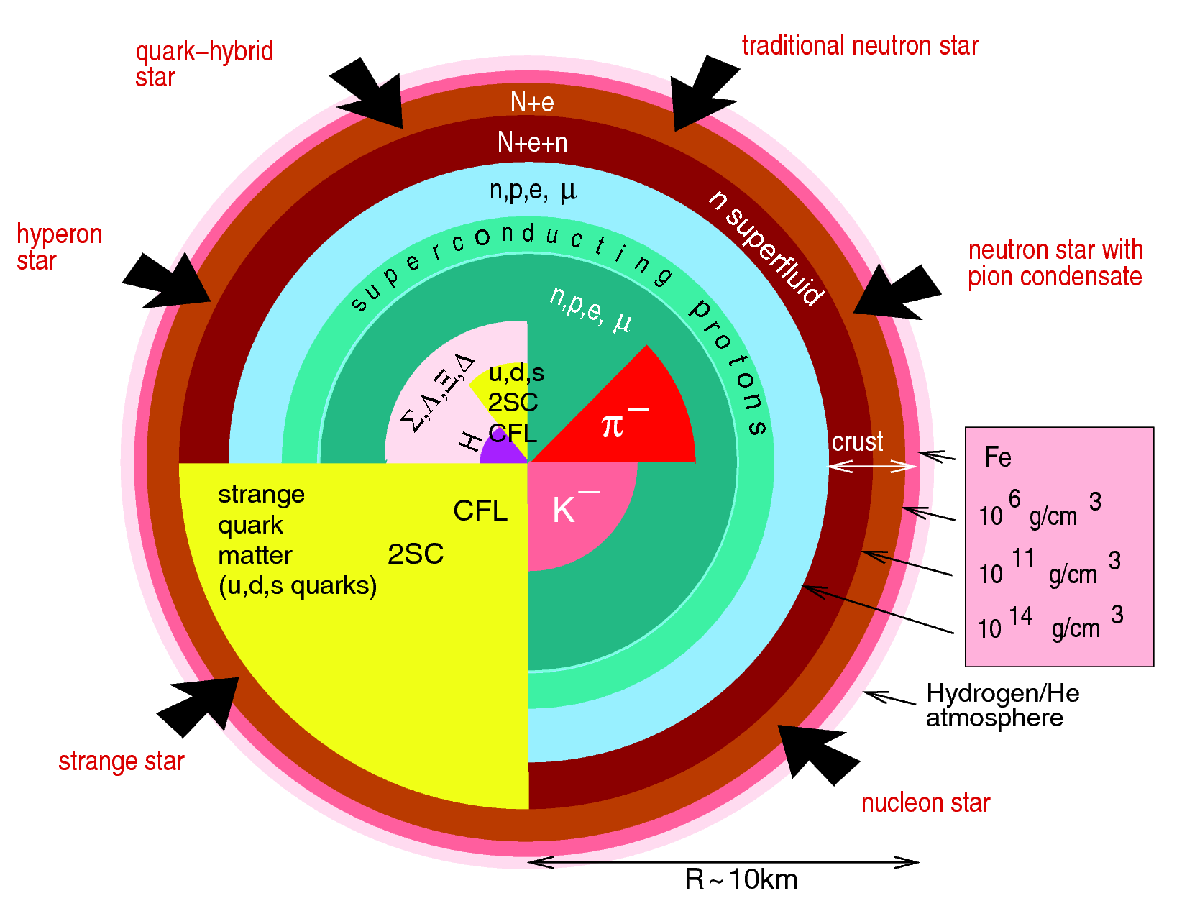
Neutron Star Structure
[Thompson et al. 2003, Rampp & Janka 2002, Liebendoerfer et al. 2002,2005]
[Wilson 1985; Bethe & Wilson 1985]
[Weber et al. 2009]

Slide 20
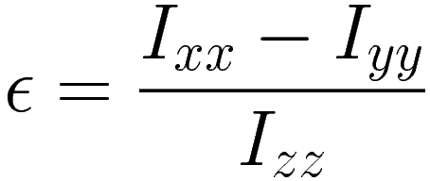
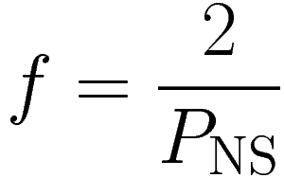
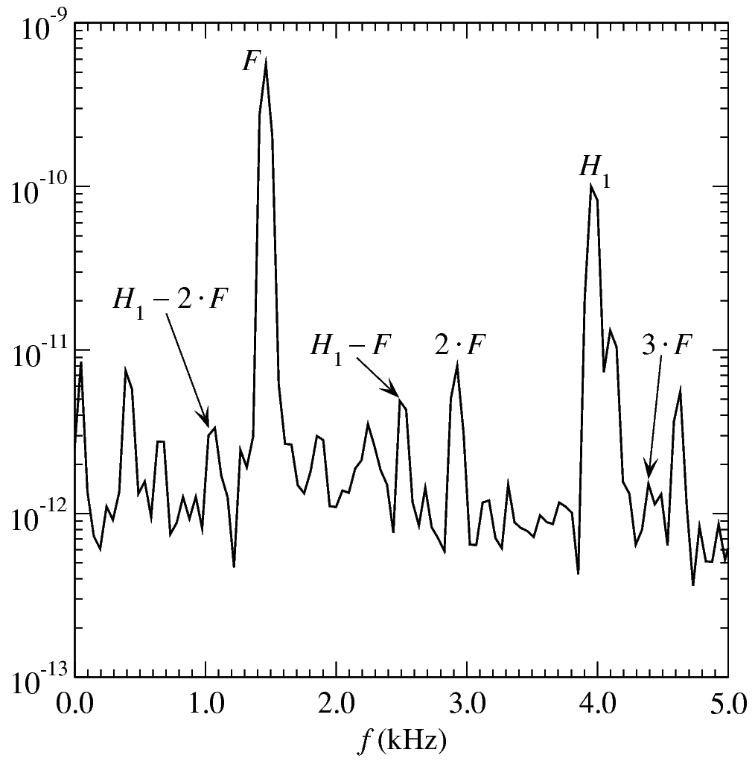
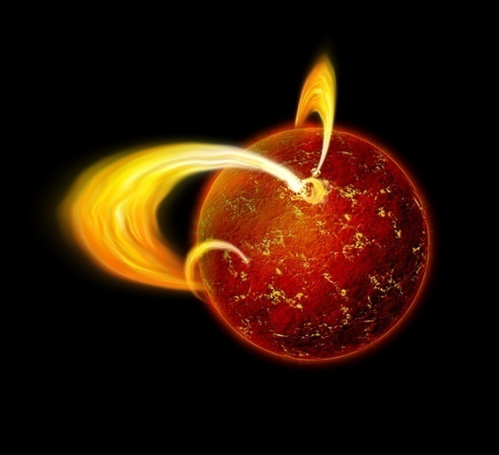
Studying Neutron Stars with GWs
“Continuous” GWs: “Mountains” on NSs and r-modes
Ellipticity є ∝ (breaking strain) x (shear modulus) x (geometry) -> set by NS crust & core physics: Normal NS: є ∼ 10⁻⁶, Quark NS: є ∼ 10⁻³
Mountain formation: Accretion (LMXBs), magnetic mountains
r-modes; limited by NS viscosity. Present in very young NSs (?)
Strongest emitters: Most rapidly spinning NSs -> f_{GW} ∼ 0.3 – 2 KHz.
Bursts: Excitation of NS pulsational modes (f, p, g, w)
Pulsar Glitches
Magnetar Quakes: Soft Gamma Ray Repeaters
[Dimmelmeier et al. 2006]

Slide 21
Summary
Beyond the First Detection -> Gravitational Wave Astronomy
Potential to answer pressing astrophysical questions with GWs:
Mechanisms of Core-Collapse Supernovae
Mechanisms and Progenitors of Long-Soft and Short-Hard GRBs.
Characteristic GW frequencies: few 100 Hz – few 1000 Hz Set by dynamical timescales/rotation frequencies of emitting systems
Additional major pay-off beyond Astrophysics: Constrain nuclear physics at high density and energy
[Buras et al. 2006ab, Scheck et al. 2007, Burrows et al. 2006, 2007abc, Marek & Janka 2007, Mezzacappa et al. 2006, Fryer & Warren 2004, Bruenn et al. 2007, Swesty & Myra 2006]

