Slide 1
The Monolithic suspensions for the interferometer Virgo+
Paola Puppo
for the Virgo Monolithic Suspension Team
INFN-Rome
GWADW– May 11th 2009 – Ft Lauderdale

Slide 2
Virgo+ upgrades
New IMC mirror (bigger mass, better coating → reduced rad press effect, easier to lock, reduced optical losses)
Implementation of the remote control on Faraday Isolator of suspended IB → better correction of thermal effects;
New laser (P_{in}=50 W)→shot noise reduction
Thermal compensation → thermal lensing reduction
Electronics implementation →
“DAC noise” reduction of the low freq noise;
Actuation control noise reduction;
New magnets →Eddy currents and magnetic effects reduction;

Slide 3
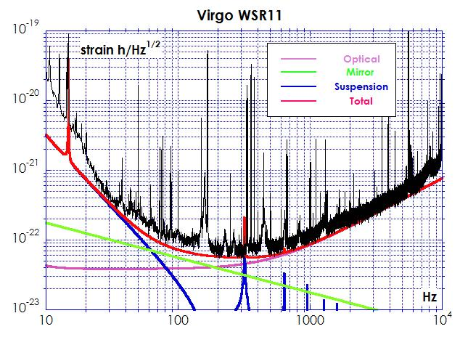
Where we are…
Actual limits:
In the 80-200Hz range the high power gain is spoiled by the thermal noise expected for the Virgo Herasil end mirrors
We need to change the mirrors if we want to profit of the larger injected power.
Paola Puppo - GWADW– May 11th 2009 – Ft Lauderdale

Slide 4
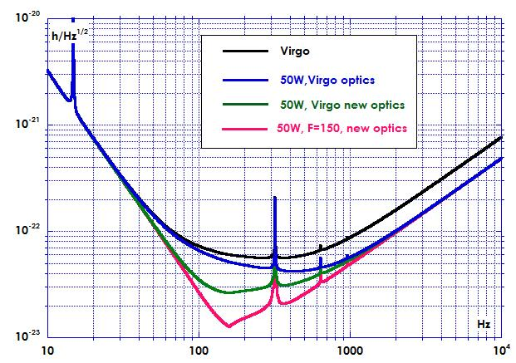
New mirrors and coatings
New Suprasil end and input mirrors
According to the Penn’s noise model the loss angle expected for this material is about 10⁻⁹, a new perspective is open in the middle frequency range;
But an higher finesse is needed: F=150 instead of the current 50.
New coatings (TiO2 dopants: lower mechanical dissipation)
New cleanliness procedures
Use of a special protecting film (Lyon);
Virgo, 50W, F=150
BNS: 24.7 Mpc
BBH: 126 Mpc

Slide 5
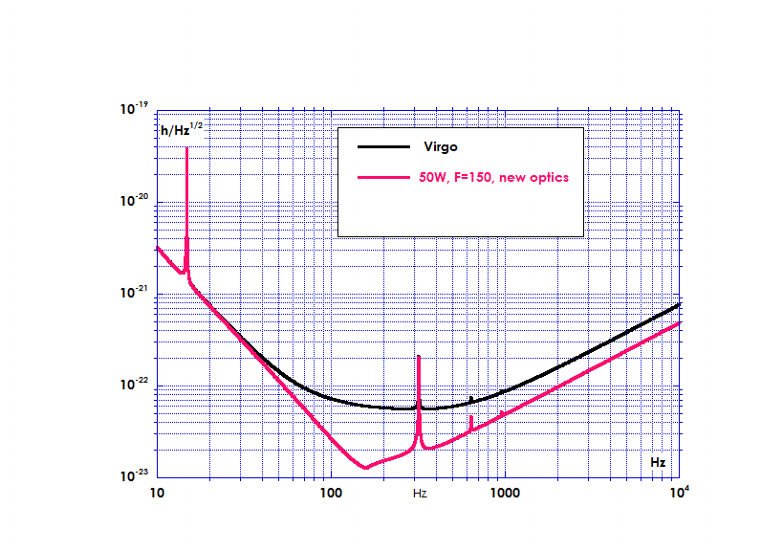
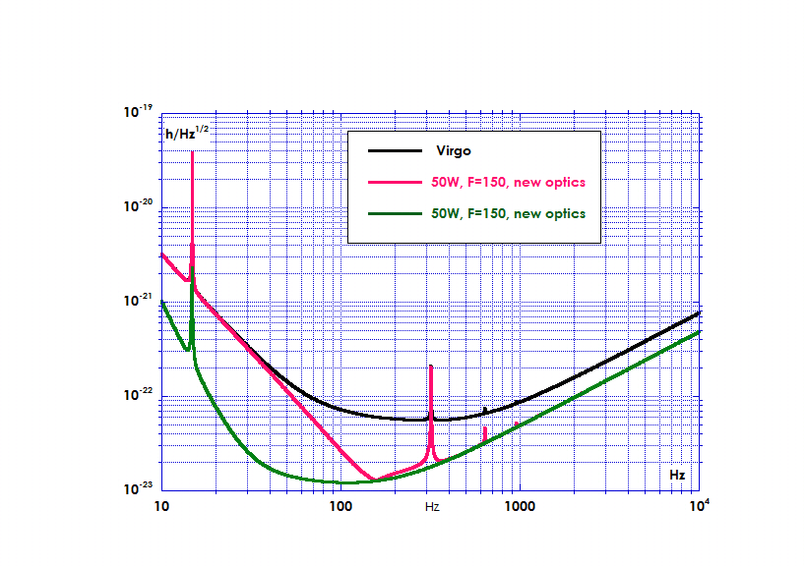
Why do we want to use the monolithic suspensions?
Powered injection
new mirrors
(Hi-Finesse)
new mirrors
(Hi-Q)
new magnets
new recoil mass
Thermal deformation
of FP cavity mirrors
Thermal Compensation
New payloads
Virgo+ with monolithic suspension

Slide 6
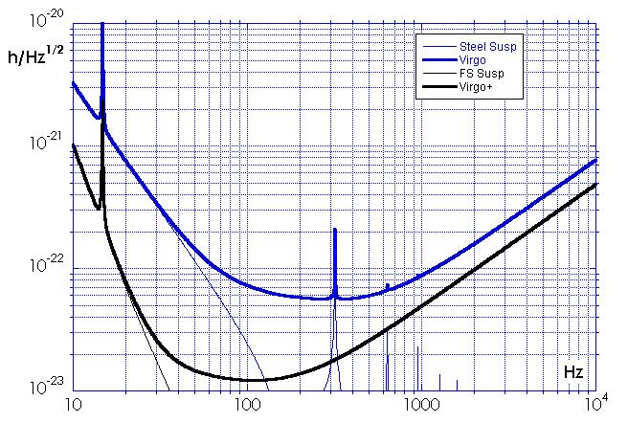
The suspension thermal noise is reduced with the FS suspensions
In the low frequency range, the mirror pendulum thermal noise plays an important role
Thanks to the lower mechanical dissipation of the fused silica, a monolithic suspension promises an excellent performance by reducing all the loss
term of
Thermoelastic Loss Angle
wire diameter
loss angle
Young modulus
thermal expansion
specific heat
density
Cagnoli G and Willems P A Phys. Rev. B, 65, 17
Eccess loss angle
Frictional losses in the marionetta-wire clamps
Frictional losses in the mirror-wire clamps
Surface losses
Virgo+ average sight
BNS: 53.6 Mpc
BBH: 284 Mpc
A.M. Gretarsson et al, PLA 270 (2000), 108-114

Slide 7
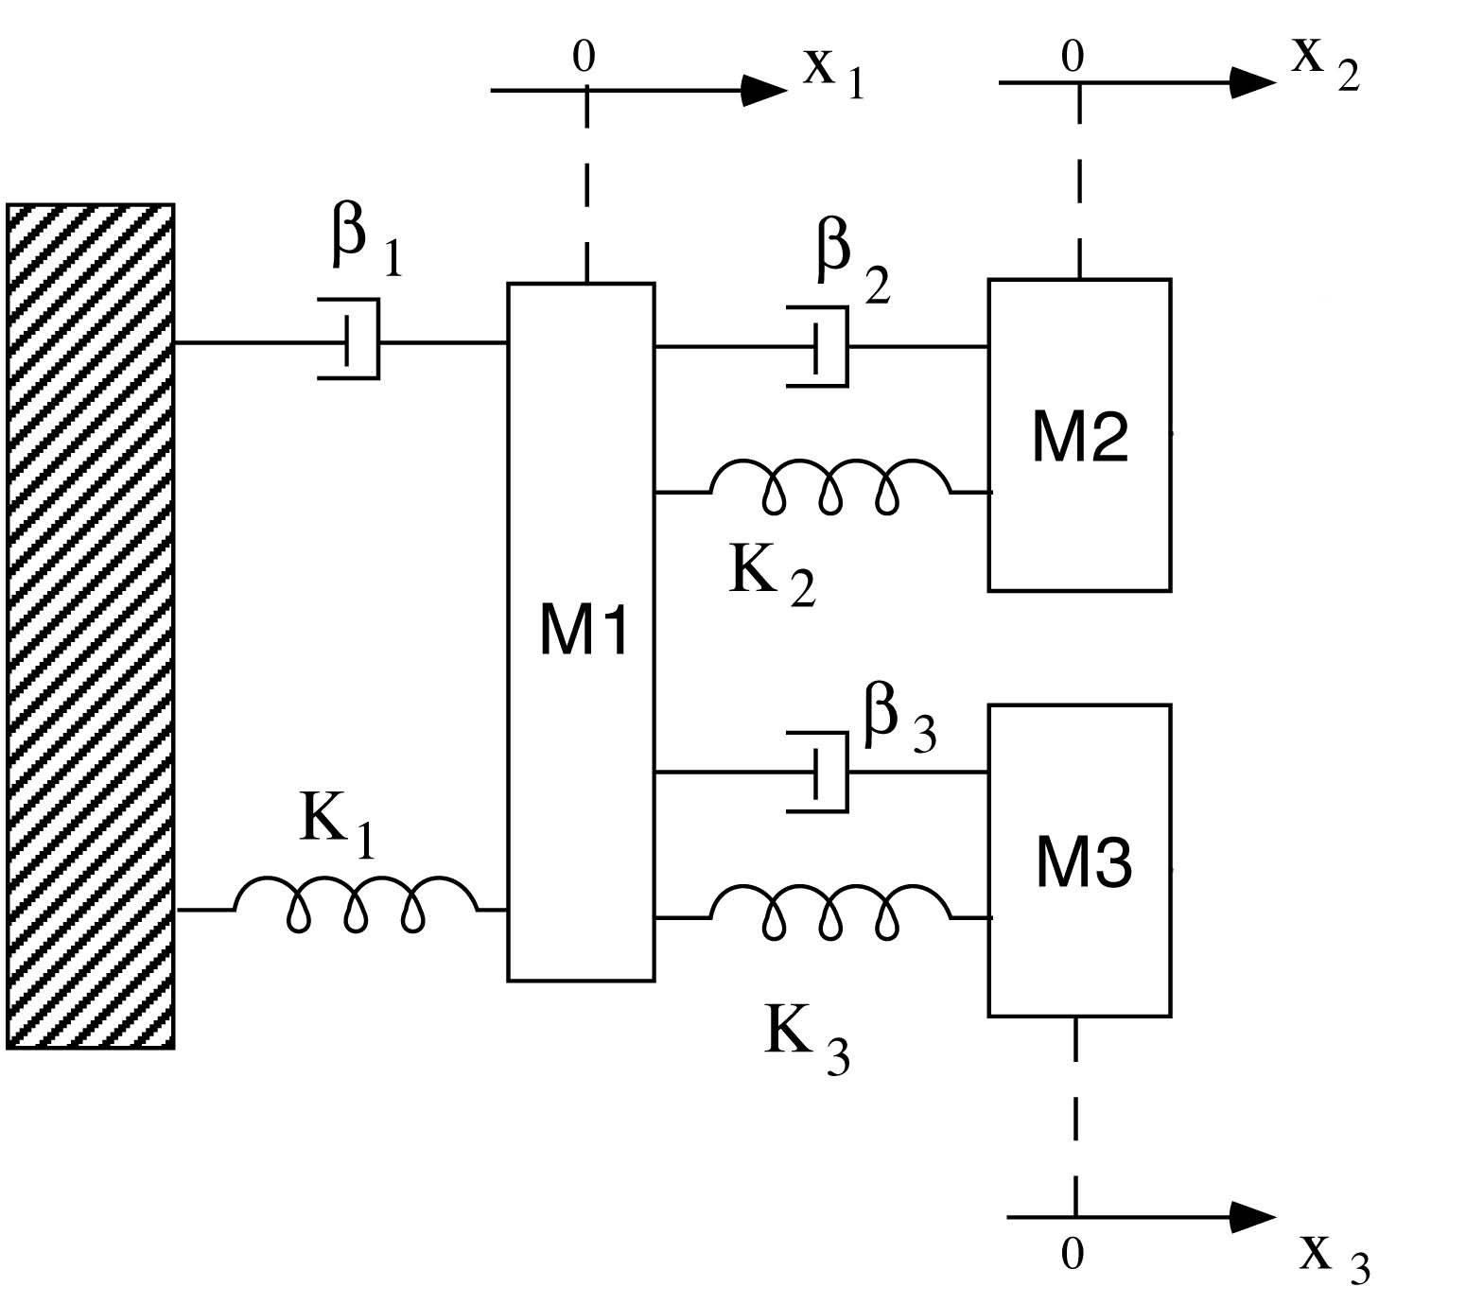
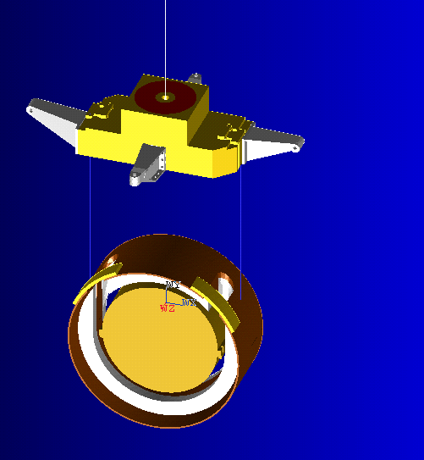
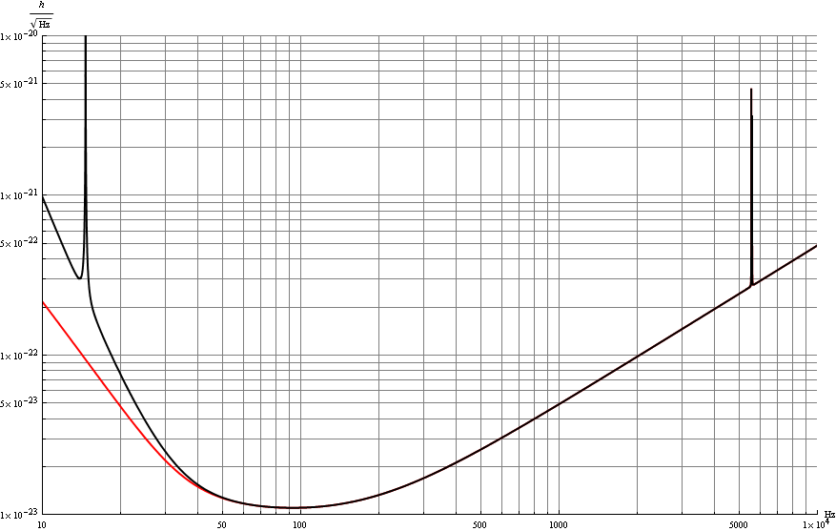
The new thermal noise model
Monolithic suspensions payload
With the low dissipative monolithic suspensions, the contributions of the other last stage suspension elements to thermal noise of the mirror cannot be neglected.
A new thermal noise estimation has been done, it includes the viscous and internal dissipations of the marionette and recoil mass.
It turns out that the marionetta’s mechanical losses give a non negligible effect via its recoil, in the off-resonance high-freq. range.
Marionetta (110 kg)
Reaction Mass (59 kg)
Branched pendulum:
FDT model with violin modes
and Normal modes model*.
Vertical modes are included
Simple Pendulum
*F. Piergiovanni, M.Punturo, P.Puppo, The thermal noise of the Virgo+ and Virgo Advanced Last Stage Suspension (The PPP effect), Virgo Note: VIR-015A-09.

Slide 8
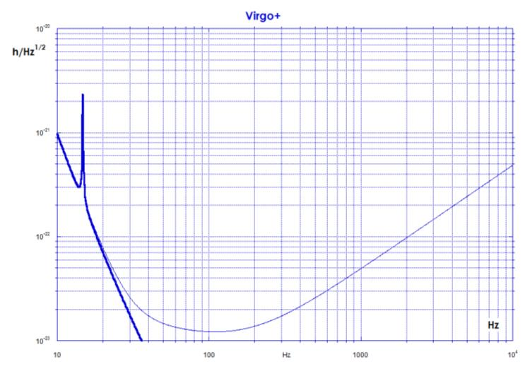
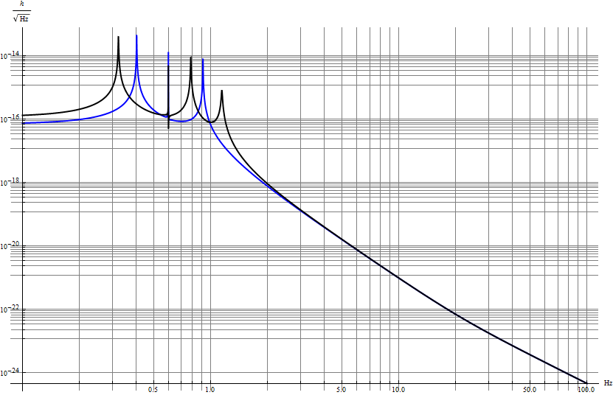
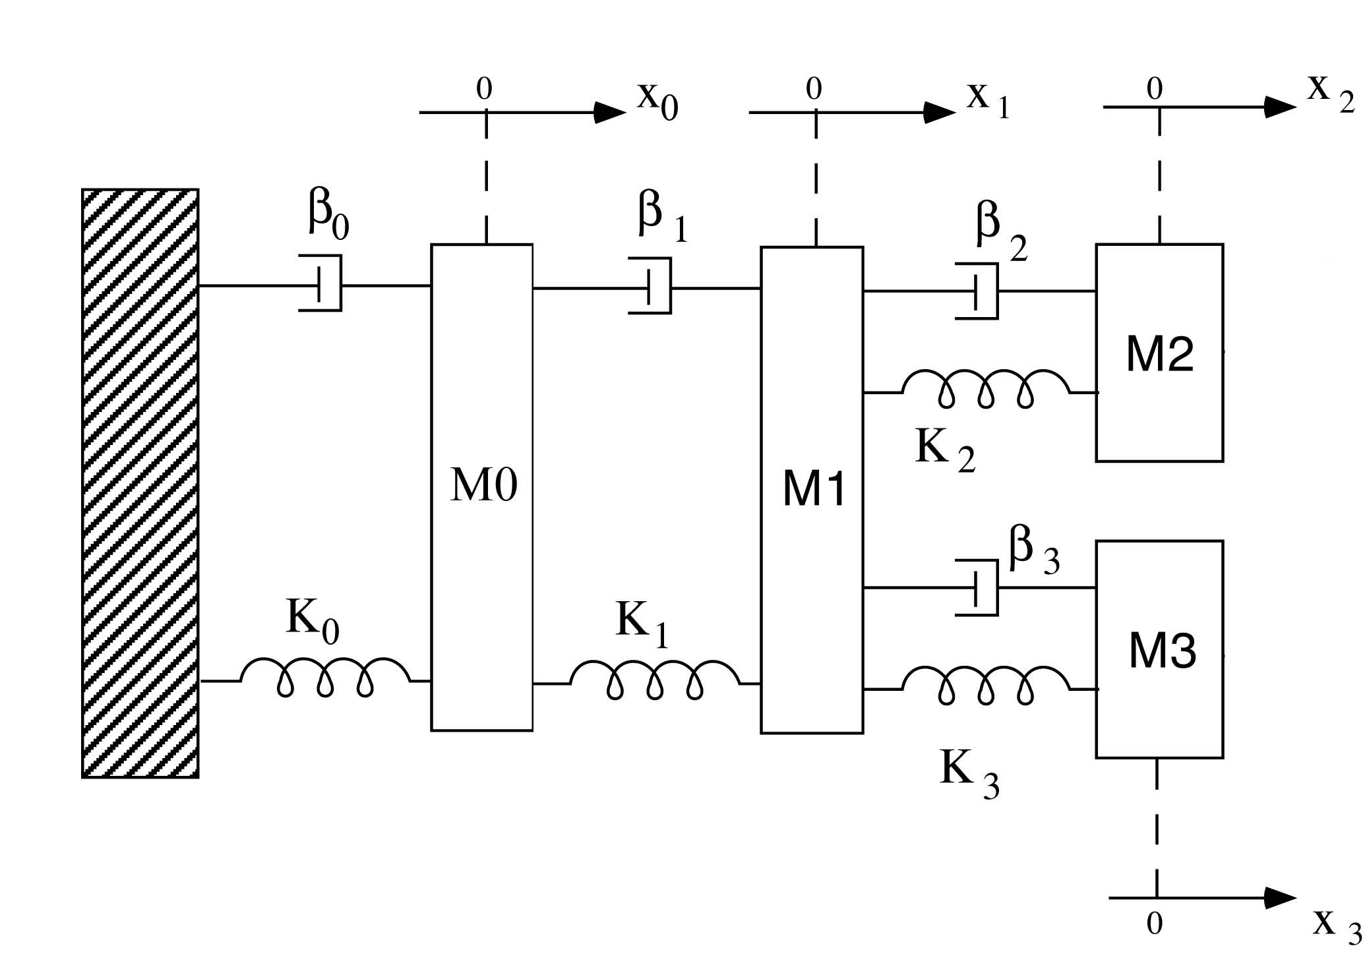
The new thermal noise model
The evaluation of the losses of the marionette, is crucial for the correct estimation of the sensitivity curve.
It is not possible to measure the marionetta losses on the payload hung to the SA by simply looking at the quality factors of the modes;
They are influenced by the whole SA chain, the quality factors of the SA modes are of order of 50-100;
From the measurements of the quality factor of the modes on our in-air monolithic prototype we can infer a marionette loss of 1000. (without any optimization)
The coupling to the SA chain can modify the marionette losses.
For this reason a conservative marionette quality factor of 300 is chosen for our thermal noise estimations.
The effect of the other lossy SA stages on the thermal noise
have been evaluated to be negligible.
with filter 7
Q_{F7}=50
Q_{marionette}=300
without filter 7
Q_{marionette}=300

Slide 9
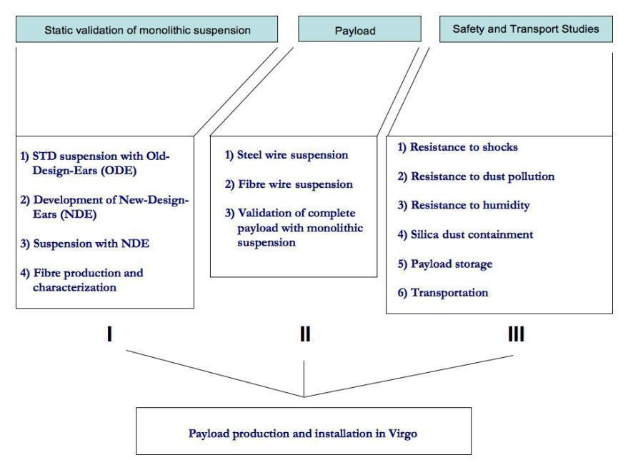
Virgo+ Upgrade: monolithic suspensions
Monolithic fused silica suspension development is an heavy activity in Virgo
Joint effort of many Virgo labs (Roma, Firenze, Perugia and EGO)
Activity progressing thanks to the full immersion of the involved group.
Activity tasks

Slide 10
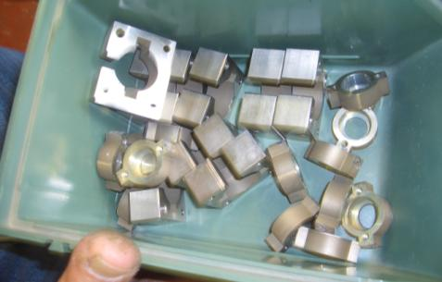
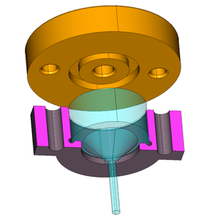
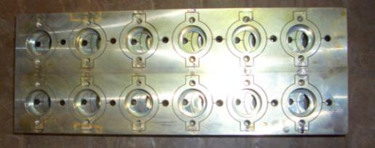
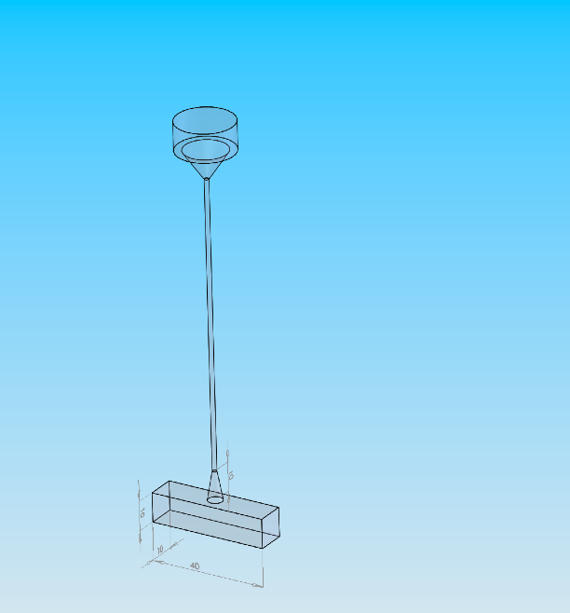
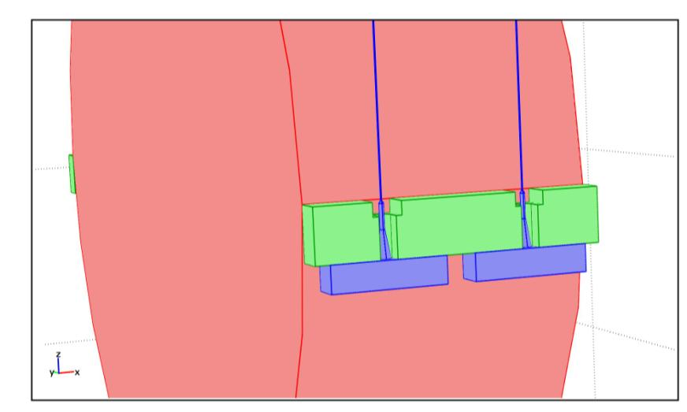
Clamps: design and production
Steel box to host the upper silica clamp on the marionetta
Coupling to the mirror flats with New Ears
Silica Clamps
on the marionette
Silica anchors
Silicate bonding

Slide 11
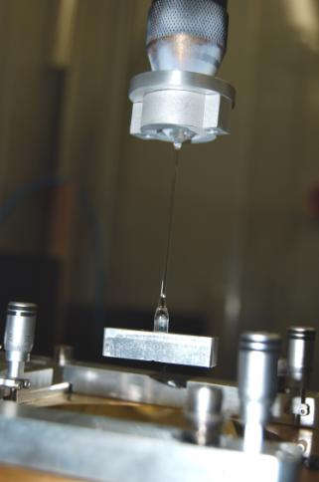
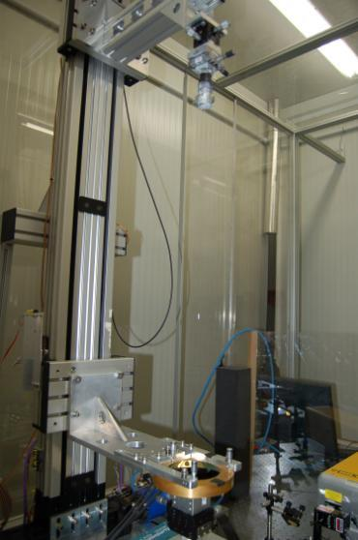
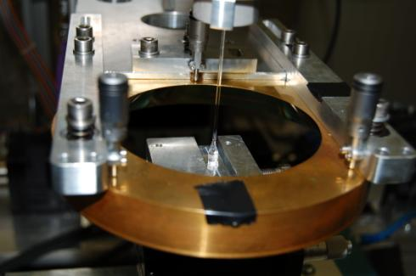
silica wires: fiber production and characterization
Fiber production validated
Implemented the fiber welding with the laser on the lower and upper silica clamps;
Upper
cone
CO₂
1.5 mm
rod
CO₂
Lower
“anchor”
CO₂

Slide 12
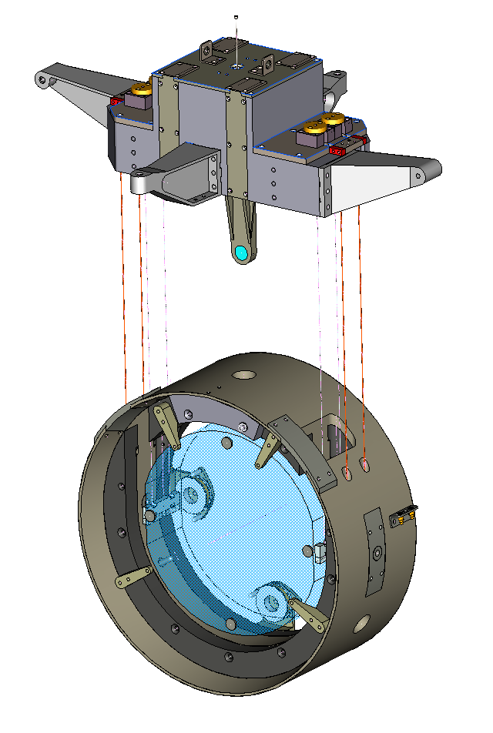
The payload
Marionette (110 kg):
amagnetic steel AISI 316L, dielectric arms (peek)→ no eddy current and magnetization effects;
designed to be fully compatible with the monolithic suspensions assembly;
equipped with mirror for LC purposes;
step motor to displace a balancing weight;
Recoil Mass (60 kg):
amagnetic steel AISI 316L outer cylindric mass (500 mm diam);
dielectric inner ring (peek CF30) → no stray currents or magnetization effects
it carries four coils for e.m. actuation on magnets attached the mirror rear side;
suspended with steel C85 wires (0.6 mm diam.)
option: it can carry the markers for the LC purposes
equipped with safety stop (peek made)
Mirror (21 kg):
FS with lateral flats (350 mm diam), silica ears attached with silicate bonding
suspended with silica wires (285 μm diam)
magnets attached on rear side
option: markers attached on front side (LC)

Slide 13
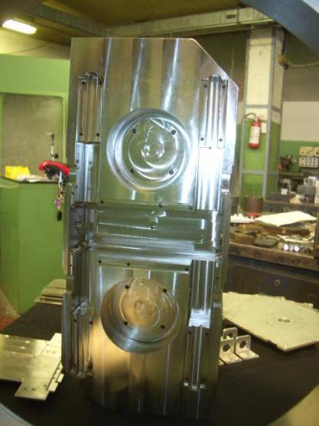
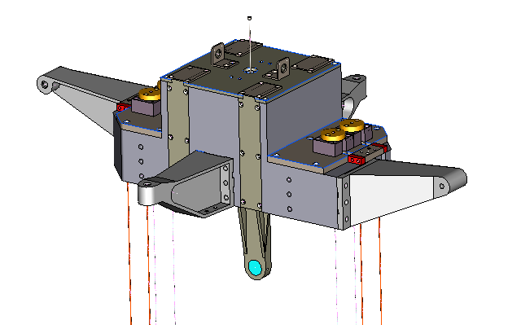
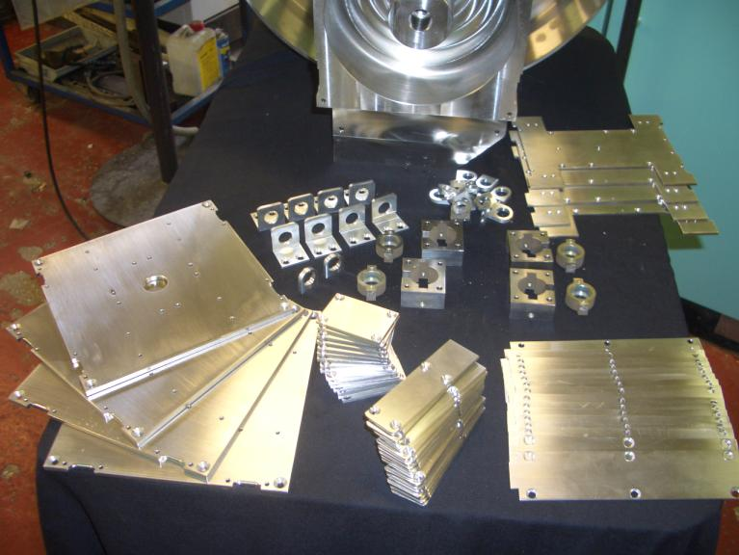
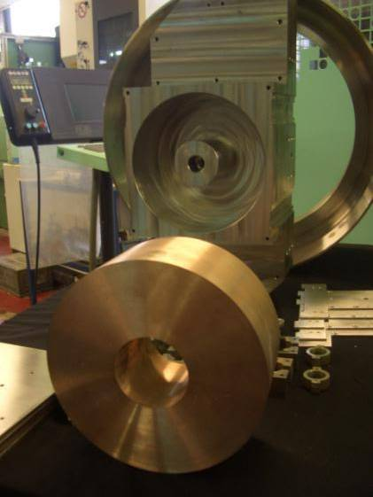
Payloads: The marionette
The marionette: some details
Marionette and Copper Tungsten inner mass

Slide 14
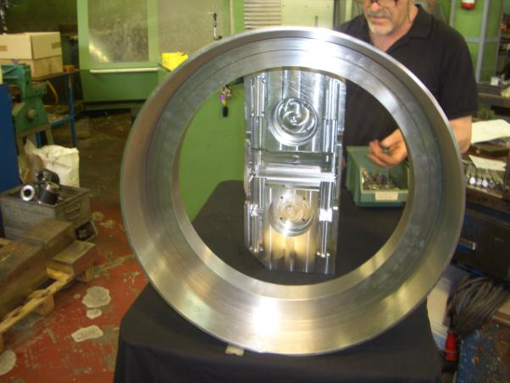
Payload: Reaction masses and payload frame
The frame design is being finalized
Frame for payload assembly:
a new frame has been designed on the base
of the acquired experience during the tests;
the precisions required for the positioning
of the pieces are respected;
it is equipped by a vacuum pump clamp the
mirror face during trasportation;
The reaction masses are being machined

Slide 15
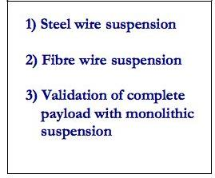
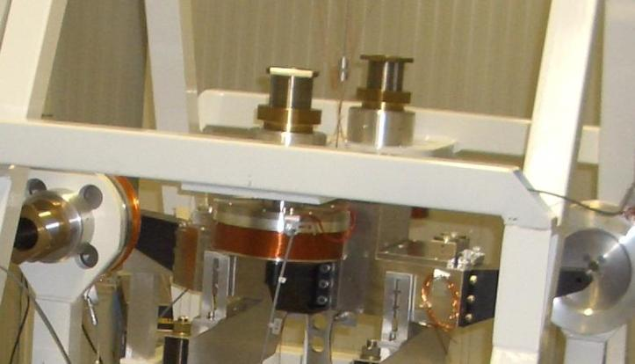
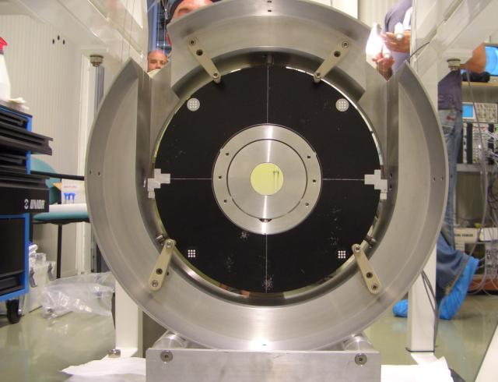
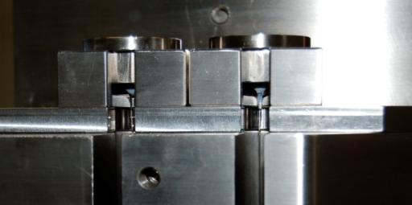
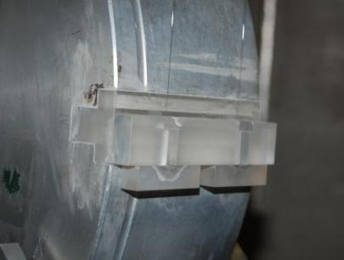
II TASK: Payload suspension
Steel AISI304 Marionetta prototype with PVC arms
Dummy reaction mass, coils with peek supports
A mirror is inserted in the holder, and the system is balanced.
All the pieces are secured by safety structures Fibers bending point placed on the marionetta’s center of mass

Slide 16
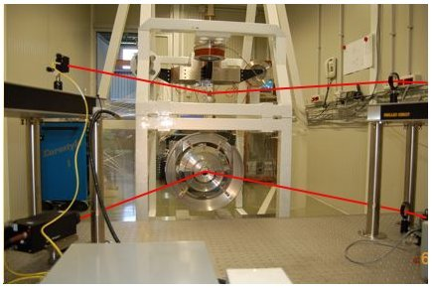
II TASK: Payload LOCAL CONTROL
marionette
and coils
Laser
Mirror and markers
y
Camera
x
z
lens
(and PSDs)
Electronic equipment:
- crate with ADCs/DACs, DSP, DOL and 2 timing boards

Slide 17
Monolithic payload prototype tests
Mechanical Assembling using a suspension frame: done in 3 steps
0) STEEL WIRES
I) FS with AL ANCHORS
and EARS
II) FS with FS ANCHORS and EARS
assembly procedure (I)
Note: mario baricentre moved upwards in two steps (IIa,IIb)
TF meas
controlled operation
model retuning (with new marionette baricentre)
- TF meas
control design
preliminary
models: analytical and FEM model
assembly procedure (I)
TF meas
controlled operation
model retuning (with FS)
STEEL
HYBRID
FULL

Slide 18
Example of TF meas results / model
1
Longitudinal (z)
Mirror OL response
VS
Mario exc
2
Longitudinal (z)
Mirror OL response
VS
Mirror exc
Yaw (Θ_{y})
Mirror/Mario OL response
VS
Mario exc
3

Slide 19
Example of TF meas results / model
4
Yaw (ty)
Mirror OL response
VS
Mirror exc
5
Pitch (tx)
Mirror/Mario OL response
VS
Mario exc
6
Pitch (tx)
Mirror OL response
VS
Mirror exc

Slide 20
Example of TF meas results / model
vertical (y)
Mario Accel response
VS
Mario exc
7
seed/tuned
Param
TF meas
FIT
model
Tuned parameters for lumped-impedance matrix model
check
y
n
model driven design

Slide 21
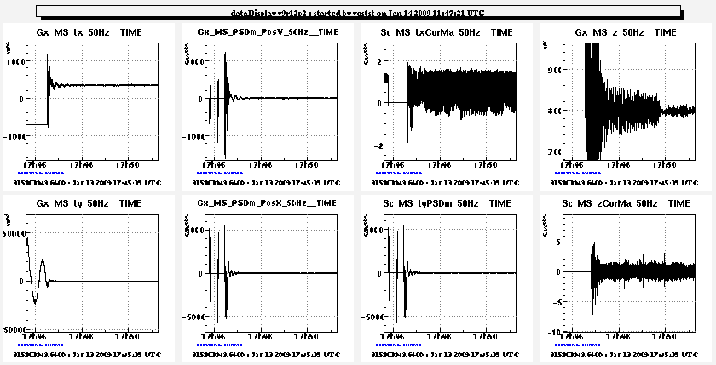
Automated hierarchical activation of controls
3b: optical lever tx mario =>mario act
5: optical lever tx mirror =>RM act
Notes:
- no motors installed
in the payload
environmentally sustained oscillation (5 mrads)
8 error signal used, 7 loops activated (5 in this plot + tx ty RM dampers)
damper from both ground => mario and RM => mirror
few microrads tx,ty rms accuracy at regime
kick
4: optical lever z mirror =>mario act
3a: optical lever ty mario =>mario act
2 : optical lever ty mirror =>mario act
1: coarse ty mirror =>mario act

Slide 22
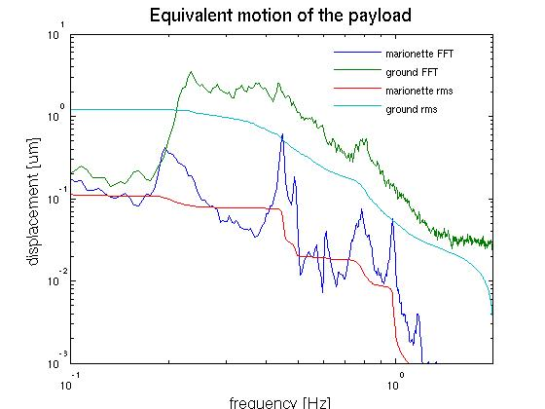
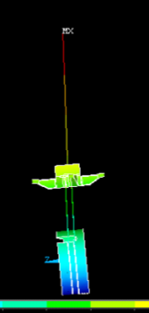
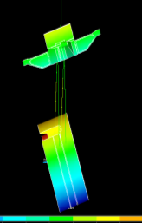
A further check of the modeling process and possible payload optimization
microseism due to sea activity is often active in the range 0.2-0.6 Hz
Thanks to IP inertial damping and suspension performance the lock force applied to the marionette corrects the residual payload motion, whose rms above 100 mHz is ~ 1 order of magnitude smaller than the ground motion (MSC,Hannover 25 10 07)
Pitch (in present payload):
g=-88 urad/V (DC);
cp=[0.409 300]
cz=[0.449 60]
cp=[0.4525 60]
cz=[1.705 1500]cp=[1.753 1500]
cp=[3.205 1500]
sp=10
Effective attenuation
of μseism at the payload
Murphy law: Virgo suspension chain and actual payloads have z/p couples in the same range, which falls in the microseismic band=> pitch alignment suffers …

Slide 23
Baricentre move tests in monolithic payload configurations I,IIa,IIb
baricentre
+2. 7 mm
Maraging wire clamp and fibre λ
4.85 kg steel inserts used to rise up artificially the baricentre
+5.85 mm
Meas/Model check
- 4.85 kg
The clean way to drive pitch mode in the range 250-300 mHz, reducing z/p couple impact on pitch control accuracy is to bring the bending point of marionette wire closer to the baricentre.
+ 4.85 kg
+7.8 mm

Slide 24
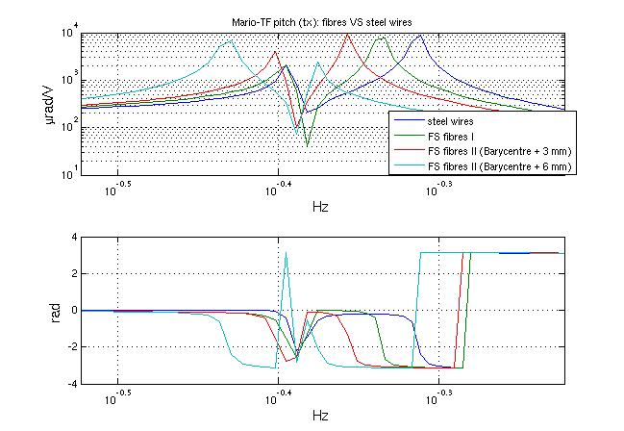
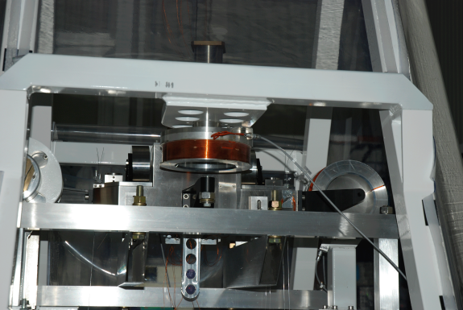
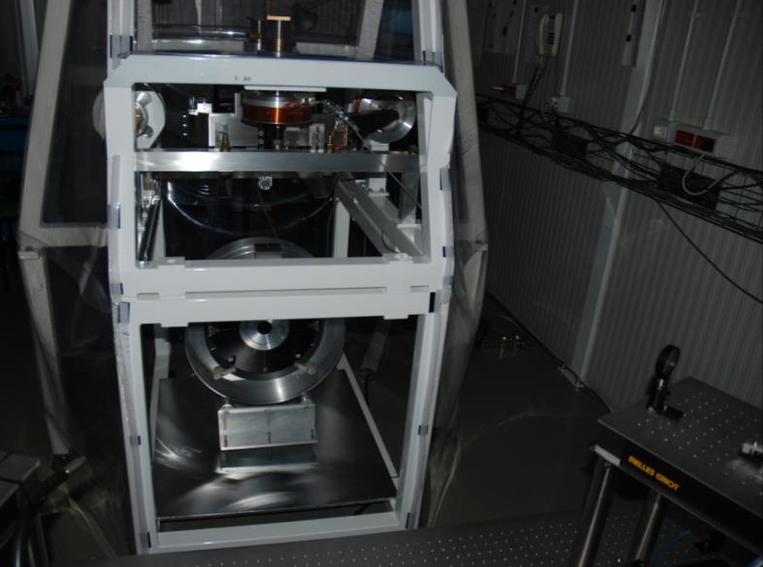
model reproduces the effect
once consistency is fulfilled full simulation of the suspension chain will assess the expected TF
the realization of payload design will need a fine tuning

Slide 25
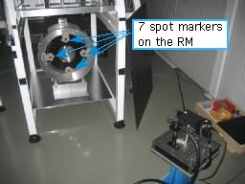
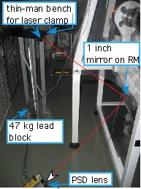
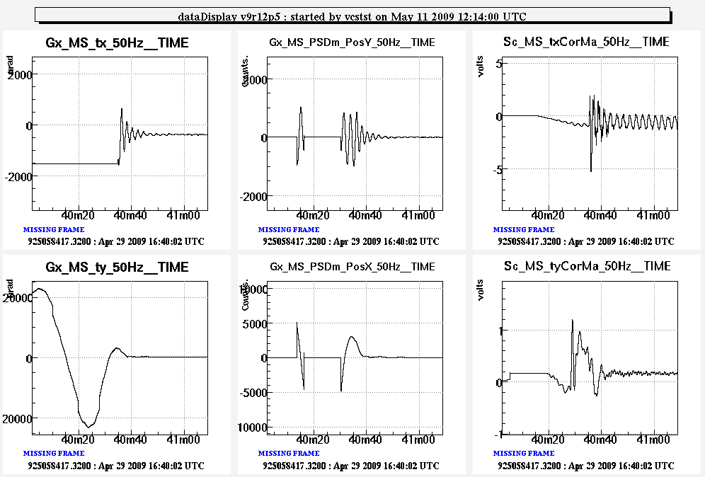
LC implementation
markers on the rear face of RM
(to avoid markers on the mirror front side)
lateral optical lever reading-out x position of RM (transversal pendulum)
RMCCD/MiPSD
Mario PSD
Correction
actuation under implementation:
the back coils will be used.

Slide 26
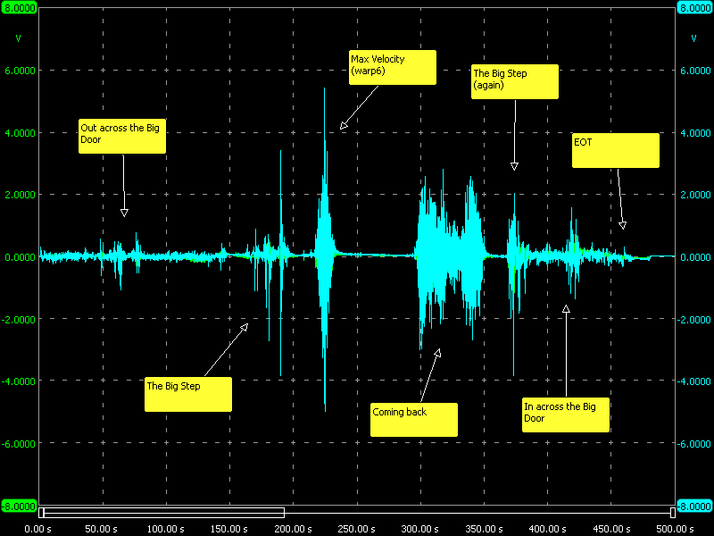
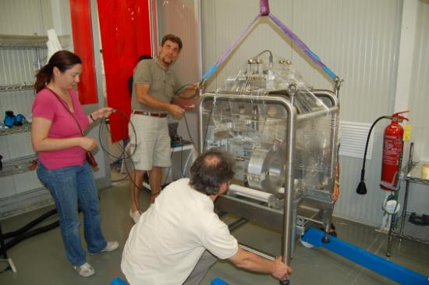
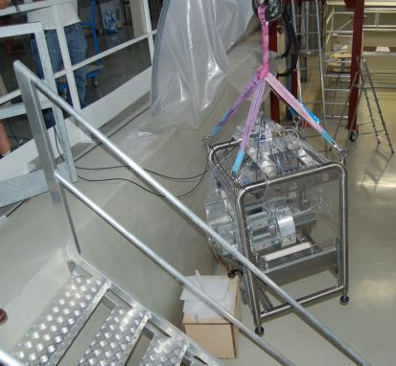
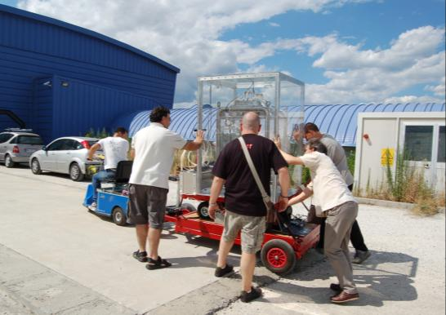
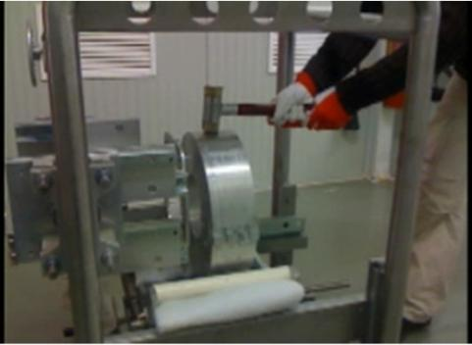
Resistance to shocks, dust pollution, to humidity
m/s²
Transportation test):
On the dummy payload
Mechanical vibration monitored with accelerometers
The test was successful (no broken fibers! );
Crash Test : see movie on YouTube
(search monolithic crash), fiber robustness tested , weight at the moment of rupture: 70kg

Slide 27
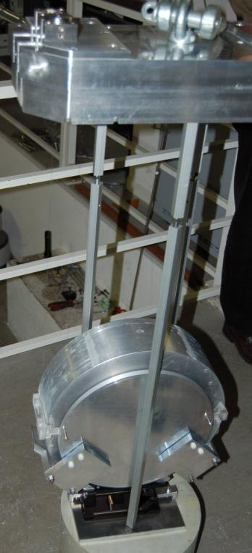
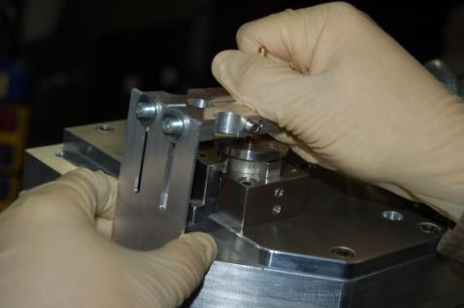
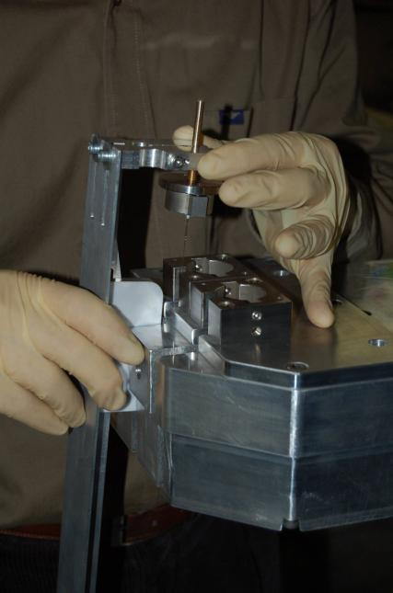
Dummy mirror Suspension for the mechanical losses measurements
Dummy Mirror suspended with NDE and silica wires in Perugia labs;
The aim is to measure the wire mechanical losses with the new clamping system;
Dummy payload and C tool
Silica wires installation on the marionette
Steel box for the silica upper clamps

Slide 28
Dummy mirror Suspension for the mechanical losses measurements
The anchors are glued with water glass on the ears
The upper clamps are tightly clamped on the dummy marionette
Silica wires installation on the mirror
Silica anchors glued on the ears

Slide 29
I Task: Dummy mirror Suspension for the wire mechanical losses measurements
The assembled system is positioned on very stiff legs attached to the ground so that the recoils are negligible, this is a crucial point for measuring the pendulum losses;
The system is now ready for measurements.
Dummy payload installation in the vacuum chamber
Shadow meter
Legs
ES actuators for pendulum and violin modes

Slide 30
I Task: Dummy mirror Suspension for the wire mechanical losses measurements
First preliminary measurement of the pendulum decay.
an overall loss angle of
the system losses will be
identified, probably a new set-up will be used.

Slide 31
Conclusions
Fiber production validated;
Design ready for clamps and ears;
Payload design ready;
Local Control:
TF measured,
developed FEM and lumped-impedance matrix model,
angular control & longitudinal hierarchical control implemented
with markers on the recoil mass.

Slide 32
near future steps:
Measurement on the mechanical losses both of the wire clamps (new set up under assembly) and silicate bonding;
Final design of the assembly structure;
Ready to install at the end of year 2009

