Slide 1
HP Lasers for future GW detectors
C.Nary MAN
Observatoire Cote d’Azur
06304 Nice - France
Starting from Sensitivity
Specifications for laser source
The laser’s story
What could be done to prepare the future?
What are the limits to HP extrapolation ?
Discussion
Fiber lasers
Disk lasers
Ceramic lasers
Other wavelengths

Slide 2
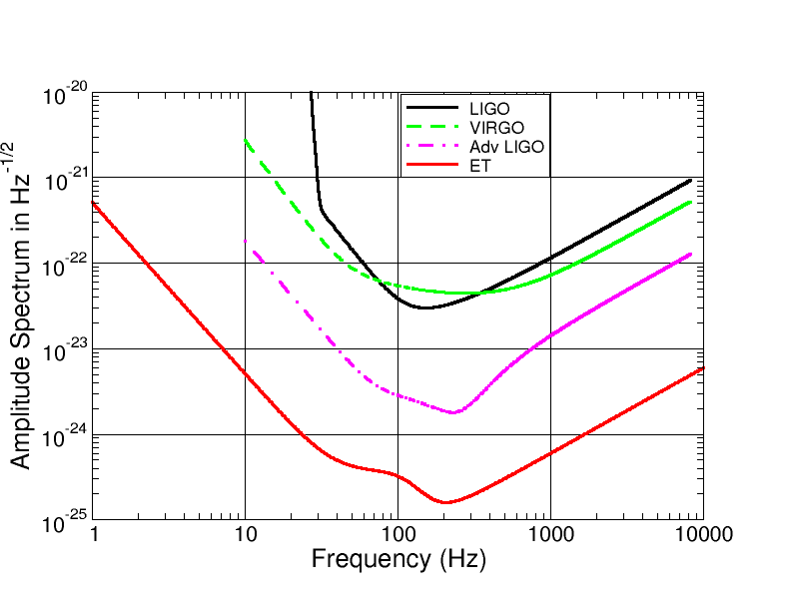
Sensitivity curve
SN 20W
SN 125W
SN 50kW
Notes:
Améliorer sensib pour détection de sources avec proba de plusieurs par mois ou par an?
Sensitivity curve conditioned by the sources we want to detect?
Shot noise 10-25 pour 5 kW TBC cf Next slide

Slide 3
First specifications of the laser
Laser power: 10 kW – 50 kW, easy to get but difficult to handle
Reliability in long term operation
Easy and rare maintenance
Easy controllable through rapid and large dynamical transducers
Weak thermal effects (beam geometry and polarization))
Wavelength : 1 μm to 1.55 μm, depends on test-mass material
1.06 μm linked to SiO₂ , known but absorbing & heating
1.55 μm to enjoy telecom developments, use Silicon optics,
to improve mirror figures (scatter goes as 1/ λ²)
.

Slide 4
Laser Frequency Noise specifications
Origin of laser noise’s influence comes from interferometer (ITF) imperfections:
β Contrast defect
around
Like in Virgo/LIGO today, the laser needs a few stabilization stages:
-pre-stabilization on rigid cavity
-stabilization on the common-modes
-stabilization on differential mode
In any case, need a quiet free-running laser
and improve the mirror figures to sub nm rms.

Slide 5
Laser RIN specifications
Amplitude Fluctuations couples to ITF:
Frequency [Hz] | Rel Intensity Noise [1/Sqrt[Hz]
10 | ? < 2 x 10⁻⁸
10 < f < 500 | ? < 2 x 10⁻⁹ f
f >= 500 | ? < 1x10⁻⁷
Via non perfect dark fringe contrast
via radiation pressure
Via rad. press noise: quantum noise can be reduced by squeezing techniques and QND
A low level requirement at 10 Hz is very tough to get
In case of RF readout in the range above the limit of UGBW of servos, passive control can be done with filtering .
In any case the stabilization level is limited by the shot noise of the photodetector:
DC power on photodetector | 35mW | 23 W
RIN [1/Sqrt[Hz] | 2.5 x 10⁻⁹ | 10⁻¹⁰
.
Photodiode with such HP standing and such dynamic range?

Slide 6
Injection locking and Amplification schemes
To avoid operating HP laser in single-frequency mode by inserting losses inside:
Use a low power single frequency master laser
- injection-lock a HP single-mode laser
-- amplify a HP stage in saturated regime
- use more than one HP stage to go to very HP
High power stages
Pre Mode Cleaner
Master laser
Diode-pumped laser
EOM for modulation or correction
Faraday optical isolator

Slide 7
Initial GW detectors’ solution: SSL
=> Diode-pumped Solid-State lasers rod geometry (mm x cm): Nd:YAG, Nd:YVO4
Power scaling to kW is restricted by many thermo-optical problems if want good beam quality (less than 10% out of gaussian mode)
stress fracture
birefringence / depolarization
spatial distortions
cavity stability / thermal lens
spurious oscillations in high gain material

Slide 8
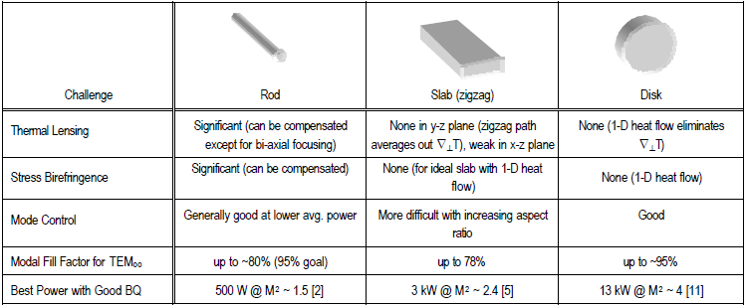
SSL gain medium
Principal configuration of SSL gain medium and their comparison (Boeing Cie 2002)
Do we try to look ahead for other kind of lasers? Other wavelengths?

Slide 9
Fiber lasers
distributed gain available from a long length of fiber enables efficient thermal management.
distributed gain available from a long length of fiber enables efficient thermal management.
Promising alternative to bulk SSL are rare-earth doped fibers:
large ratio of surface-to-active volume : good heat dissipation
distribution of thermal load on a longer length
beam quality depends on the physical design of the fiber
Wall-plug efficiency > 28% while bulk YAG is between 10-20%
Fixed spot size at all power levels
Minimum spare parts, low maintenance operation
pumping diodes at 980 nm has MTBF > 100,000h of operation better than 808nm pumping diode of Nd:YAG, better quantum defect
* Fiber laser setups need fewer mechanical components, which can make them significantly cheaper and smaller than bulk lasers.
Erbium doped Silica (1.55 micron)
Ytterbium doped all glass (1.06, eff > 80%)
Ytterbium doped Silica (1.06, eff 85%)

Slide 10
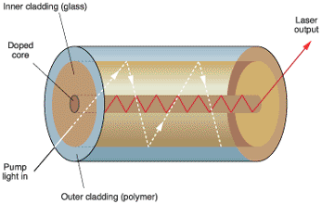
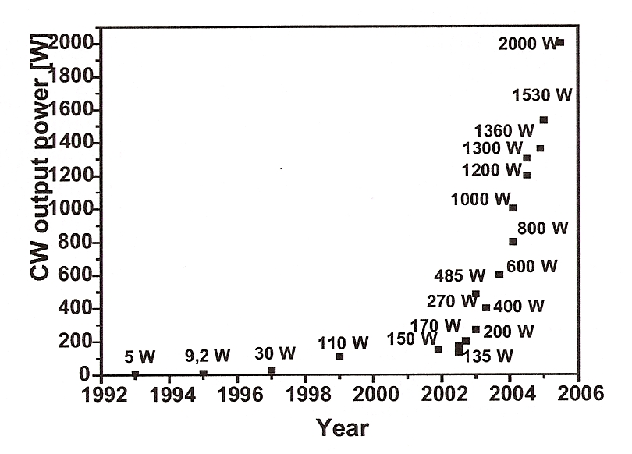
Fiber lasers’ concept and evolution
Double-clad fiber concept
the core contains a rare-earth element that provides laser gain,
the 1rst inner cladding layer confines laser light in the core but in addition it transmits the pump light.
The outer cladding layer has a refractive index lower than the inner cladding, confining the pump light and reflecting it many times through the core

Slide 11
Fiber technologies
Bragg gratings
as reflector
aperiodic perturbation of the effective refractive index in the core over a few mm/cm
reflection of light (propagating along the fiber) in a narrow range of wavelengths, for which a Bragg condition is satisfied (→ Bragg mirrors).
Polarisation-maintaining fiber (commercially available)
The 20 μm (NA 0.065) core diameter is Ytterbium doped and surrounded by 2 borosilicate rods to induce birefringence as high as 3. 10^{-4.}
The fiber has an inner cladding with a diameter of 400 μm

Slide 12
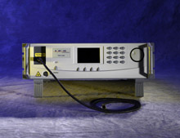
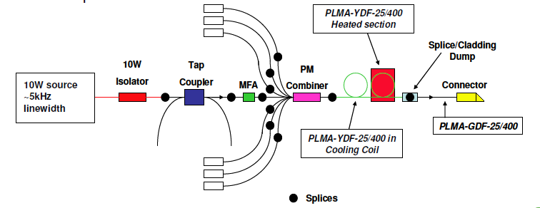
Fiber amplifier
State of art on fiber laser and amplifier
Single-mode fiber laser
IPG: Yb Fiber lasers based on rare-earth doped silica delivers up to 5 kW single-mode (March 2009) 557950.htm
Single frequency Fiber laser
IPG: single frequency (line width ~100kHz) linearly polarized Ytterbium fiber lasers 150 W cw output power
http://www.ipgphotonics.com/products_1micron_lasers_single.htm
Output power
>120W
Nufern 2008

Slide 13
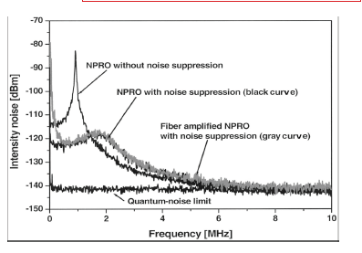
Intensity noise of a 100W amplifier

Slide 14
Monitoring and control of a fibre oscillator
980 nm
pump
980 nm
pump
D1
D2
Bragg
grating
1 mW
100 mW
Y doped
fibres
Thermal effects:
D1 current affects laser frequency Freq stab with Diode D1
D2 current affects gain and intensity of laser RIN with D1 + D2 controls
Fast easy feedback

Slide 15
Stabilisations scheme for Advanced detector laser source
Oscillator
(Nd-YAG
or fibre)
10W
Fibre
Amp.
>200W
Fibre
Amp
FI
FI
Faraday
isolator
Amplitude
and/or
phase control
Monomode
fibre (LMA-PM)
Frequency control
Polarization control
(optional)
In vacuum Input bench
No more input mode-cleaner
Permanent alignment
Immunity to laser lab. environment
Will require:
- Prestabilization in the low power area
- Re-design of high power monitoring
Still needs high-power FI
Modulation system TBD
Laser Beam
monitoring
200W
to Interferometer
Optional additional
beams/sidebands

Slide 16
Limitations of fiber lasers/amplifiers
- Brillouin scattering: gain proportional to the length of the fiber and to the power
(has been overcome for 264 W Jeong264WYbdopedFiber.pdf)
- Raman scattering: negligible because gain is about 100 times smaller
- Photodarkening
Fibers in which optical mode occupies a large modal area, and hence is less intense ➔ large mode area fiber ➔ multimode , except excite a single high order mode and use HOM
High Order Mode Fiber Laser

Slide 17
Other geometries/types
Geometry of fibers = their built-in waveguide effect eliminate disturbing thermal effects (such as e.g. thermal lensing➔ possible to achieve an excellent beam quality even at very high power levels.
More difficult with bulk lasers, although some concepts (the thin disk laser, the ceramic laser) can also enable great achievements with bulk lasers.
1.55 μm laser, Erbium doped fiber laser, developed eagerly for telecomm application
Color coupled with Silicon test-mass?
Smaller gain than Yb (10 dB/mW pumped at 980 nm)
Best reported today is 48W with Er:Yb Fiber (Nova techno & Army Res Lab),
Possible to scale up to higher power ?
HP Laser Diodes 2kW multimode exists
Monomode with HP ?
Where are they today? Development speed? What are their limits ?

Slide 18
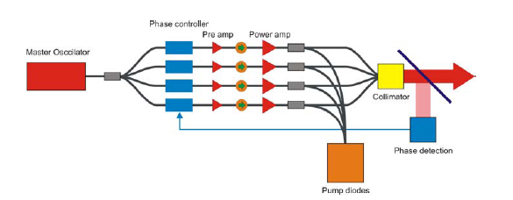
Spectral and Coherent beam combining
Crystal Fibre, white paper 2006

Slide 19
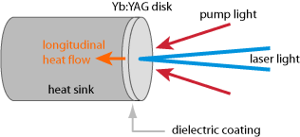
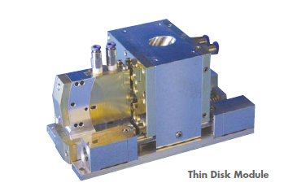
High Power Disk lasers
Introduced in 90s by Giesen (U of Stuttgart):
Laser xtal = thin disk, thickness < laser beam φ
Heat extracted through end face
Cooled end face is mirror
Disk thickness 100-200 μm, temp rise small
Temp gradients perpend to the disk ➔ small thermal lensing, high beam quality
Power Scalability in adding pump power
Limitations of gain due to ASE in transverse direction, but composite disk can push ASE limit to kW ?
230W, M2< 1.1

Slide 20
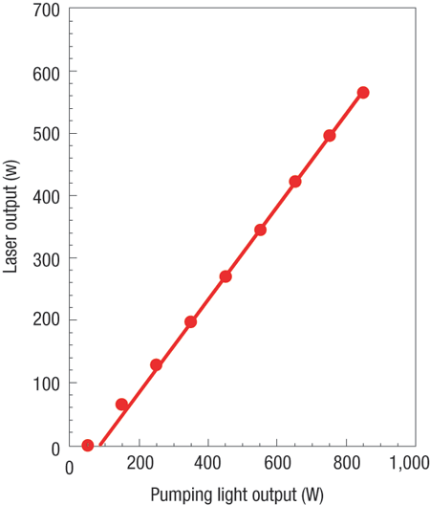
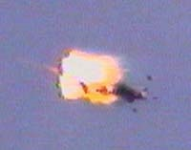
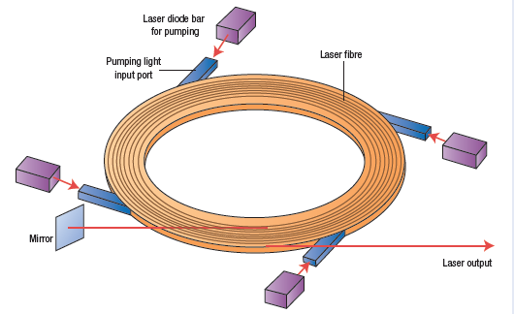
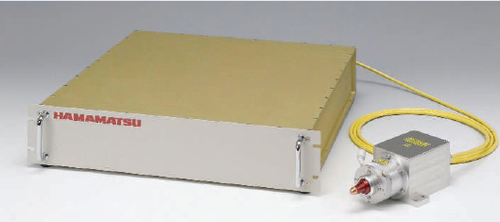
HP Disk lasers
Boeing _25kWhtml.htm
Yb doped fiber disk

Slide 21
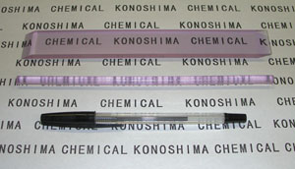
High power lasers: ceramic lasers
Ceramic laser : any size (23 cm long max for xtals, twice this length for ceramic), any shape, high Nd doping, mass production…
Possibility of having Nd:Y2O3 ceramic where thermal conductivity twice of YAG with similar thermal expansion coef.
98 in Japan, development of highly transparent Nd:YAG ceramic: efficiency comparable to single xtal lasers , 1.5 kW cw output ( Ueada et al, 2001)
Lasing also at 1.3μm
Direct pumping to laser upper levels to get 1.06 wavelength
Wavefront quality, ? ….
Notes:
Ceramic laser materials have attracted considerable attention since the 1960s because of their favorable characteristics
They offer new possibilities in designing laser medium, with respect to
- dopant concentration,
- size,
- geometry
As well as multilayer, multifunctional structure, & mass production
---These advantages make ceramic laser materials a powerful challenger to single-crystal laser materials, which are considerably more expensive,
limited in size and concentration, and difficult to grow.
The 1st highly transparent Nd:YAG ceramic has been made in Japan in 95 & quite rapidly a lot of progress has been made
Now more than kW has been reached at 1.06 and people at IEC has also exploited the lasing wavelength of 1.3micron to get HP laser/

Slide 22
Discussion
Do we try to look ahead for other kind of lasers? Other wavelengths?
criteria to be fulfilled?
- fulfill the specs of stability, reliability
- good efficiency, high power scaling possibility
- easy maintenance/ number of components, soft failure mode
- simplicity of implementation
- (in)sensitivity to environment …..
- transducers for laser controls (pzt, heater, polariser etc…….)
What kind of limitations? -Technical? - fundamental?

Slide 23
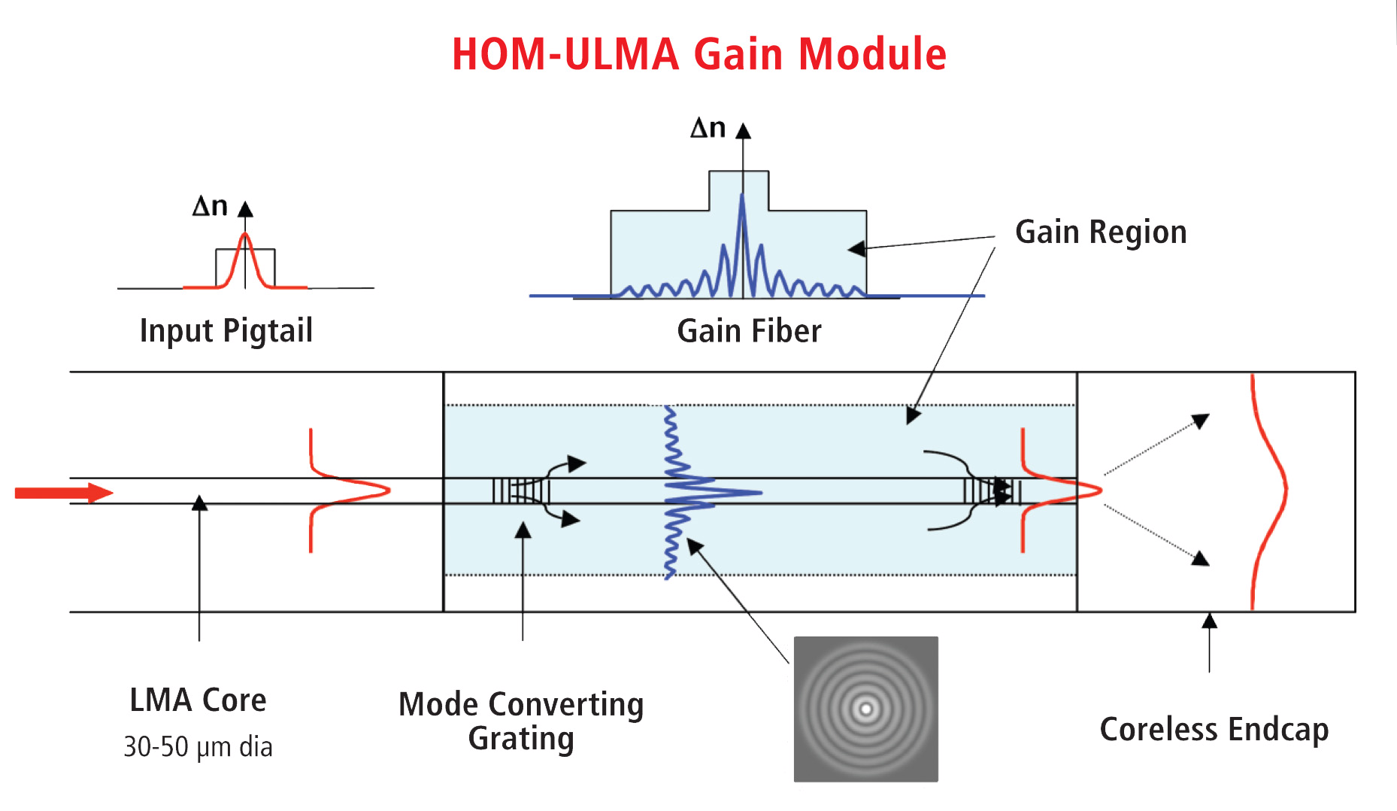
High Order Mode Fiber Laser
distributed gain available from a long length of fiber enables efficient thermal management.
distributed gain available from a long length of fiber enables efficient thermal management.
distributed gain available from a long length of fiber enables efficient thermal management.
distributed gain available from a long length of fiber enables efficient thermal management.

Slide 24
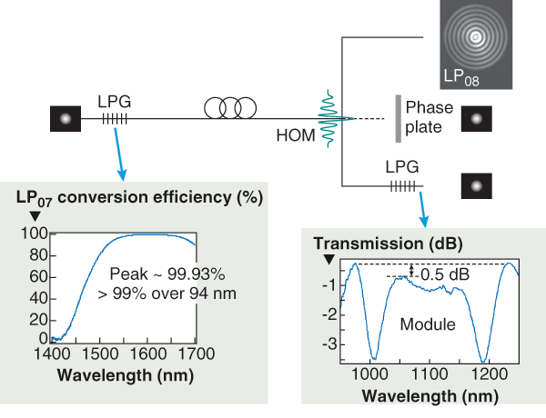
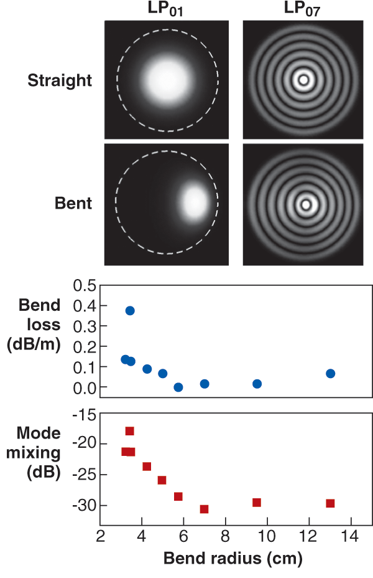
Few Moded Fiberr
Other geometries/types

Slide 25
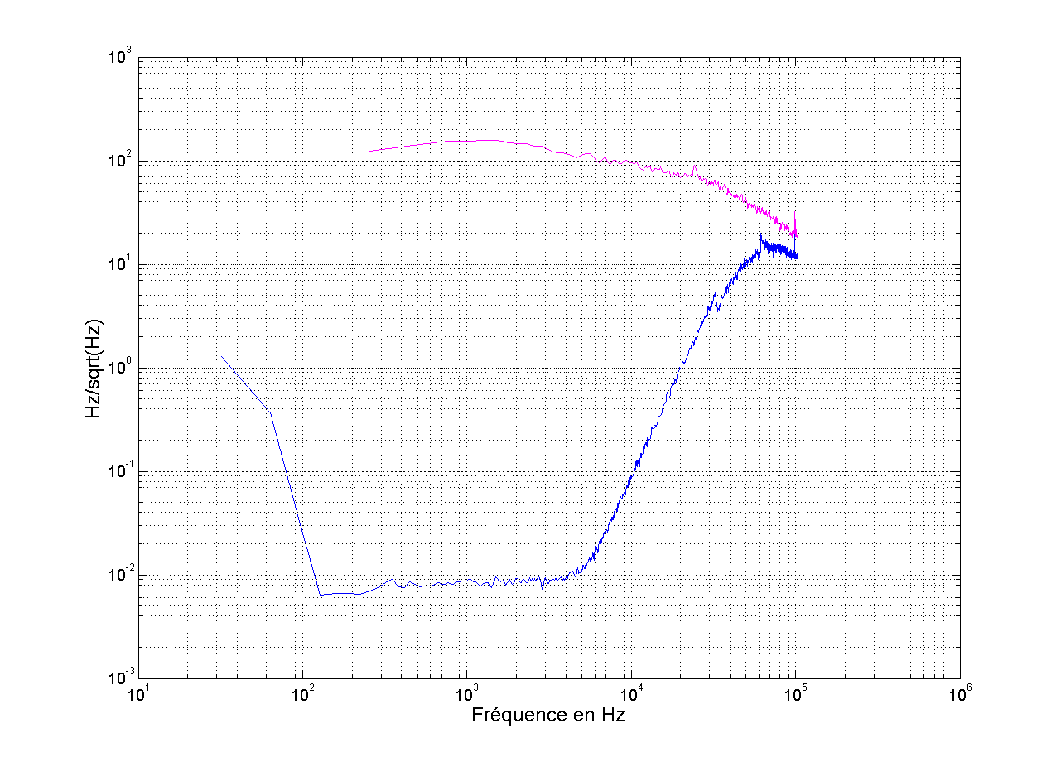
Freq stab with Diode D1
Free-running
Free running
fibre laser
Nd-YAG
(free running)
Prestabilized
fibre laser

Slide 26
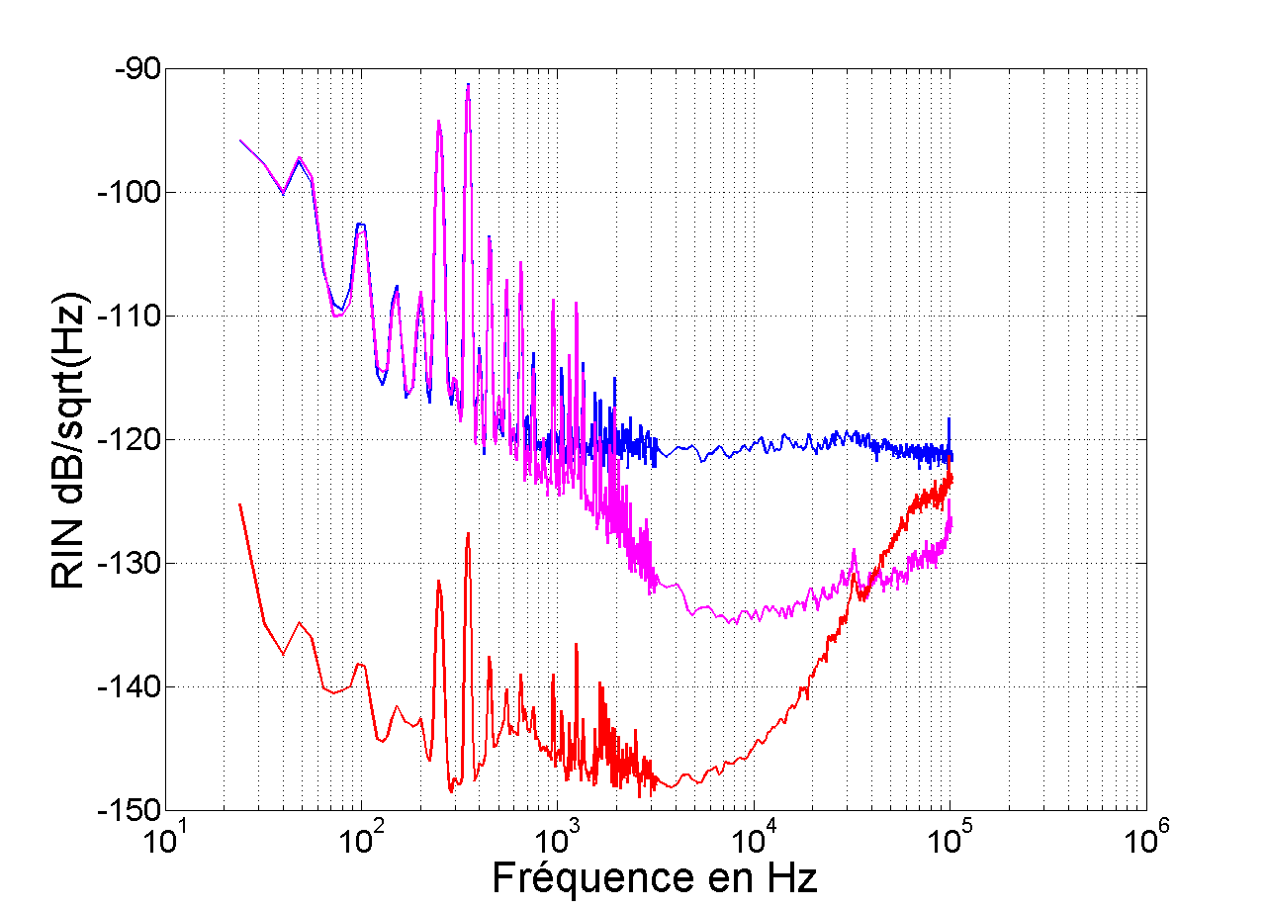
RIN with D1 + D2 controls
Control of master diode
Control of ampli diode
Stabilisations scheme for Advanced detector laser source

