Slide 1
Effect of energy deposited by cosmic-ray particles
on interferometric gravitational wave detectors
Kazuhiro Yamamoto
Max-Planck Institute for Gravitational Physics
Albert Einstein Institute
15 May 2009
Gravitational-Wave Advanced Detector Workshop
@Lago Mar Resort, Ft Lauderdale, Florida, U.S.A.

Slide 2
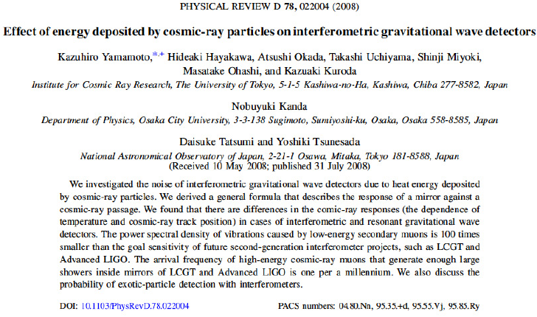
Phys. Rev. D 78, 022004 (2008)

Slide 3
0. Abstract
Investigation of the cosmic ray effect
on the interferometric gravitational wave detector
Serious noise ?
(ii) Exotic particle search ?

Slide 4
Contents
1. Introduction
2. Difference between interferometer
and resonator
3. Effects on interferometers
4. Summary

Slide 5
1. Introduction
Gravitational wave detector (interferometer and resonator)
: Ultra high sensitive sensor
Many noise sources : Quantum noise
(shot and radiation pressure noise),
Thermal noise, Seismic motion,
Noise from laser source
(frequency, intensity, jitter),
Circuit noise, Electric and Magnetic fields, ....
Cosmic rays ?

Slide 6

Process of cosmic-ray excitation
(i) Passage of cosmic ray particle in mirror or resonator
(ii) Energy deposition
(iii) Temperature gradient
(iv) Thermal stress
(v) Elastic vibration of mirror or resonator
Cosmic ray
particle
Mirror

Slide 7
Process of cosmic-ray excitation
(i) Passage of cosmic ray particle in mirror or resonator
(ii) Energy deposition
(iii) Temperature gradient
(iv) Thermal stress
(v) Elastic vibration of mirror or resonator
Mirror

Slide 8
Process of cosmic-ray excitation
(i) Passage of cosmic ray particle in mirror or resonator
(ii) Energy deposition
(iii) Temperature gradient
(iv) Thermal stress
(v) Elastic vibration of mirror or resonator
Hot
Mirror

Slide 9
Process of cosmic-ray excitation
(i) Passage of cosmic ray particle in mirror or resonator
(ii) Energy deposition
(iii) Temperature gradient
(iv) Thermal stress
(v) Elastic vibration of mirror or resonator
Mirror

Slide 10
Process of cosmic-ray excitation
(i) Passage of cosmic ray particle in mirror or resonator
(ii) Energy deposition
(iii) Temperature gradient
(iv) Thermal stress
(v) Elastic vibration of mirror or resonator
Mirror

Slide 11
Study of resonator
First paper : B.L. Baron and R. Hofstadter
Physical Review Letters 23 (1969) 184.
First observation : P. Astone et al.,
Physical Review Letters 84 (2000) 14.
Recent hot topic : Exotic events in superconductive resonator
Physics Letters A 373 (2009) 1801.
Study of interferometer
only a few calculations ...
Topic in this talk

Slide 12
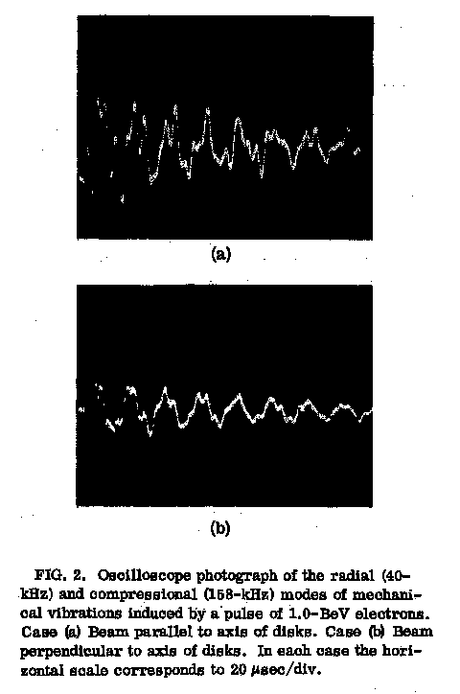
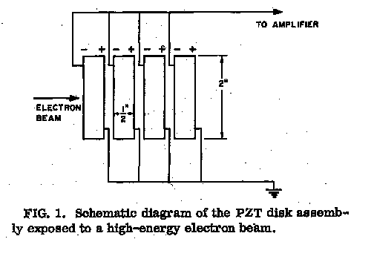
Study of resonator
First paper
B.L. Baron and R. Hofstadter
Physical Review Letters
23 (1969) 184.

Slide 13
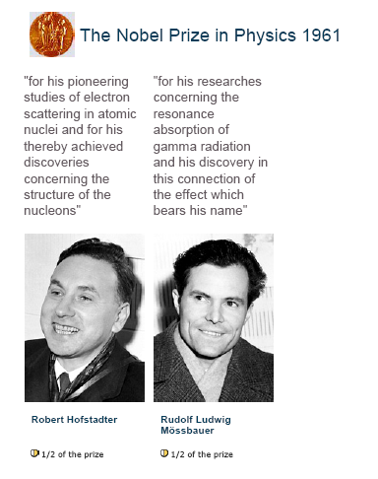
Web of Nobel Foundation

Slide 14
Study of resonator
First paper : B.L. Baron and R. Hofstadter
Physical Review Letters 23 (1969) 184.
First observation : P. Astone et al.,
Physical Review Letters 84 (2000) 14.
Recent hot topic : Exotic events in superconductive resonator
Physics Letters A 373 (2009) 1801.
Study of interferometer
only a few calculations ...
Topic in this talk

Slide 15
2. Difference between interferometer
and resonator
Two components
(1) Excitation and decay
of resonant motion
(2) Motion of center
of resonant motion
(Excitation and relaxation
of thermal stress)

Slide 16
2. Difference between interferometer
and resonator
Two components
(1) Excitation and decay
of resonant motion
(2) Motion of center
of resonant motion
(Excitation and relaxation
of thermal stress)

Slide 17
2. Difference between interferometer
and resonator
Two components
(1) Excitation and decay
of resonant motion
(2) Motion of center
of resonant motion
(Excitation and relaxation
of thermal stress)

Slide 18
Resonator
Observation band : Near resonant frequency (about 1 kHz)
Excitation of resonant motion
Interferometer
Observation band : Below resonant frequencies (10 Hz - 10 kHz)
Motion of center of resonant motion
Difference of cosmic ray effect at cryogenic temperature

Slide 19
Room and cryogenic temperature (resonator)
(thermal expansion)/(specific heat)
Temperature independent (Grueneisen relation)

Slide 20
Room and cryogenic temperature (interferometer)
(specific heat)/(thermal conductivity)
Smaller cosmic ray effect at cryogenic temperature

Slide 21
3. Effects on interferometers
(i) Low energy cosmic rays
(ii) Shower
(iii) Exotic particle search

Slide 22
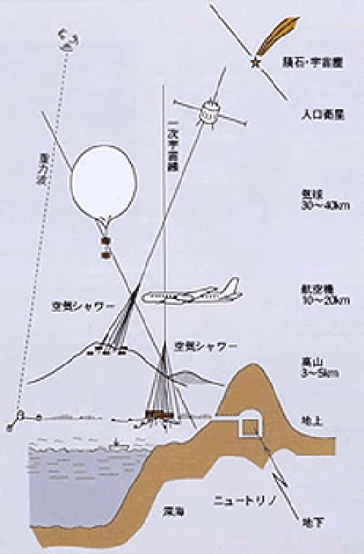
3-1. Low energy cosmic rays
Primary
cosmic ray
Primary particles (from Universe)
Secondary particles
: Shower caused
by primary particles
Secondary particles are different
from primary particles.
Shower
Secondary particles
Three quarters : Muon(μ)
One quarter : Electron
(Electron easily stop in wall etc.)
Secondary
cosmic ray
Shower
Web of Institute for Cosmic Ray Research, University of Tokyo
(http://www.icrr.u-tokyo.ac.jp/about/cosmicray_eng.html)

Slide 23
Flux of low energy cosmic rays (μ) at sea-level
2*10⁻² /cm²/sec
Typical mirror size : 25 cm in diameter
15 cm in thickness
km-scale interferometer
Average arrival interval : ~ 0.1 sec
Decay time of resonant motion : ~ 1000 sec
Mirrors always vibrate owing to low energy μ.

Slide 24
Power spectrum density
of cosmic-ray vibration
100 times smaller than goal
of second generation project
(Advanced LIGO and VIRGO,
LCGT)
not serious problems

Slide 25
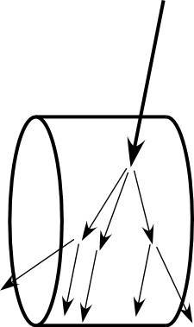
3-2. Shower
Shower : Many particles generated
by high energy cosmic-ray particle
Burst like fake signal
In second generation interferometers,
1000 particles shower makes sufficiently large fake signal.
Rare event : How often ?
(a) In mirror
(b) Near mirror

Slide 26
(a) In mirror
Monte Carlo simulation (by Atsushi Okada)
high energy muon (μ)
Energy spectrum is same
as that at sea level.
1000 particles shower
every 1000 years !
No problem !
More than
1000 particles ?
Half infinite sapphire

Slide 27
(b) Near mirror
Shower strongly depends on structure around mirror.
Future work
Energy of original particle : 1 TeV
1000 particles shower
How many do particles go into mirror ?
How often does such a event occur ?

Slide 28
3-3. Exotic particle search
Not noise, but signal !
Exotic particle search
Candidate particles : Large dissipation in material
Magnetic monopole
Nuclearite (up, down, strange quarks nugget predicted by QCD)
Mirror dust particles ...
Upper limit of flux of nuclearite (resonator)
G. Liu and B. Barish, Physical Review Letters 61 (1988) 271.
P. Astone et al., Physical Review D 47 (1993) 4770.
Comparison between interferometer (second generation, 300 K)
and resonator (bar)

Slide 29
(i) Cross section
Bar : 2 m² (0.6 m in diameter, 3 m in length)
Interferometer : 0.2 m²
(0.25 m in diameter, 0.15 m in thickness, 4 mirrors)
Bar : 10 times larger
(ii) Sensitivity
Signal to Noise Ratio (output of matched filter)
Bar : (30-300) times larger

Slide 30
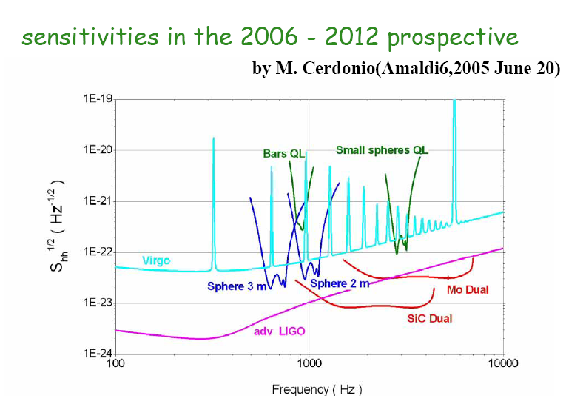

Slide 31
(1)Detector size
Gravitational wave detector : Strain sensor
Particle detector : Displacement sensor
If strain sensitivity is same,
smaller detector is better displacement sensor.
Difference of size (Interferometer : 3 km, Bar : 3 m) cancels
the advantage of interferometer
(high sensitivity and wide band).

Slide 32
(2) Mechanical response
Bar : 10 times larger
(3) Coefficient of thermal expansion
fused silica : 5.5 * 10⁻⁷ /K
sapphire : 5.0 * 10⁻⁶ /K
Al 5056(bar) : 2.4 * 10⁻⁵ /K
Bar : (4-40) times larger
Total
Bar : (30-300) times larger

Slide 33
4. Summary
(1) Calculation of cosmic-ray effect on interferometer
Resonator : Excitation of resonant motion
Cosmic ray effect : Temperature independent
Interferometer : Motion of center of resonant motion
Smaller cosmic ray effect at cryogenic temperature
(2) Low energy cosmic rays :
Not serious problems in second generation interferometers
(3) Shower generated in mirror :
Not serious problems in second generation interferometers
(4) Exotic particle search :
Bar resonator has larger cross section and higher sensitivity.
(5) Future work
Simulation for shower generated near mirror

Slide 34
Study of interferometer
A. Giazotto, Phys. Lett. A 128 (1988) 241.
No term for drift of center of resonant motion
R.W. Clay et al., Publ. Astron. Soc. Aust. 14 (1997) 195.
It is the same as Giazotto's paper.
V.B. Braginsky et al., Phys. Lett. A 350 (2006) 1.
Shower (Burst)
Only room temperature
Time domain
V.B. Braginsky et al., Phys. Lett. A 359 (2006) 86.
Low energy particles (Power spectrum)
Some comments about cryogenic temperature

Slide 35
