Slide 1
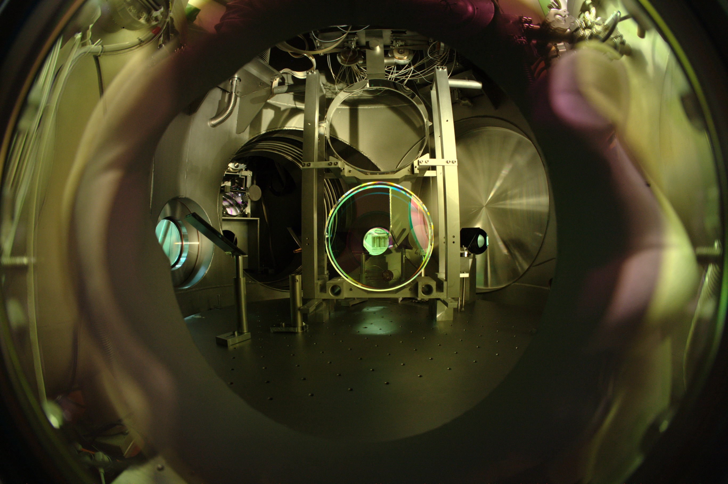


The Transition to GEO HF
Harald Lück
for the LSC
8. Amaldi Conference
New York, 23. June 2009
LIGO-G0900523

Slide 2
The limits

Slide 3
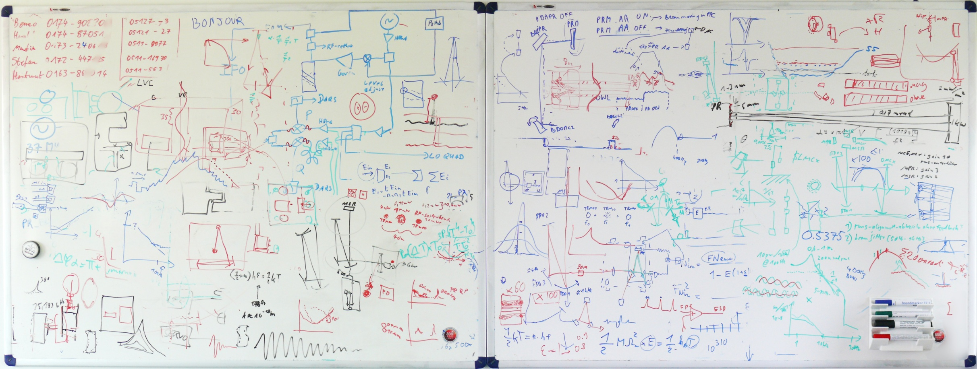
The Master Plan Experimenter‘s Notation

Slide 4
The GEO600 Interferometer

Slide 5
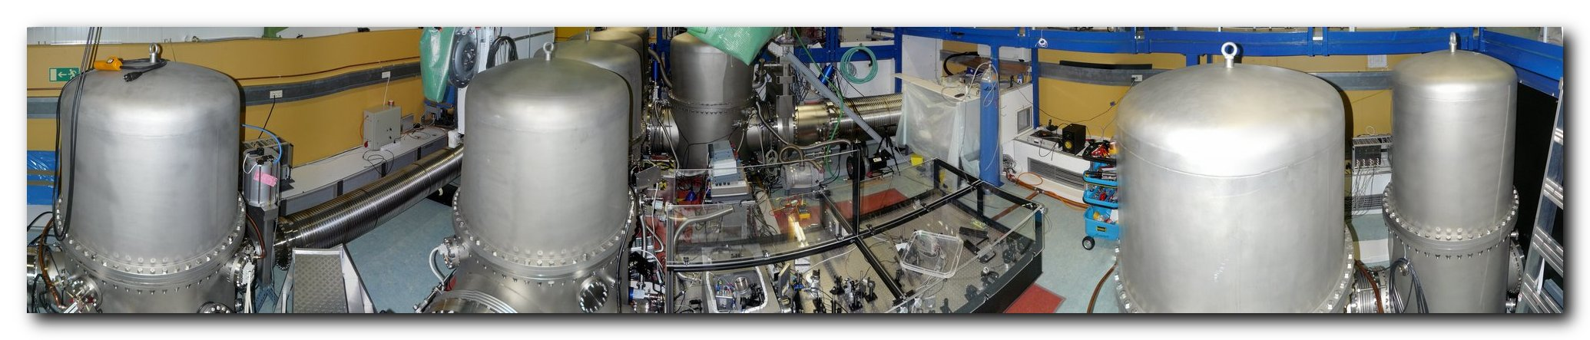
Upgrade Plan A
DC readout
Squeezing
Tuned SR
OMC
  Adv. Ligo CDS system for SQZ, OMC, GEOcontrols
Increase Power (8x, Laser 5x, 1.5x IMC throughput, Shadow-sensors)
Thermal Compensation
Increase SR Bandwidth
2009
2010

Slide 6
Upgrade Plan B
DC readout
Squeezing
Tuned SR
OMC
  Adv. Ligo CDS system for SQZ, OMC, GEOcontrols
  Increase SR Bandwidth
Increase Power (8x, Laser 5x, 1.5x IMC throughput, Shadow-sensors)
Thermal Compensation
2009
2010

Slide 7
The GEO600 Interferometer

Slide 8
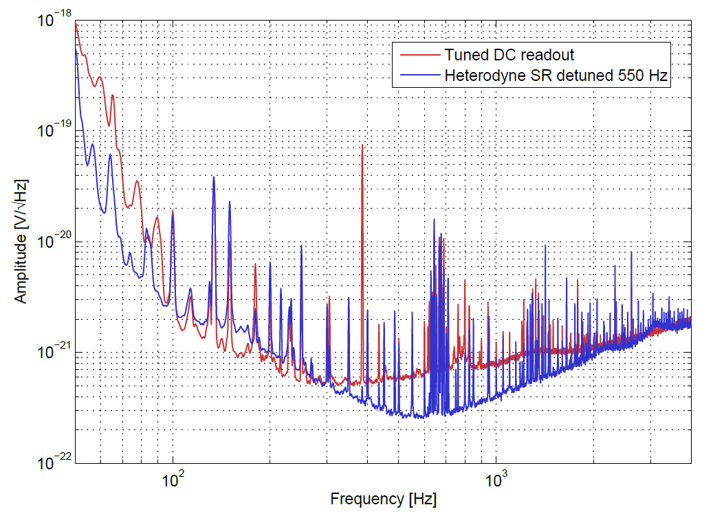
Recent DC-Readout vs. Heterodyne
Strain [1 / rt(Hz)]
Poster available:
Jerome Degallaix: Commissioning of the tuned DC readout at GEO600
Frequency [Hz]
Frequency [Hz]

Slide 9
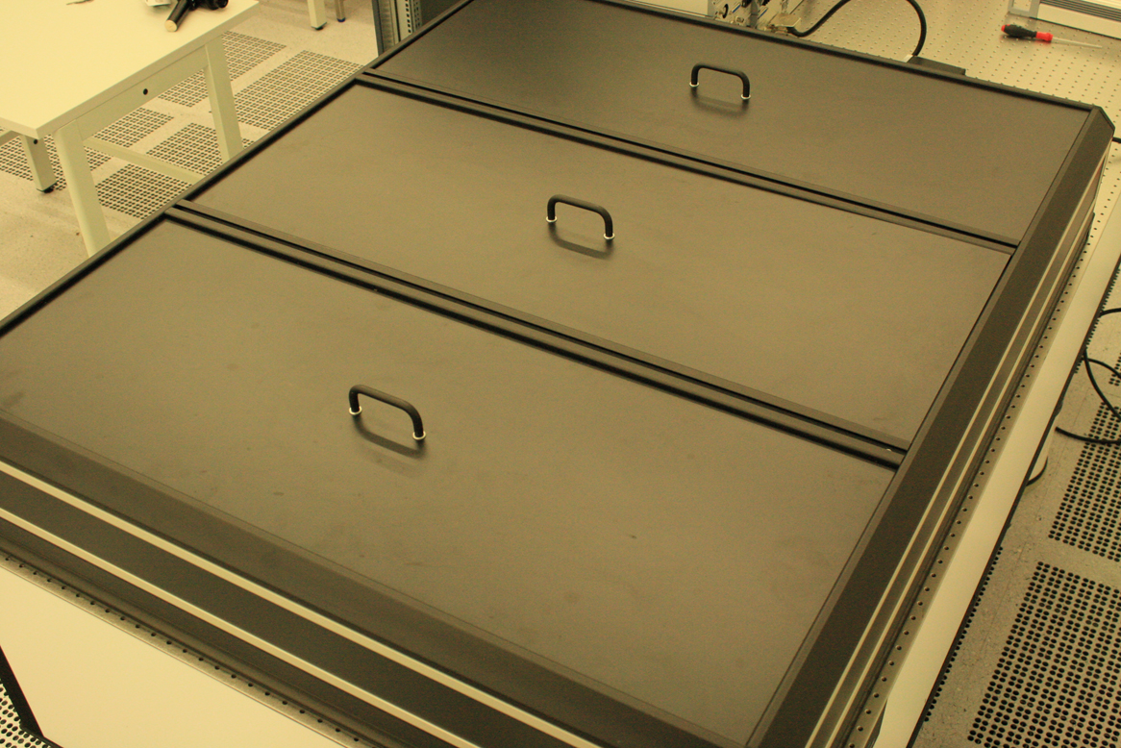
The Squeezing Black Box

Slide 10
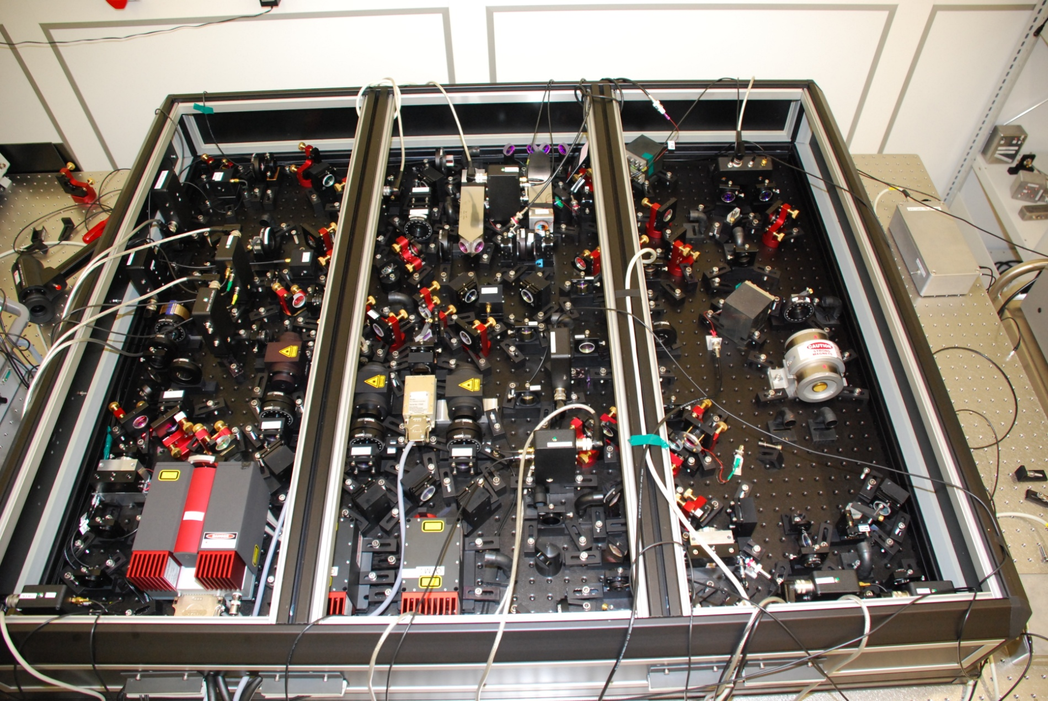
... inside

Slide 11
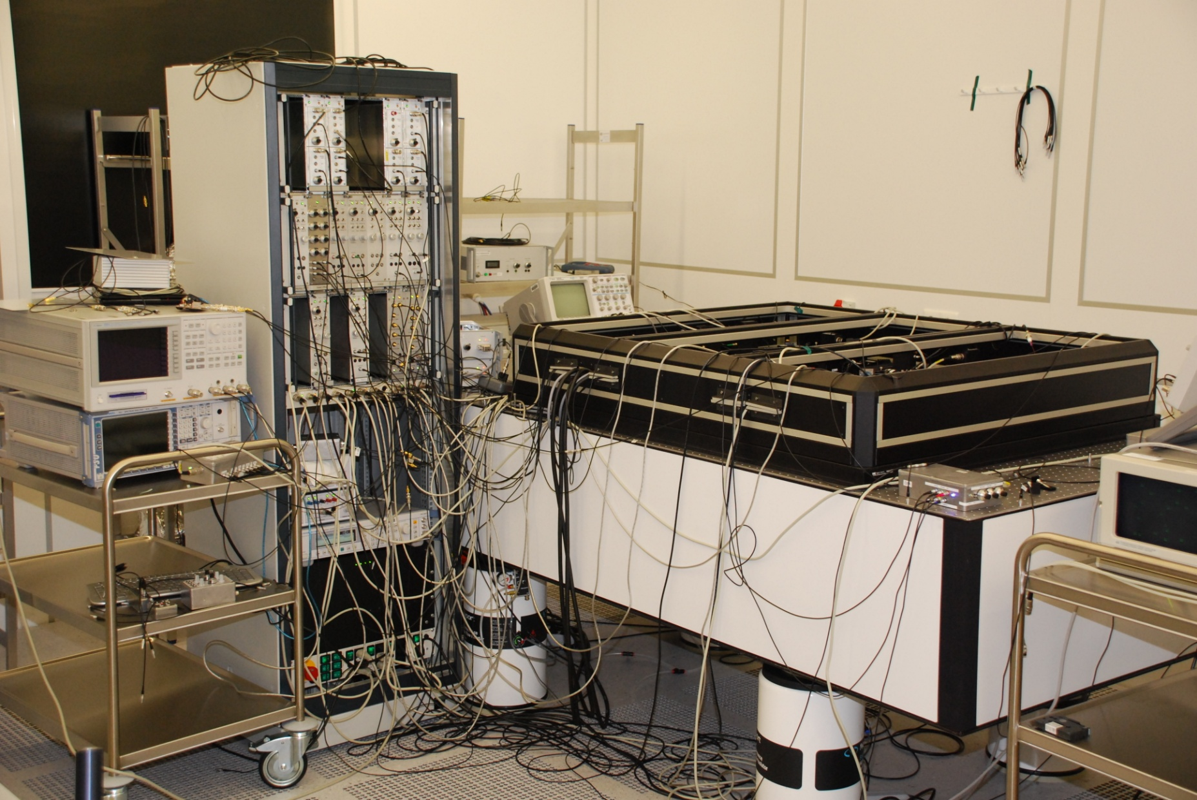
+ Control Electronics

Slide 12
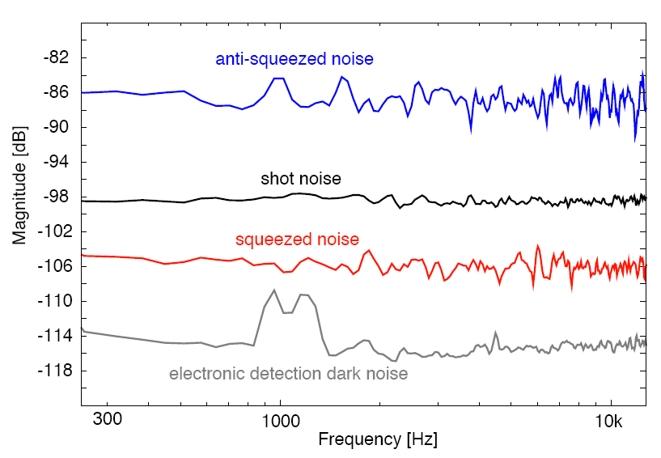
Initial Performance
8 dB
Henning Vahlbruch (Fri, 11:20):
Squeezed light for Gravitational Wave Astronomy

Slide 13
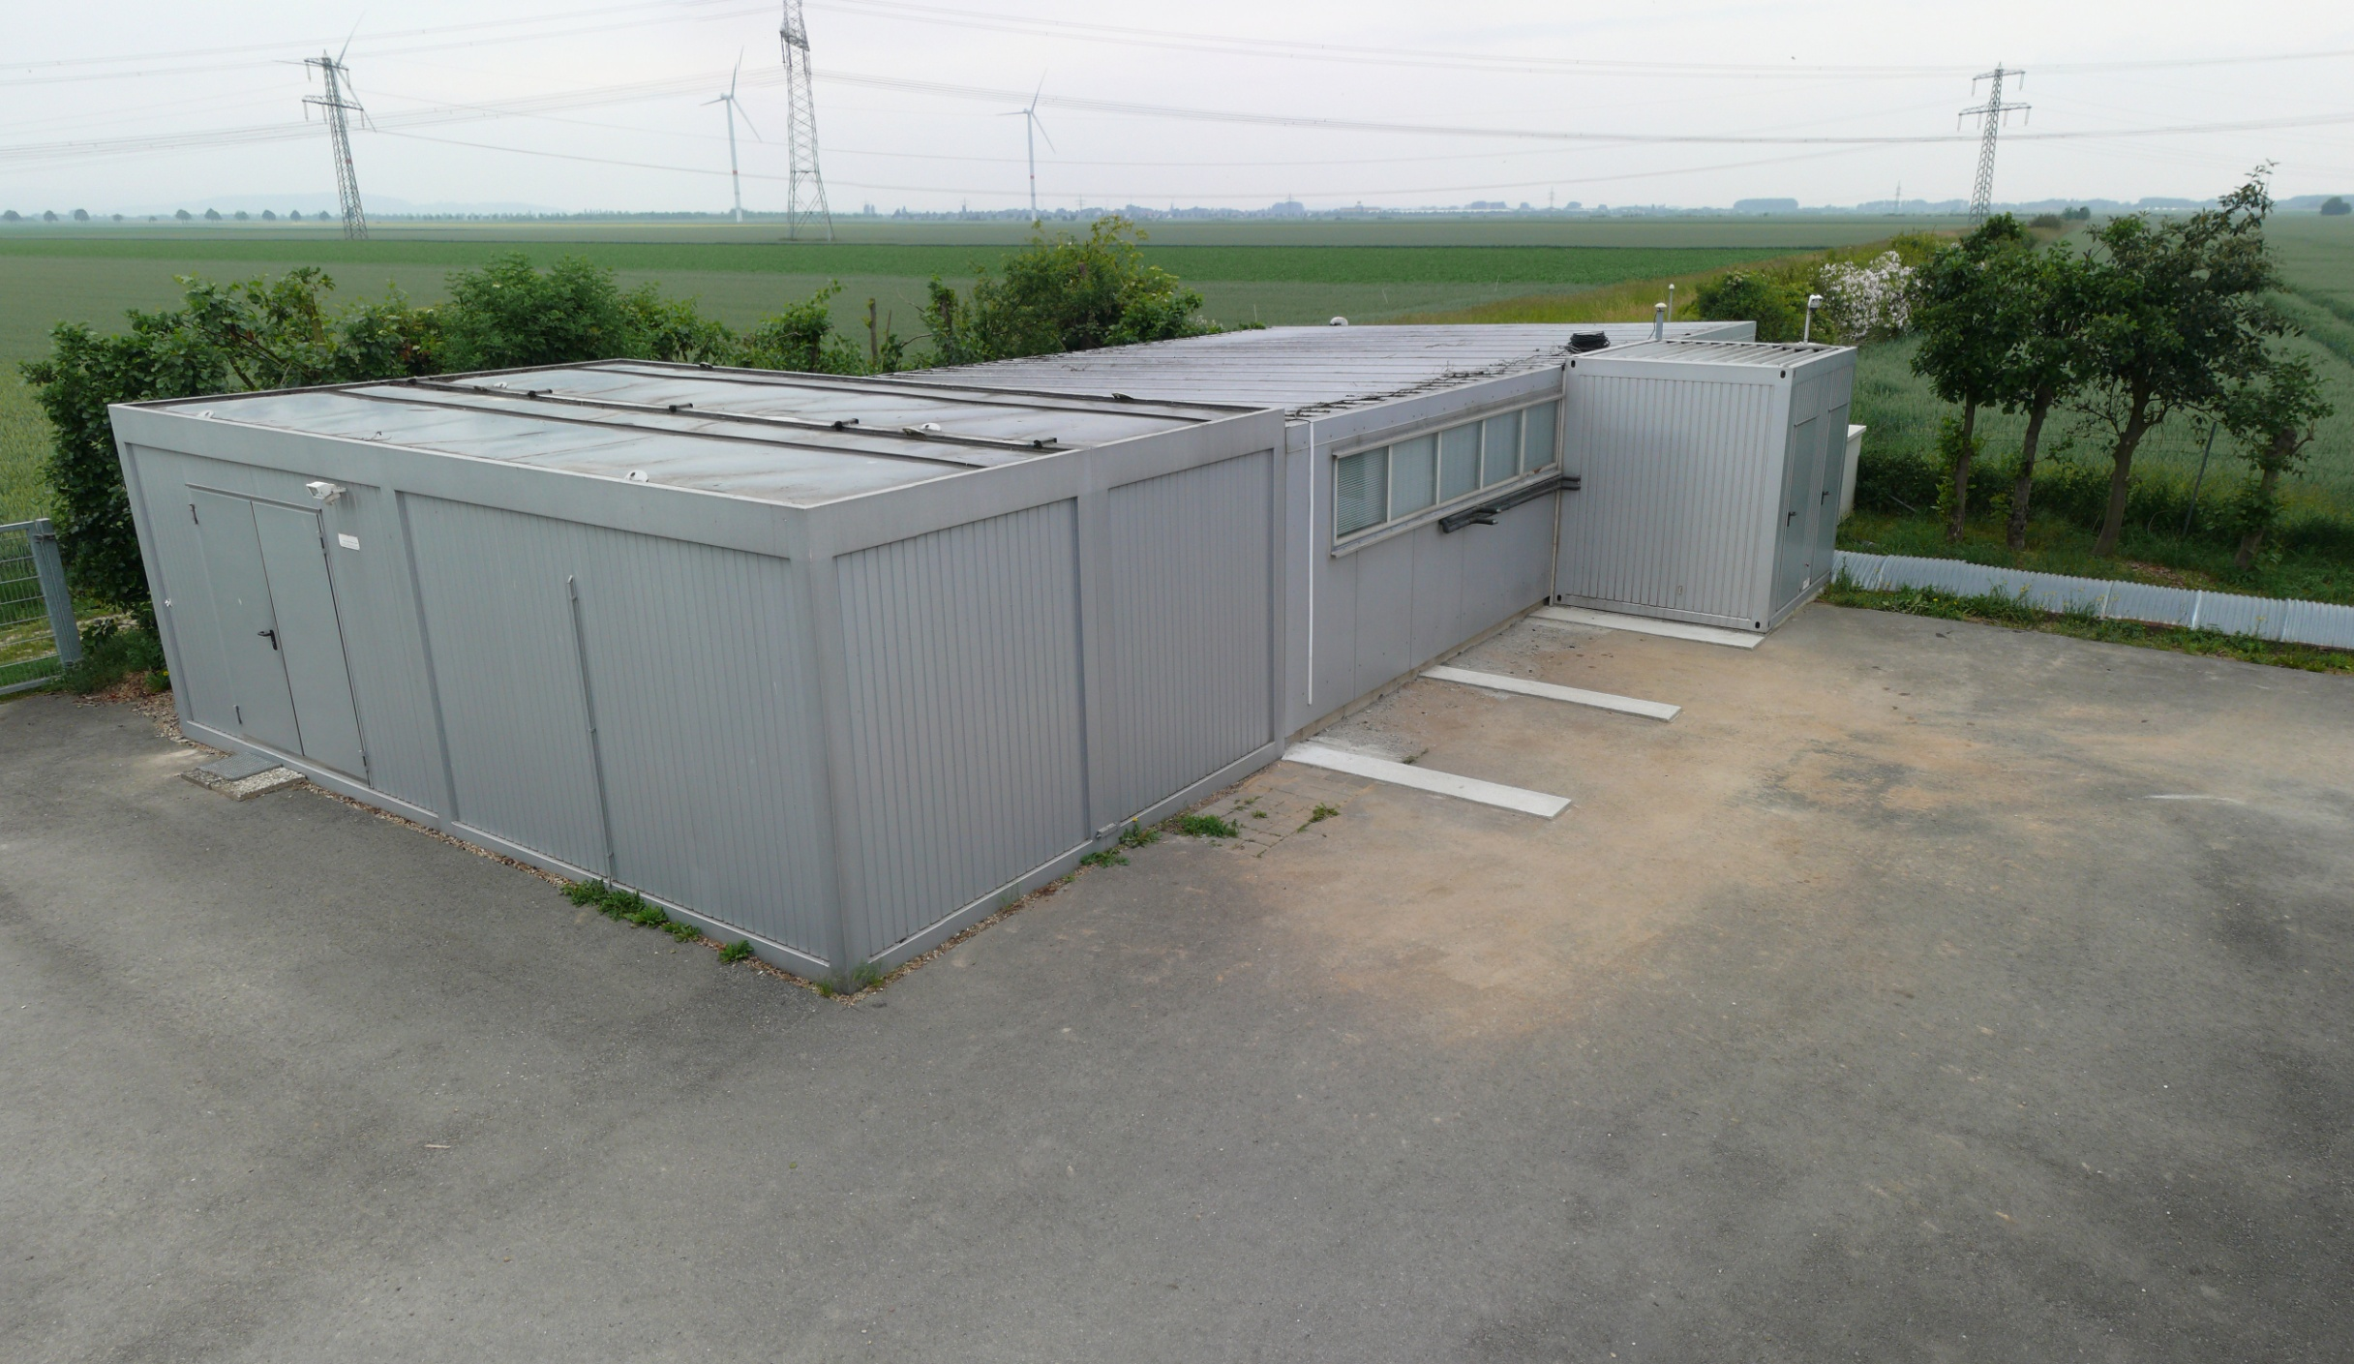
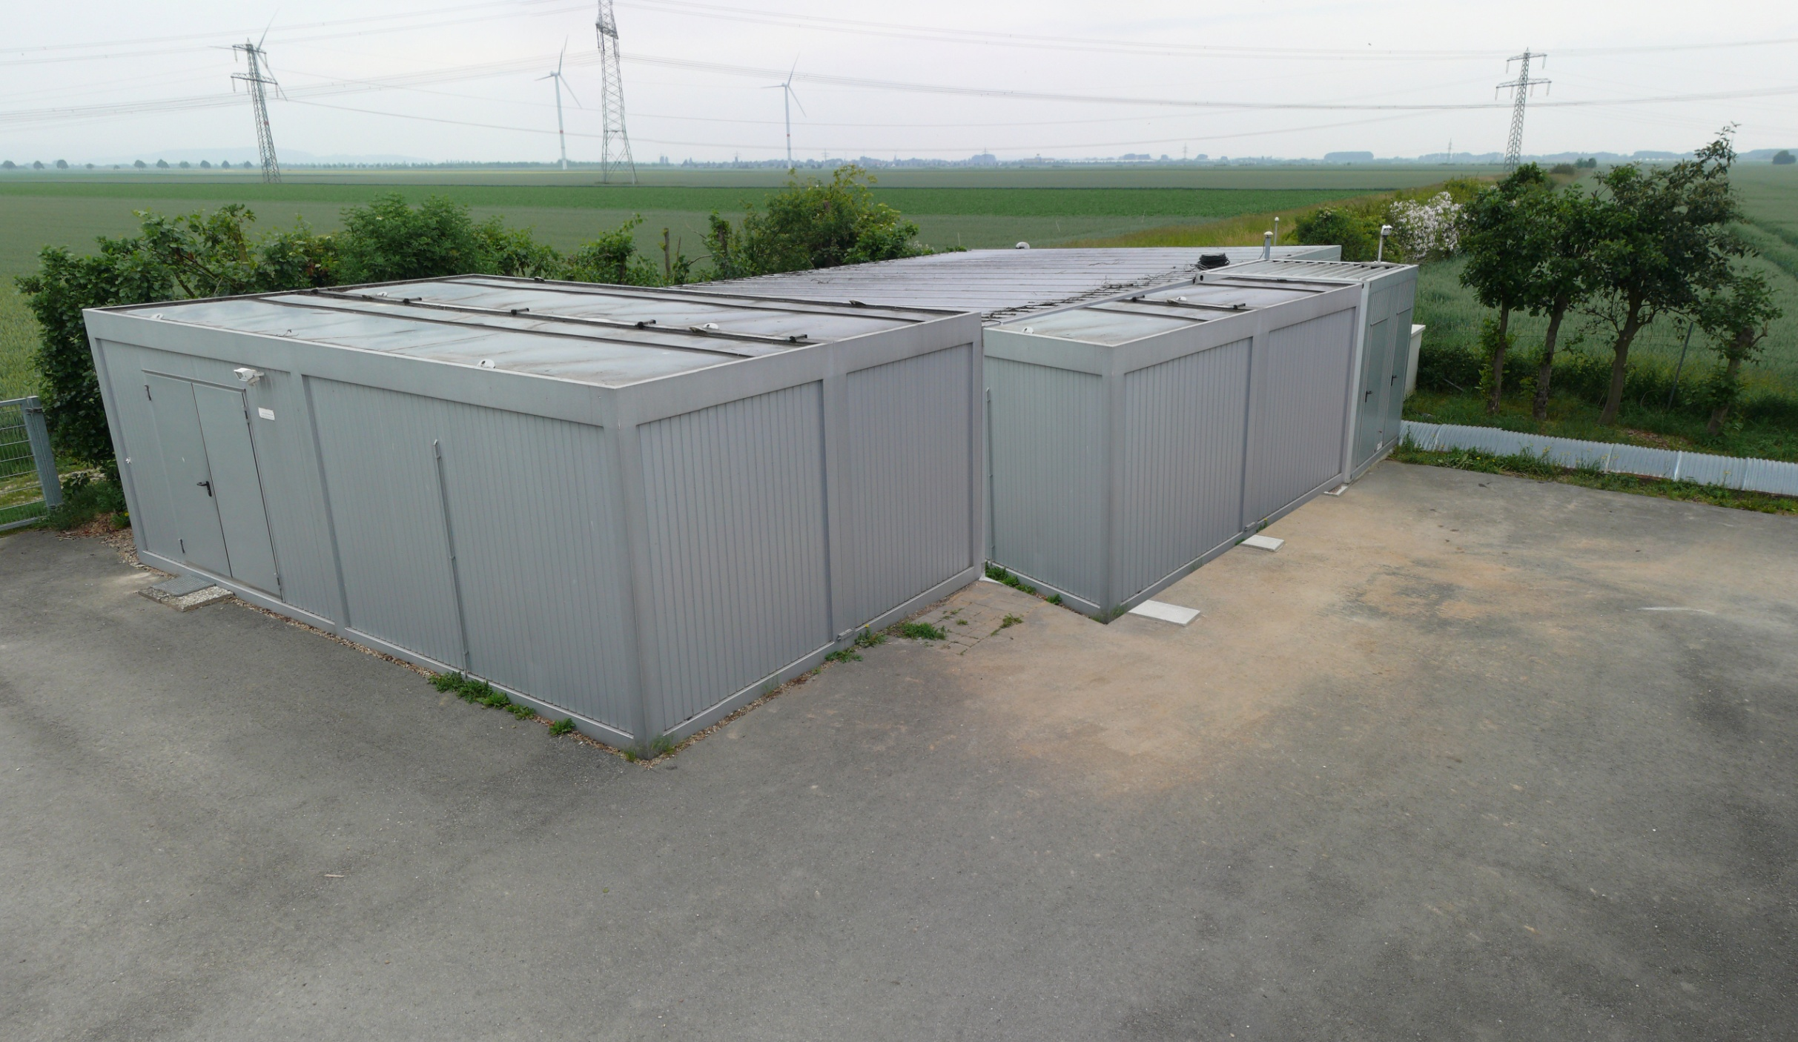
Extending the central building

Slide 14
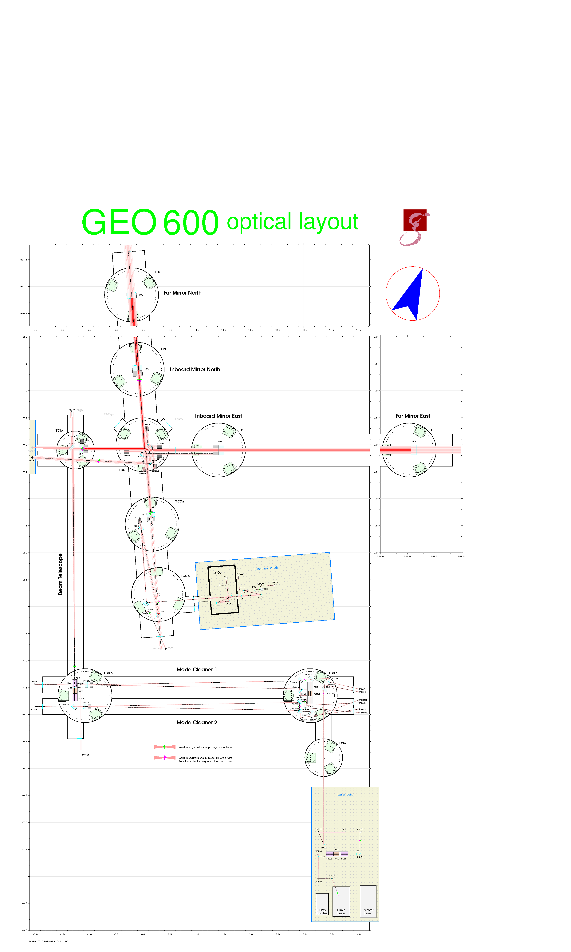
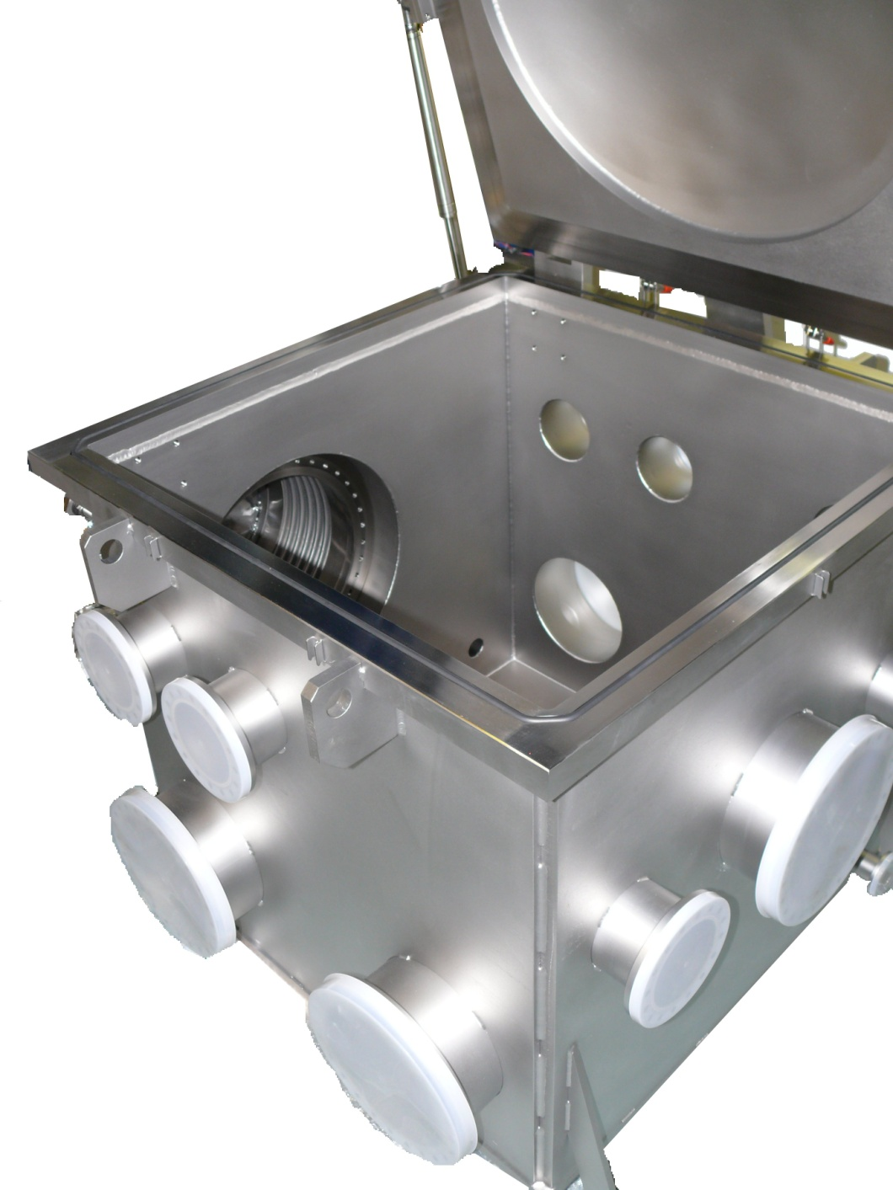
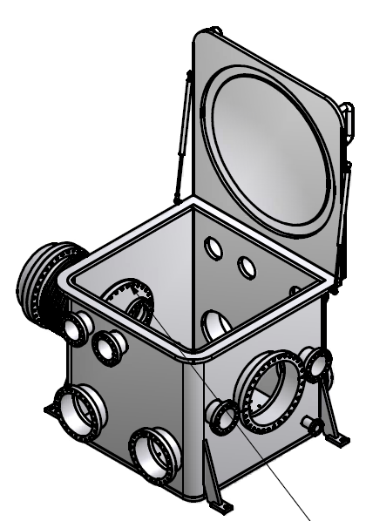
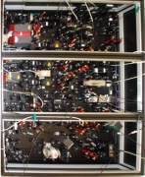
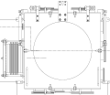
Detection Bench
Changes
Moved AA / Lock acquisition off Detection Bench
Shift / Rotate Detection Bench
Install new HV Vacuum tank

Slide 15
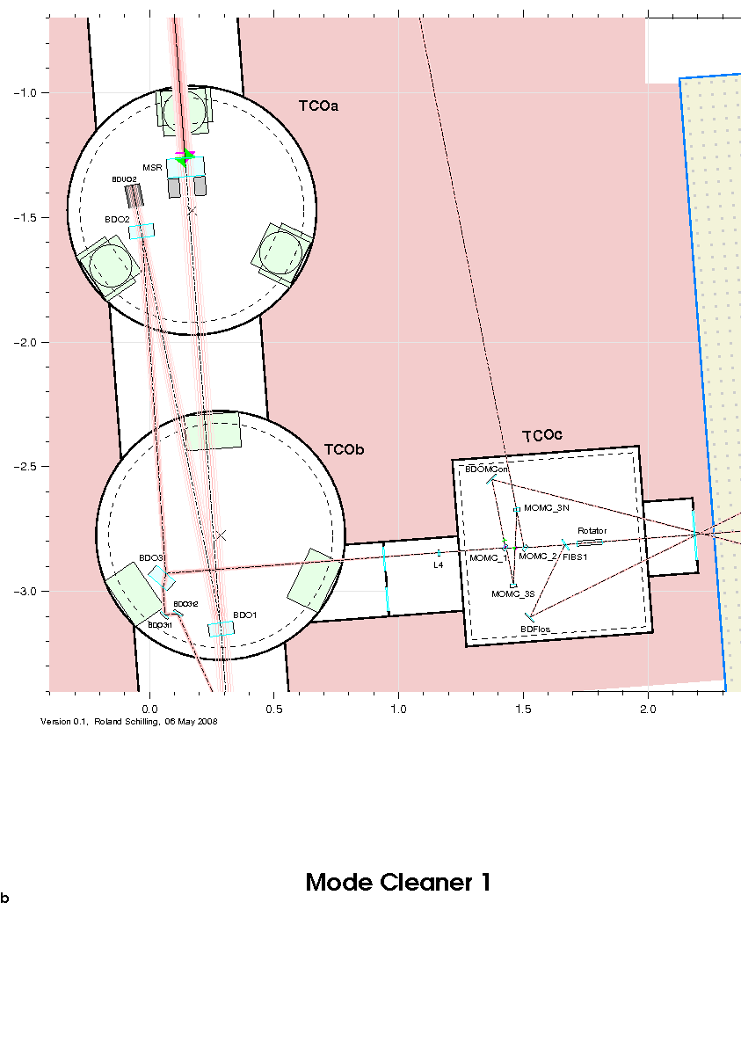
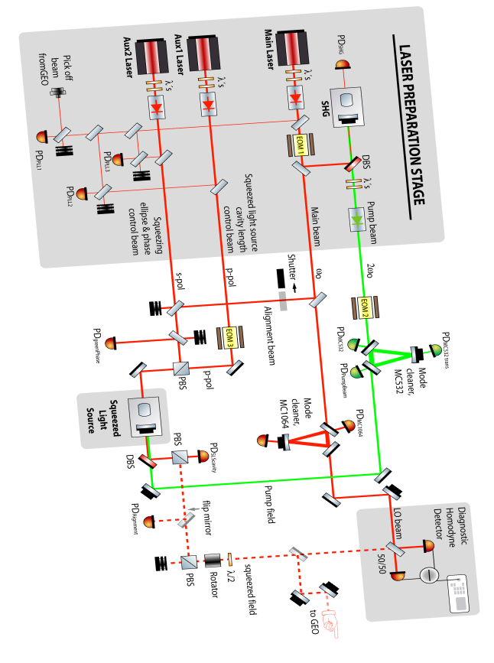
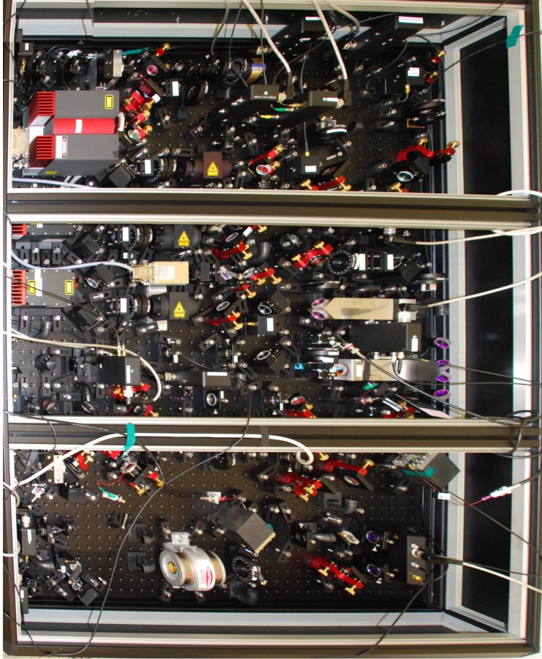
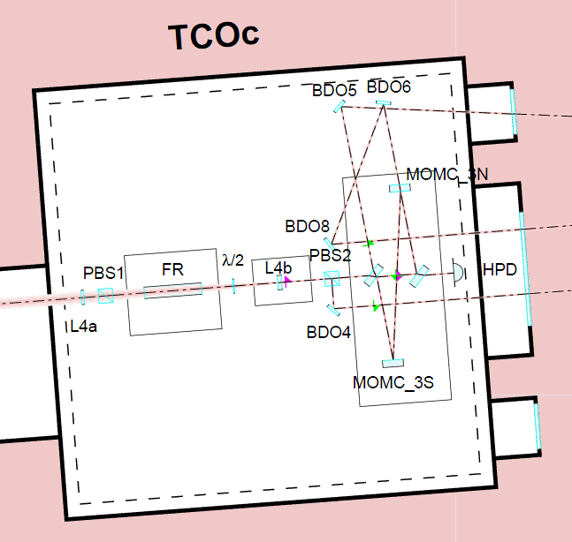
Poster available: Simon Chelkowski
How to inject a squeezed vacuum field into a gravitational wave detector
Frequency [Hz]

Slide 16
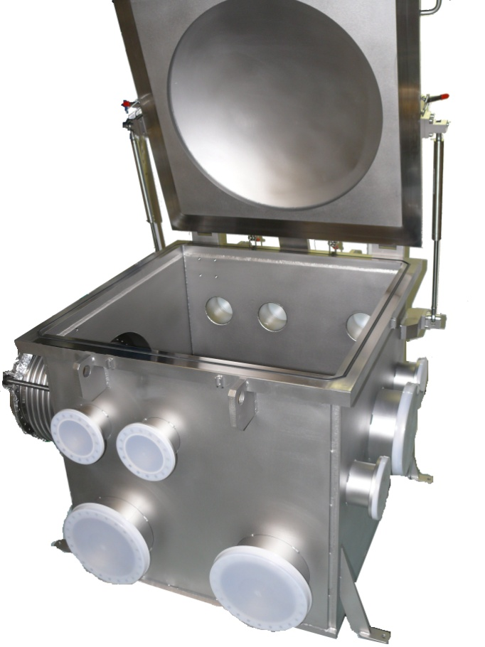
New Vacuum Chamber
Photo-Detector
Faraday
Rotator
OMC

Slide 17
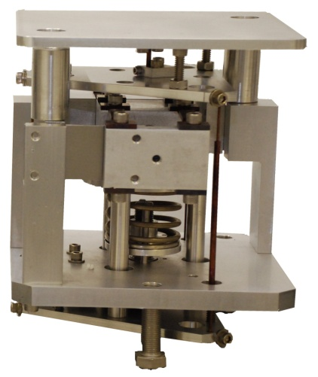
Vibration Isolation Inside TCOc
Minus-K Isolators
Stainless Steel plate ~80kg
Viton

Slide 18
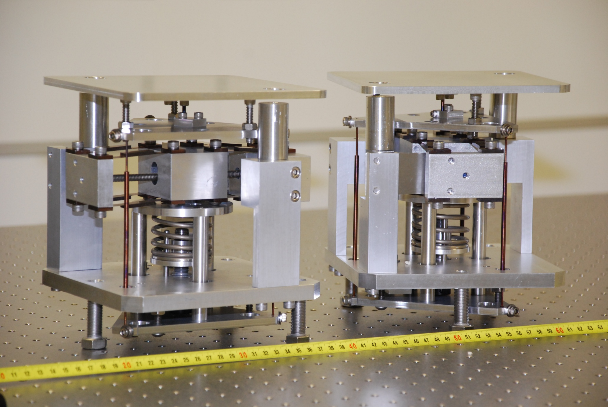
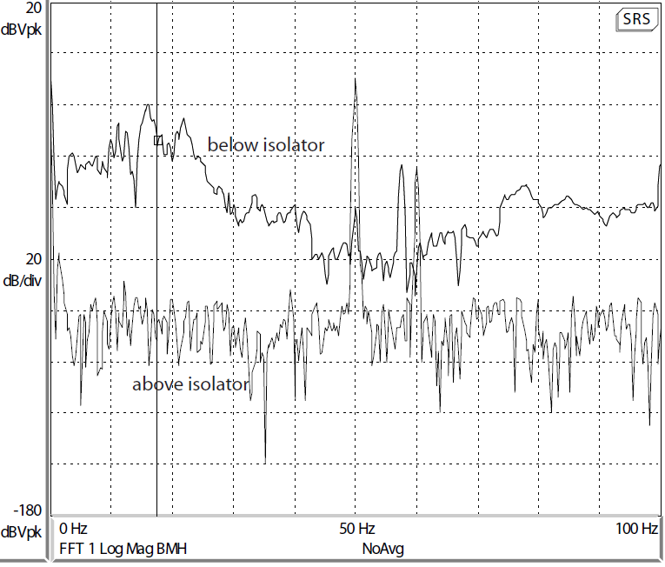
3D Seismic Isolators: ‚Minus-K‘
>40dB Isolation

Slide 19
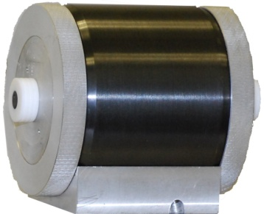
Inside TCOc
Payload + breadboard ~ 36kg
Faraday
Isolator
OMC
Payload
Aluminium breadboard +
Eddy current damping
Minus-K Isolators
Stainless Steel plate
Viton

Slide 20
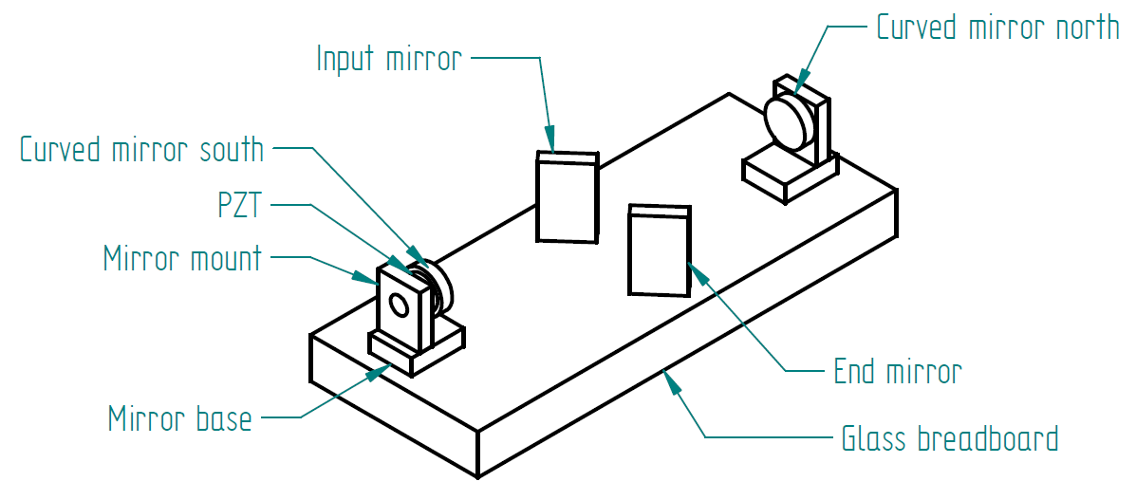
GEO - OMC
Finesse 150
Rejection of HOM and RF SBs power > 100

Slide 21
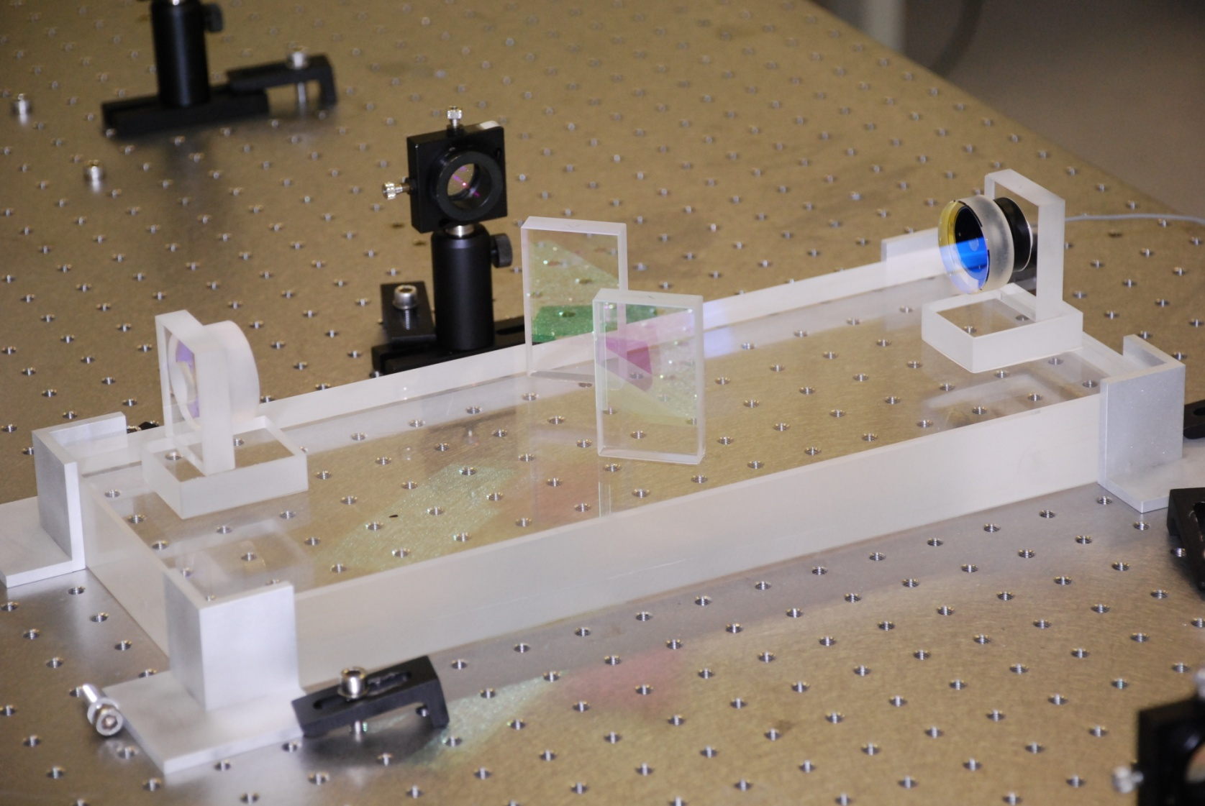
GEO - OMC
Finesse 150
Rejection of HOM and RF SBs power > 100

Slide 22
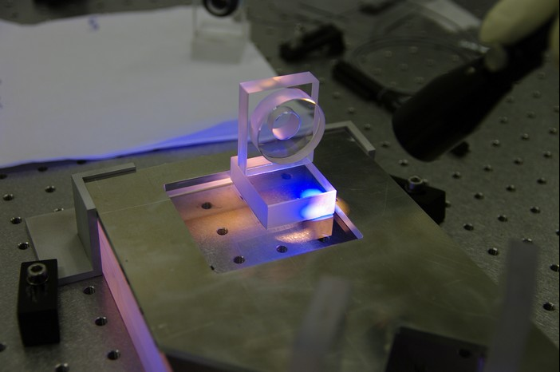
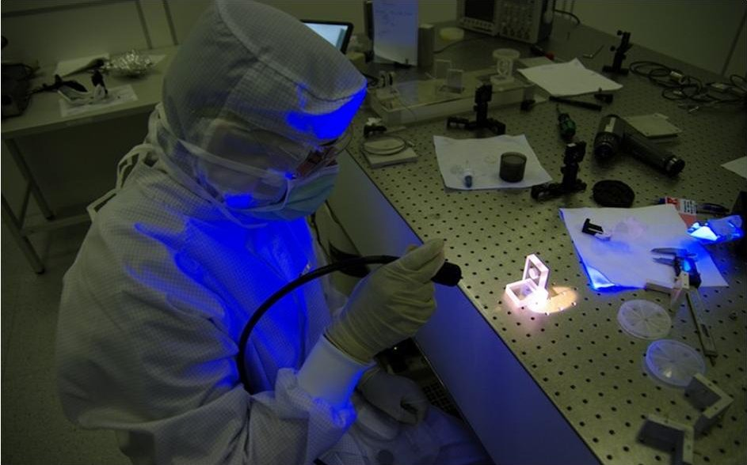
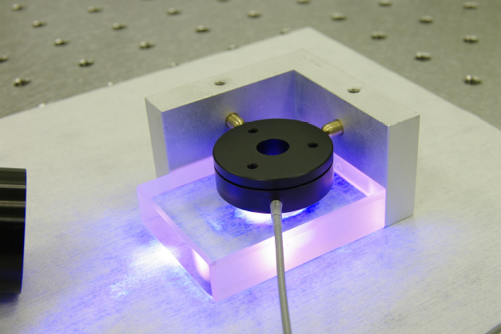
GEO - OMC

Slide 23
GEO - OMC
Poster available:
Mirko Prijatelj: Control and Automatic Alignment of the Output Mode Cleaner of GEO
Jerome Degallaix: Commissioning of the tuned DC readout at GEO600
Frequency [Hz]

Slide 24
Power increase
Decrease MC Finesse
  T= 0.1% -> T=0.8%
Increase Laser Power
  P=6W -> P=35W
  Increase Power into PRC by factor ~10
  Shadow Sensor Read-out
  DC -> AC

Slide 25
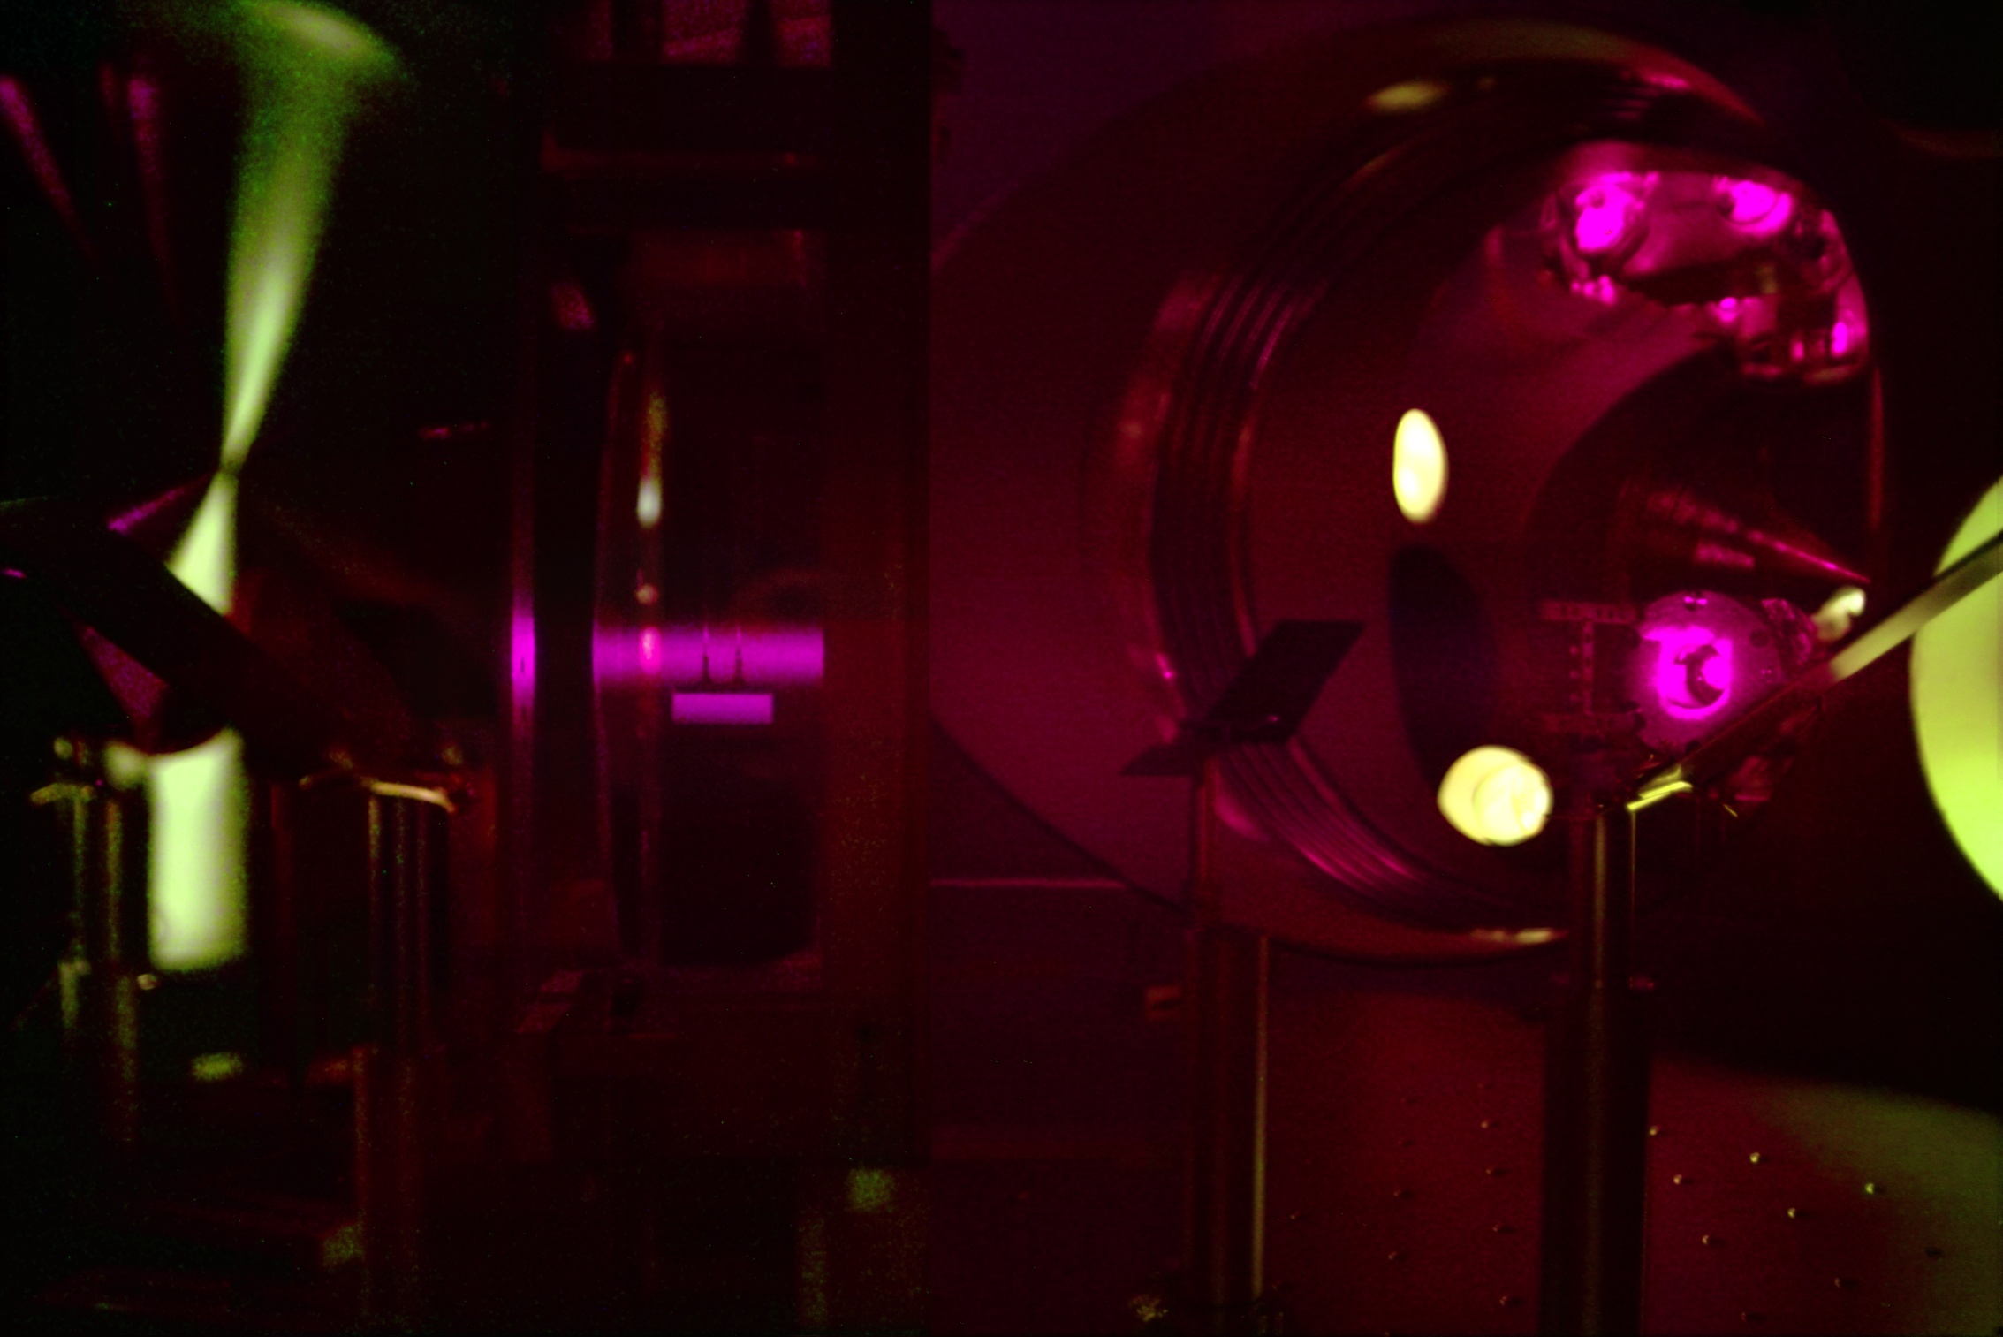
Shadow sensors @ high power

Slide 26
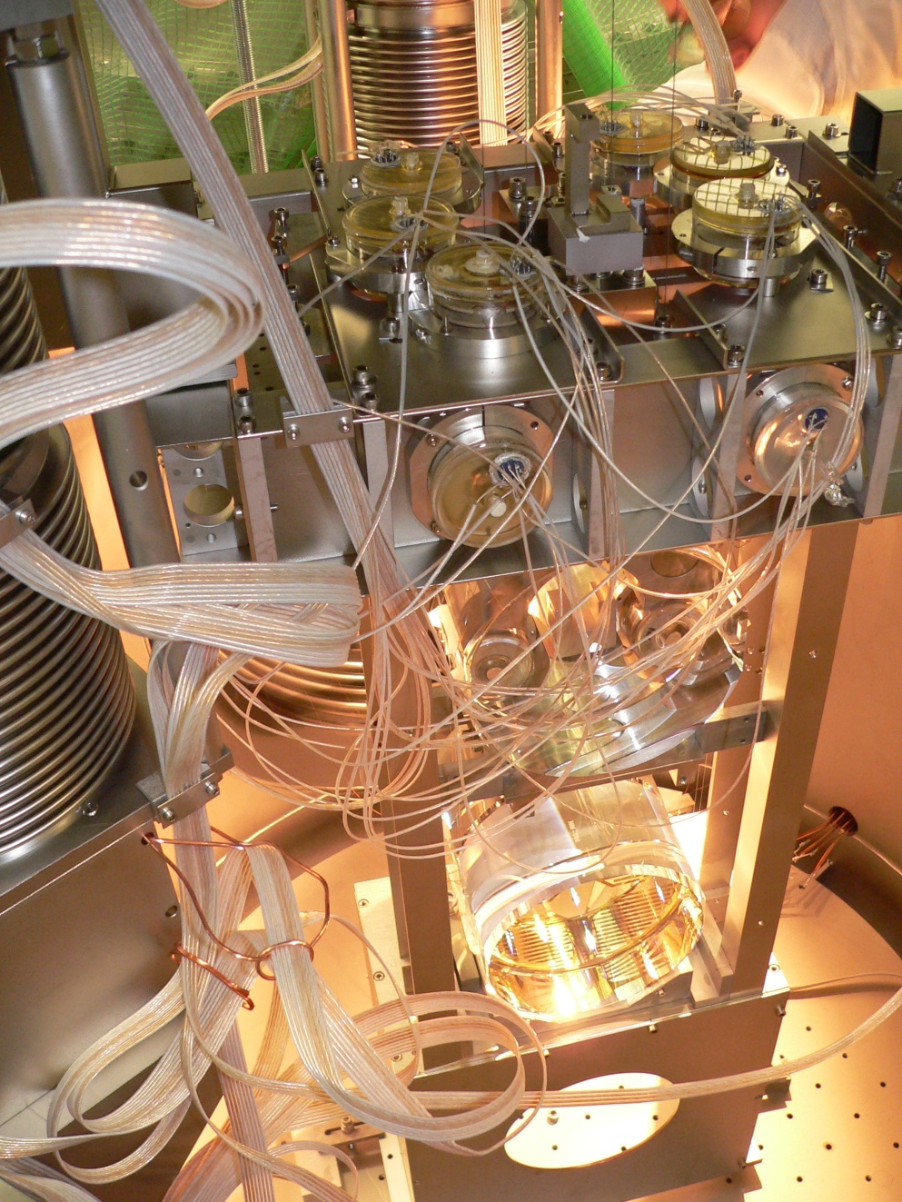
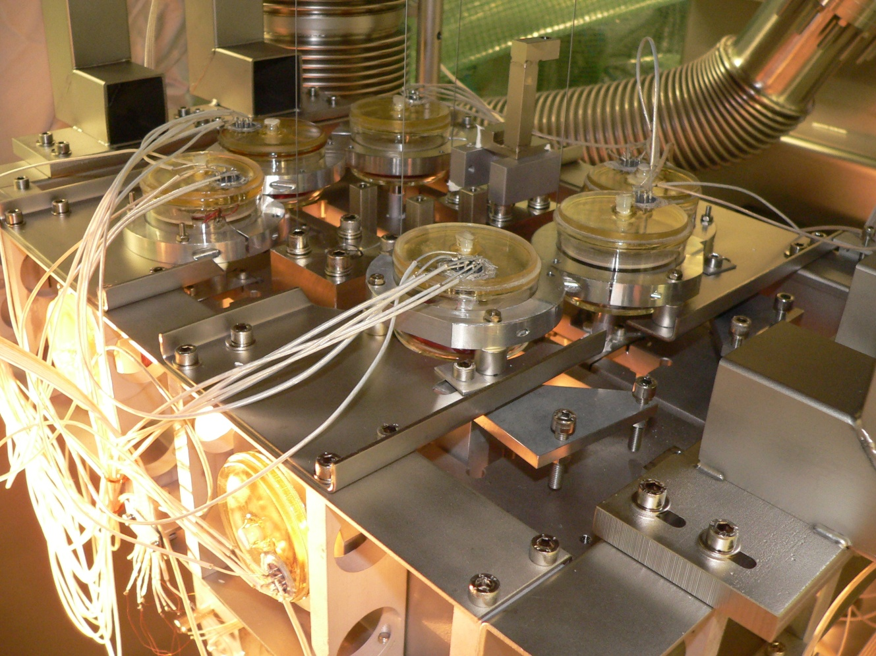
GEO Shadow Sensors change to AC operation

Slide 27
Thermal compensation

Slide 29
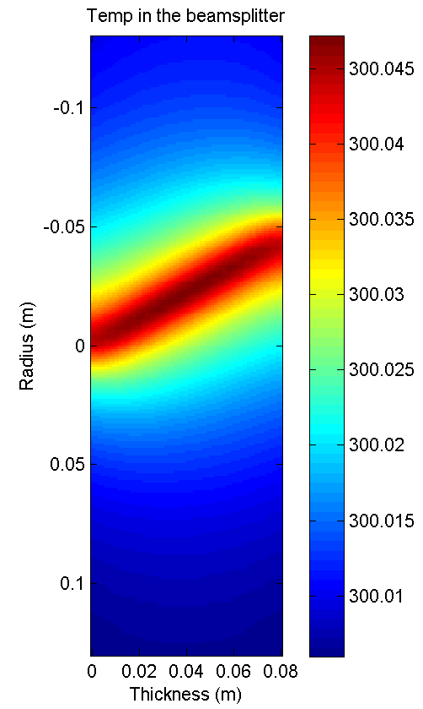
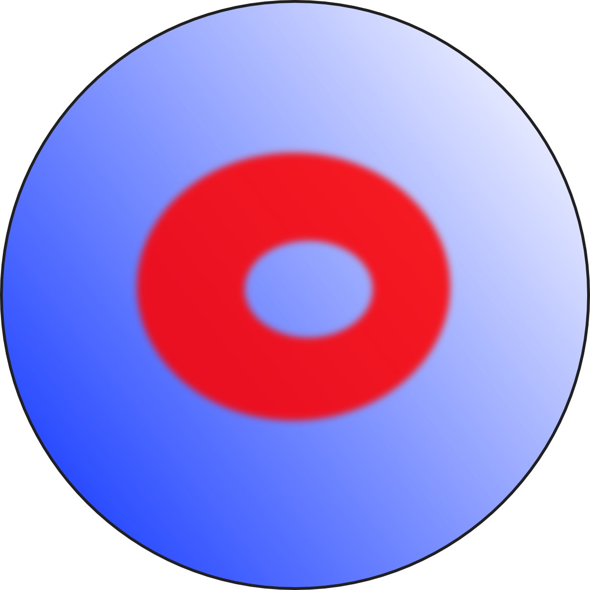
Thermal compensation
The Problem:
The Solution:
Heating the BS surface
Need about 10 W of heating power for full 25W of Laser power

Slide 30
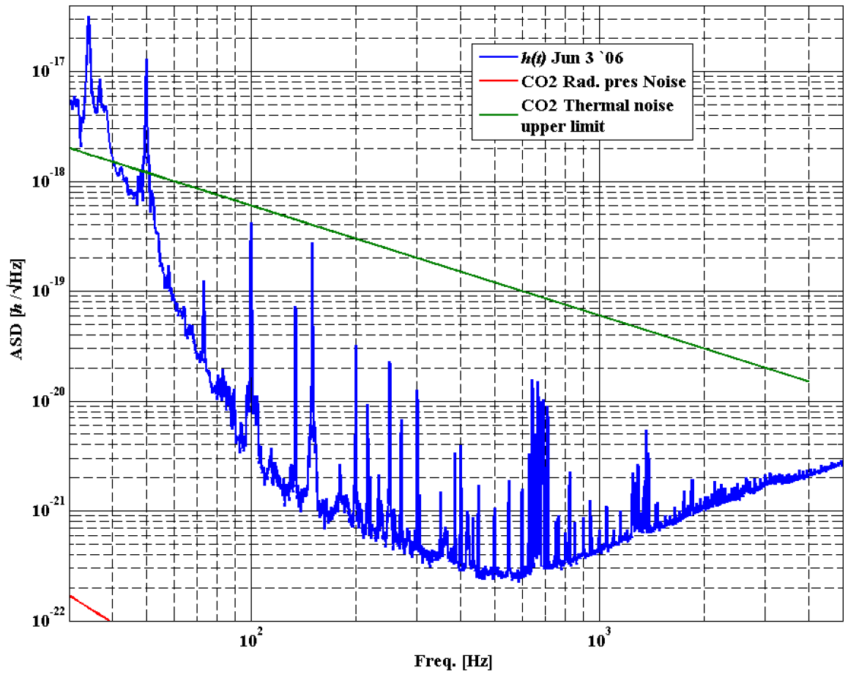
CO₂ Laser Intensity Noise
CO₂ RIN = 10⁻⁵ assumed, RIN required < 10⁻⁸

Slide 31
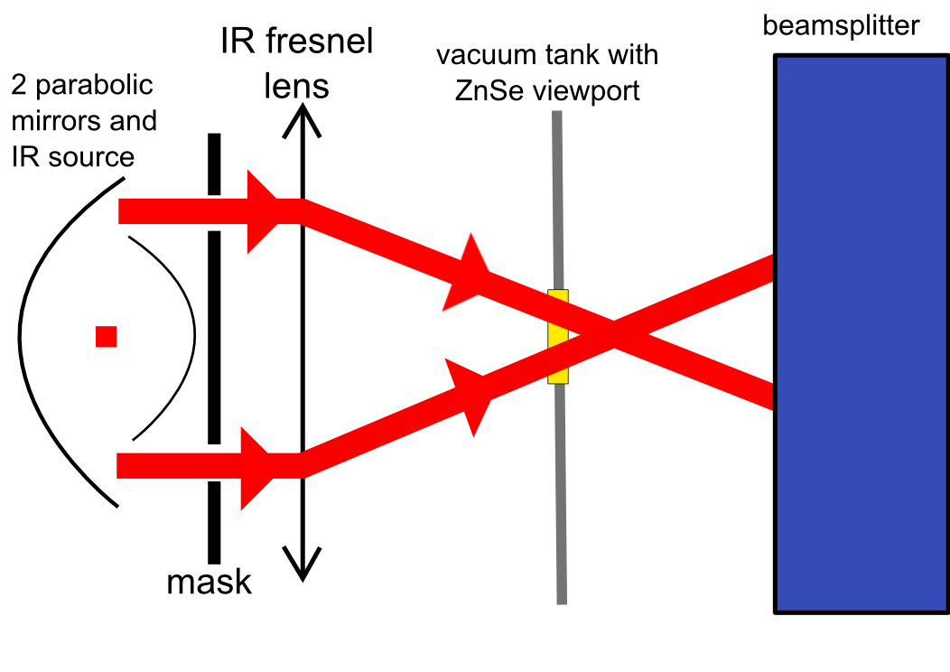
Thermal compensation

Slide 32
GEO-HF Sensitivities
DC readout, Tuned SR
BS Thermorefr.
Coating Br.

Slide 33
GEO-HF Sensitivities
DC readout, Tuned SR, 6dB Squeezing
BS Thermorefr.
Coating Br.

Slide 34
GEO-HF Sensitivities
DC readout, Tuned SR, 6dB Squeezing, MSR 10%,3.2W input
BS Thermorefr.
Coating Br.

Slide 35
GEO-HF Sensitivities
DC readout, Tuned SR, 6dB Squeezing, 2% MSR, 25W input
BS Thermorefr.
Coating Br.

Slide 36
GEO-HF Sensitivities
DC readout, Tuned SR, 6dB Squeezing, MSR 10%, 25W input
BS Thermorefr.
Coating Br.

Slide 37
GEO-HF Sensitivities
DC readout, Tuned SR, 6dB Squeezing, MSR 10%, 25W input
E-LIGO
BS Thermorefr.
Coating Br.

Slide 38
Various detunings + Squeezing
Notes:
Detuning MSR does not yield as much as might be expected as we will loose the benefit of squeezing outside the SR resonance

Slide 39
