Slide 1
Seismic attenuation, problems for Low Frequency underground Gravitational Wave Observatories
Riccardo De Salvo
Arianna Di Cintio
Maria Ascione
LIGO project, Caltech
Abhik Bhawal
Arcadia High School
Fabio Marchesoni
Universita di Perugia
LIGO-G0900521 Amaldi 2009

Slide 2
Seismic attenuation LF problem
Inconsistencies observed in Inverted Pendula and Geometric Anti Spring filters
Hysteresis, Random walk of equilibrium point, even Instability.
Manifested only at lower frequency
Not compatible with the commonly accepted viscous or loss angle description of dissipation

Slide 3
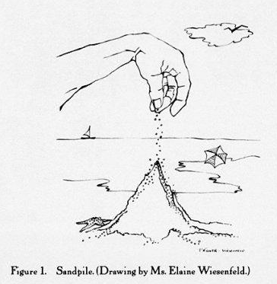
What happens at low frequency
Dislocations start acting collectively
Dissipation observed to switch
from “viscous”
to “fractal” Self Organized Criticality (avalanches)
Unexpected NEW physics
Excess LF noise
Reduced attenuation power
Is F-D theorem in trouble ?

Slide 4
Dislocation movements
Zipping happens plane by plane
An atom switches bond in a plane
The corresponding atom in the next plane responds with a delay
Dislocations form loose strings pushed and
tensioned by stress gradients
The strings glides zipping after zipping
Their motion is locally impeded (pinning)
by defects or by other dislocations

Slide 5
Self Organized Criticality (SOC)
The dislocation form a network that can shift
and rearrange in a self-organized pattern,
scale-free in space and time
Entangled dislocation contribute to elasticity (work hardening)
=> Disentangling dislocations subtract elasticity from the lattice
Disentangled dislocations generate viscous-like dissipation
Dislocations carry stress (plasticity)
=> Eventual re-entanglement of different patterns of dislocations generates static hysteresis
Per Bak 1996
How nature works: The Science of Self-Organized Criticality

Slide 6
Self Organized Criticality (SOC)
Movement of entangling dislocations is intrinsically Fractal
=> Does not follow our beloved linear rules ! !
=> Avalanches and random motion
Per Bak 1996
How nature works:
The Science of Self-Organized Criticality

Slide 7
The observational tool

Slide 8
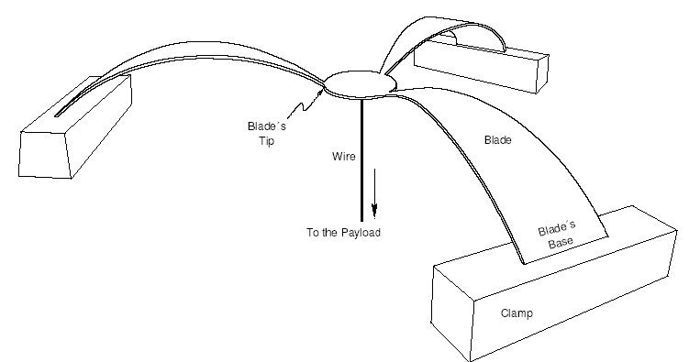
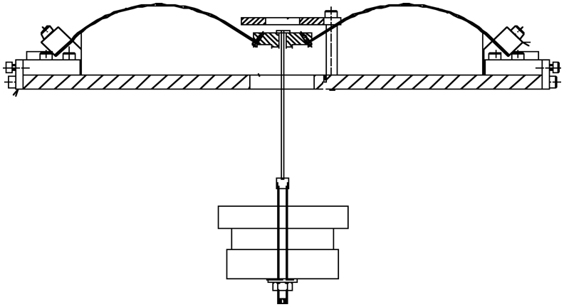
The GAS mechanism
(Geometric Anti Spring)
Radially-arranged Maraging blades clamped to a frame ring.
Radial compression produce the Anti-Spring effect
(Vertical motion produces a vertical component of the compression force proportional to the displacement)
The GAS mechanism nulls up to 95% of the spring restoring force
EMAS mechanism do the last 5%
(Electro Magnetic Anti Springs)
Our “microscope” to observe
Low frequency effects
60 cm
65 kg

Slide 9
The evidence

Slide 10
Hysteresis without actual movement
Overnight lab thermal variations
No feedback, free movement
Thermal hysteresis of equilibrium point
LVDT [mm]
Temperature [ºC]

Slide 11
Hysteresis without actual movement
Overnight lab thermal variations
No feedback, free movement
Thermal hysteresis of equilibrium point
Position feedback on
No actual movement, expect no hysteresis
Hysteresis shifts to the control current ! !
LVDT [mm]
Actuator force [mN]
Temperature [ºC]
Temperature [ºC]

Slide 12
Hysteresis without actual movement
Overnight lab thermal variations
No feedback, free movement
Thermal hysteresis of equilibrium point
Position feedback on
No actual movement, expect no hysteresis
Hysteresis shifts to the control current ! !
LVDT [mm]
Actuator force [mN]
Temperature [ºC]
Temperature [ºC]
Hysteresis does not originate from the macroscopic movement but from a microscopic stress dynamics inside the material!

Slide 13
To explore the effects of hysteresis at various frequencies
frequency 0.21 Hz (>0.2Hz)
We apply a force lifting the spring to a certain height, then cut the force and let the system oscillate freely:
NO HYSTERESIS OBSERVED
Subjecting the system to the same force, but
slowly returning the lifting force to zero, thus generating no oscillations:
HYSTERESIS OBSERVED FOR ALTERNATE SIGN EXCITATION
NO HYSTERESIS FOR SAME SIGN EXCITATION
OSCILLATIONS APPEAR TO WASH-OUT HYSTERESIS

Slide 14
Hysteresis grows much larger at lower frequency
frequency 0.15 Hz (<0.2Hz)
OSCILLATIONS APPEAR to be ineffective TO WASH-OUT HYSTERESIS at low frequency: not enough oscillations to delete hysteresis
Proposed explanation:
below 0.2 Hz the restoring force is dominated by entangled dislocations.
Under pulsed stresses dislocations mobilize and eventually re-entangle elsewhere generating a different equilibrium position.
Explaining the observed hysteresis.

Slide 15
Quality factor measurement
METHOD
Change the frequency with the EMAS mechanism
Acquire ringdowns
Measure Q = ωτ
the expected behavior is quadratic
if the losses are frequency independent

Slide 16
Quality factor measurement
The fast increase of Q-factor implies reduced losses at higher frequencies
explainable if the dissipation process needs long time to develop:
AVALANCHES NEED LONG TIME TO DEVELOP
The deviation from quadratic was fit with an exponential function accounting for the
exponential growth of avalanches with time

Slide 17
Transition between fractal and viscous
20,000
the exponential fit
reaches the free blade
Q-factor (>10⁴ )
before 0.5 Hz ! ! ! .

Slide 18
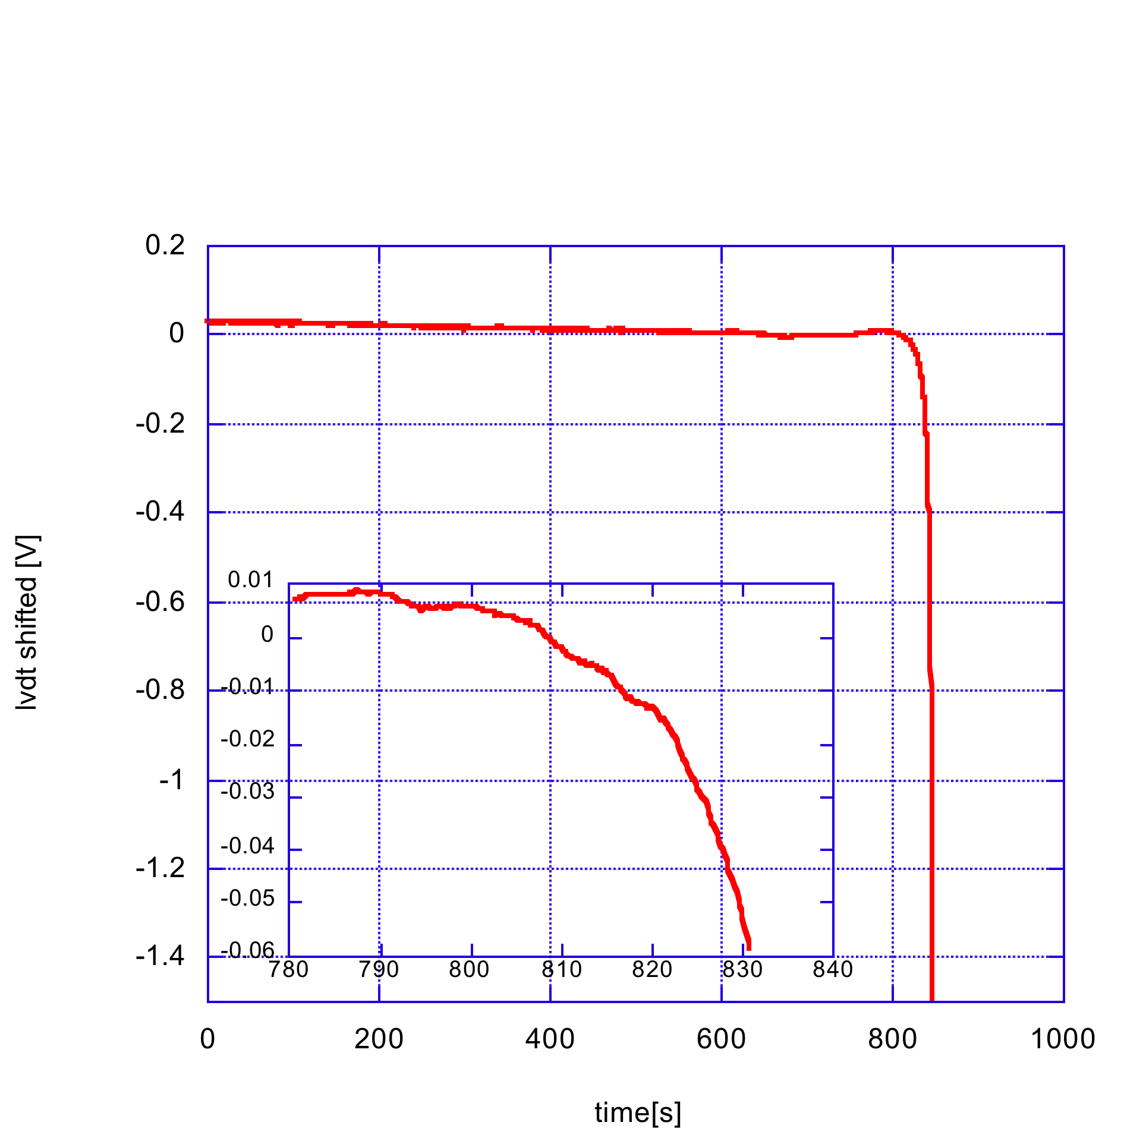
Low frequency instability
Some suddenly-activated mechanism occurs inside the blade
The filter abandons the equilibrium position slowly,
then accelerates away
The time scale is of many seconds
The acceleration is “bumpy” due to individual avalanches
Avalanches propagate across the entire 38 cm blades

Slide 19
Low frequency instability
65 kg payload can fall indifferently up or down
NO CREEP,
NO GRAVITY DRIVEN EFFECT
instability region μm
starting from ~ 0.2 Hz

Slide 20
Frequency deficit vs. oscillation amplitude

Slide 21
Interpretation
Motion disentangles some dislocations
Number proportional to amplitude
Restoring force contributed by entangled dislocations diminishes

Slide 22
Analyzing ring-downs.
damping time τ growing for smaller oscillation amplitude
Proposed explanation: larger oscillations can disentangle more dislocations, which then move freely and cause increased dissipation and shorter damping times.
Excess Dissipation at larger oscillation amplitude

Slide 23
Fitting the data with
we found an amplitude exponent of ~ 0.5
Power law, => fractality
Same behavior in the frequency domain

Slide 24
explanation
Dislocations disentangled by motion
lead to increased dissipation

Slide 25
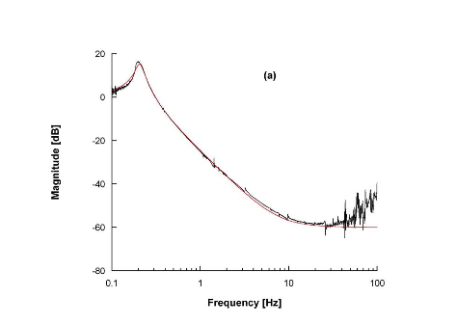
Transfer function of a GAS-filter
Experimentally found
Stationary and Unexpected 1/f
Transfer Function has been found when the GAS filter was tuned
at or below 100 mHz
Fractal dynamics predicts 1/f noise
The SAS seismic attenuation system for the Advanced LIGO Gravitational Wave Interferometric Detectors. A.Stochino et al., 2008

Slide 26
Conclusions
Static hysteresis was the first indicator of something funny inside the materials.
Hysteresis, run-offs, changing Young’s modulus,
changing damping constants, the 1/f GAS filter TF, and several other surprising effects can be explained in terms of SOC dynamics of entangled/disentangled dislocations.
An avalanche dominated 1/f noise is expected at low frequencies.
The behavior observed in Maraging blades may actually be typical of most polycrystalline metals at sufficiently low frequencies.

Slide 27
Work to do
New materials and processes need to be explored to design the seismic isolation of third generation, lower frequency GW interferometers
And to better control the mechanical noise of those presently under construction.
Glassy materials that do not contain dislocations or polar compounds that do not allow dislocation movement are
candidate materials for seismic attenuation filters and inertial sensors
Maybe refrigeration or cryogenics would impede SOC dislocation noise
Dislocation movement impede fragility => we want to avoid their movement => fragility may be an unavoidable effect

