Slide 1
Absolute Length Measurement of the Caltech 40 Meter Interferometer's Optical Cavities
Alberto Stochino, Koji Arai, Yoichi Aso, Rana Adhikari

Slide 2
Motivations
Why Size Does Matter
Cavity Characterization
Optics metrology
Thermal Lensing Effects
Cavity and IFO More Accurate Modeling
Cavity response to sidebands
Higher Order Mode Resonances Localization
Support to Lock Acquisition
Finer IFO Tuning
Suspension Positioning
Sideband Frequencies
Demodulation Phases
Possible Effect of Length Detuning on DARM Noise
Sideband Imbalance Induced by the Recycling Cavities
Sideband Intensity noise
Frequency noise

Slide 3
Interferometric Length Measurement
From the phase difference Φ between the incident and the returned light at distance L:
E_{inc}
E_{ref}
N = # wavelengths in the round-trip optical path
An RF Modulated Field Makes easier to measure Φ and N for macroscopic distances L
Resolution
For higher accuracy
Fabry-Perot Cavity
Notes:
The Interferometric Technique works only with interfering AM modulated field. Even when the field is phase modulated, the final product that we look at is an AM modulated field,

Slide 4
Fabry-Perot Cavity
Fabry-Perot Cavity
L
E_{trans}
E_{inc}
E_{ref}
R₁
R₂
TEM₀₀ Mode Resonances
Free Spectral range
Cavity Reflectance

Slide 5
FP Cavity Accuracy Enhancement
For ν_{m} near a cavity resonance:
Since around the resonance
Cavity Finesse
Notes:
Remember this is a general reasoning. It is not dealing either with the modulation mechanism, nor with the one

Slide 6
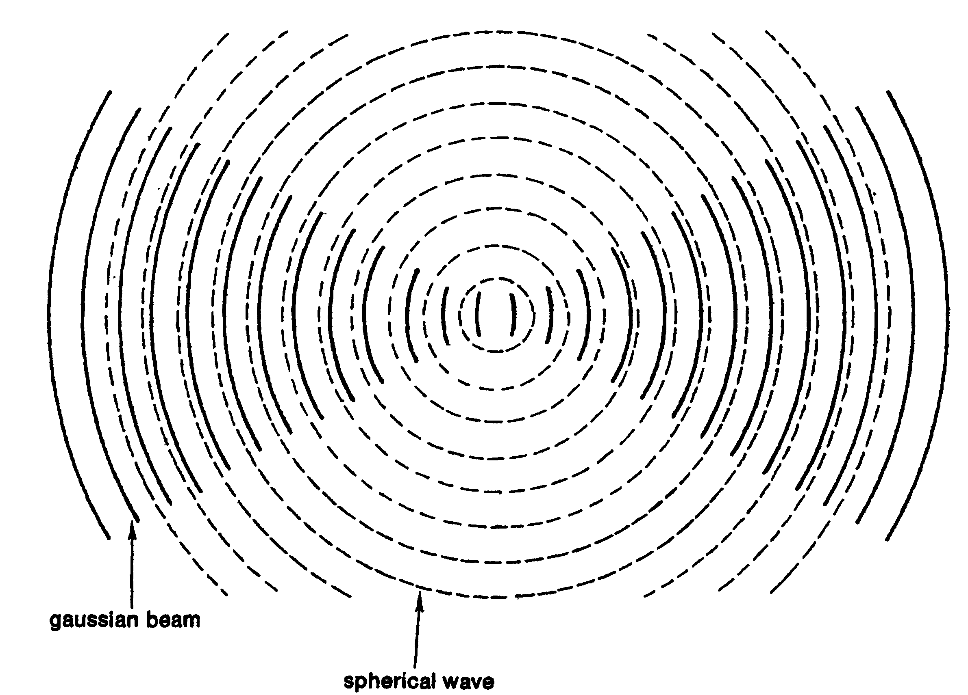
Transverse Mode Spacing
Beams: Hermite-gaussian representation
Phase Longitudinal Evolution
Guoy Phase
Resonant Condition in a Fabry-Perot Cavity
Transverse Mode Spacing
g-factor

Slide 7
Absolute Length Measurements in GWID (1)
TAMA, Japan
A. Araya et al, Applied Optics 38 (1999) 2848-2856, “Absolute-Length Determination of a Long-Baseline Fabry-Perot Cavity by Means of Resonating Modulation Sidebands”
RF Phase Modulated field
Cavity locked to both carrier and sidebands:
to the carrier with an auxiliary RF modulation frequency
to the sidebands by acoustic modulation of the sidebands and double demodulation PDH extraction
The PDH signal provides a way to measure the phase lag that one sideband accumulates inside of the cavity ν_{m}
Very accurate, but complex and not possible “online”

Slide 8
Absolute Length Measurements in GWID (2)
LHO 2k, 2000
FSR measured by tuning the sidebands frequency to complete anti-resonance when the carrier is locked.
(The anti-resonance is detected when a dip appears in the power spectrum at the AS port ‘s PD. A confirm comes from swinging one of the cavity mirror; the two sidebands’ doublet fringes fade into only one). Accuracy 10⁻⁹
(B. Kells, elog 12/7/00; LIGO doc G010255-00)
LHO 4k
Measurements of transfer functions by sweeping the sideband modulation frequency before the Mode Cleaner. Accuracy:
longitudinal mode spacing 2x10⁻⁸, transverse mode spacing 2x10⁻⁸
M. Rakhmanov et al, Class. Quantum Grav. 21 (2004) S487-S492, “Characterization of the LIGO 4 km Fabry.Perot cavities via their highfrequency dynamic responses length and laser frequency variations”
R. Savage et al, LSC Meeting on March 2005, LIGO document G050111-00, “Summary of recent measurements of g factor changes induced by thermal loading in theH1 interferometer”
R. Savage et al, Poster in 6th Edoardo Amaldi Conference (2006), LIGO document G050362-00, “Measurement of thermally induced test mass surface curvature changes in a LIGO 4-km interferometer”

Slide 9
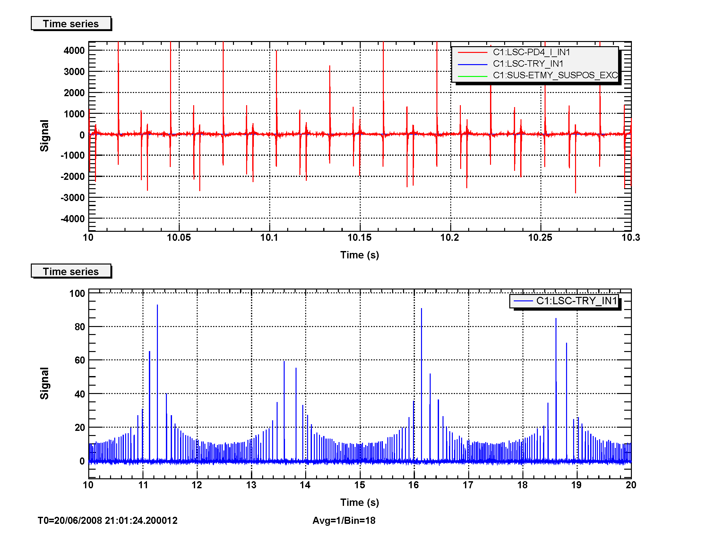
The Vernier Technique (3)
The cavity length is swept by exciting one mirror.
∆L_{FSR}
PDH
∆L = distance between carrier and one sideband relative to the same longitudinal mode n
∆L
sidebands
∆L_{fsr} = distance between two adjacent longitudinal modes of the carrier
carrier
Transmission
The cavity length is changing!
Not very accurate: ~ 10⁻³.
“If I used my finger to measure the length, that would be as much accurate!”
Rana Adhikari, Caltech, circa August 2008
M Rakhmanov, M Evans and H Yamamoto, Meas. Sci. Technol. 10 (1999) 190–194. “An optical Vernier technique for in situ measurement of the length of long Fabry–Perot cavities”

Slide 10
A New Technique
A RF modulation is produced by the beating of the main beam with that of an auxiliary laser at a slightly different frequency.
Interference Field
Power Detection Measurement
ω₁ resonant
Conditions for the measurement:
Cavity locked to main laser (ω₁)
Auxiliary laser’s frequency ω₂ locked to ω₁ by a tunable offset Δω

Slide 11
Locking the auxiliary laser to the PSL
Phase Locked Loop
(Marconi)
ω_{off}
GPS
LO
LP
Rb Frequency standard
PD
NPRO
BS
ω₂
ω₁
PSL
James B.Armor, Jr., and Stanley R. Robinson, Applied Optics, Vol. 18 No. 18 (1979), "Phase-lock control considerations for coherently combined lasers"

Slide 12
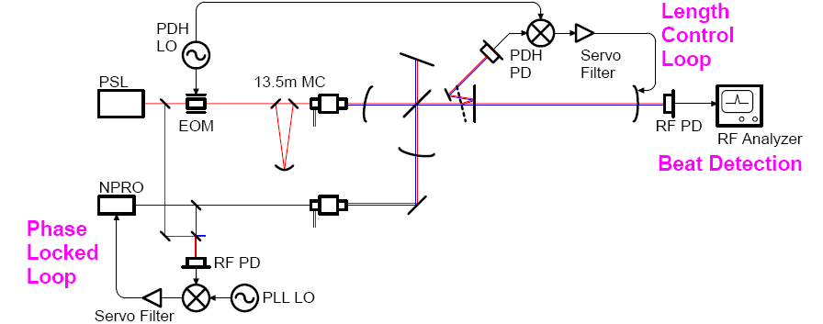
Arm Measurement Scheme
Strategy
Auxiliary beam injected from the dark port
Cavity locked to the main beam
Frequency difference of the two lasers stabilized by the PLL servo
Beating appears at the transmission only when aux. beam is resonant
Mode spacing read from the LO freq of the PLL at max of transmission

Slide 13
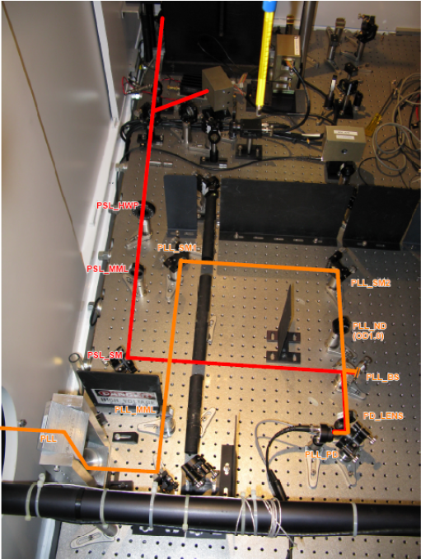
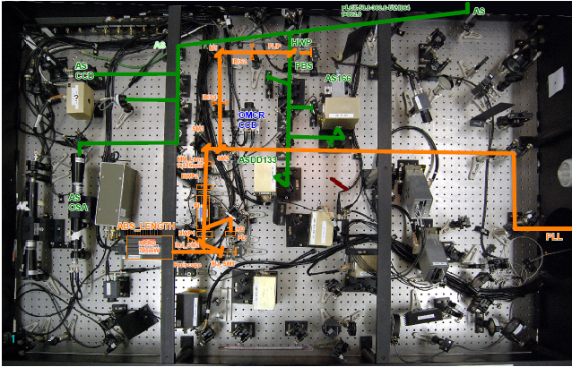
Optics Setup
AS Table
AP Table

Slide 14
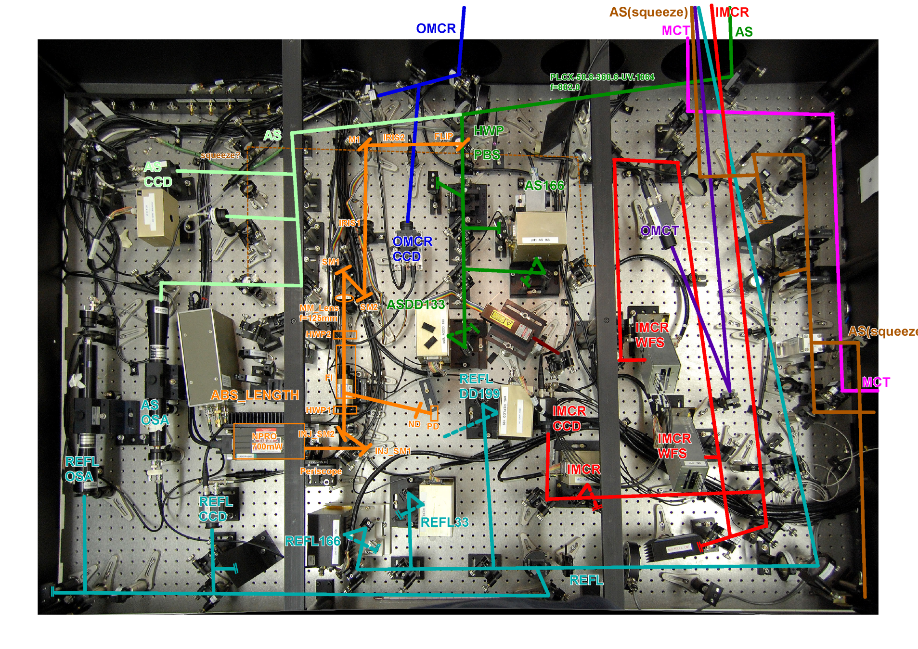
Injection Optics – AP Table Detail

Slide 15
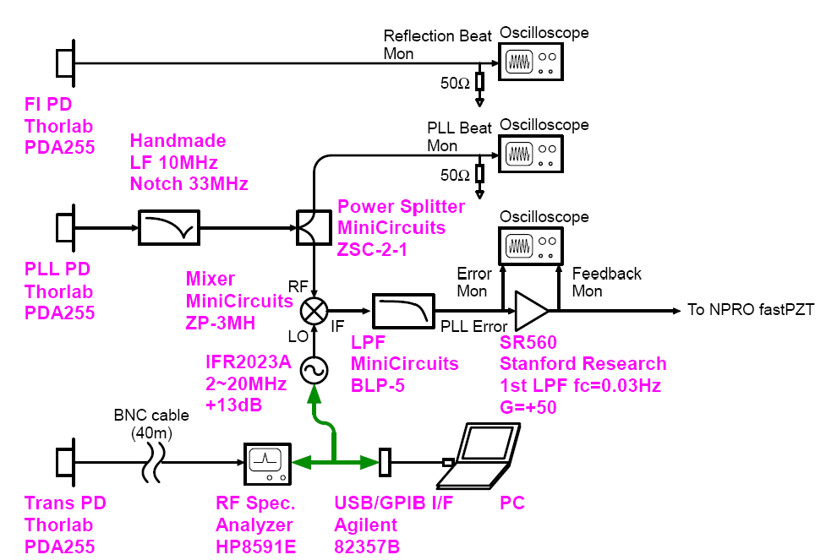
Detection Setup
GPS time
GPIB/LAN WiFi interface

Slide 16
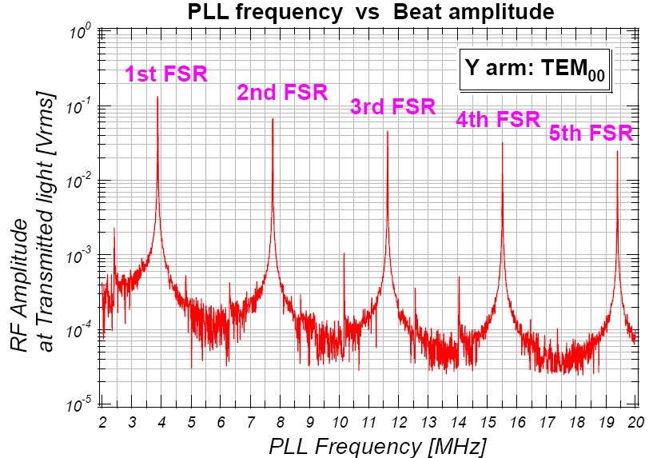
X Arm FSR Series
Fit

Slide 17
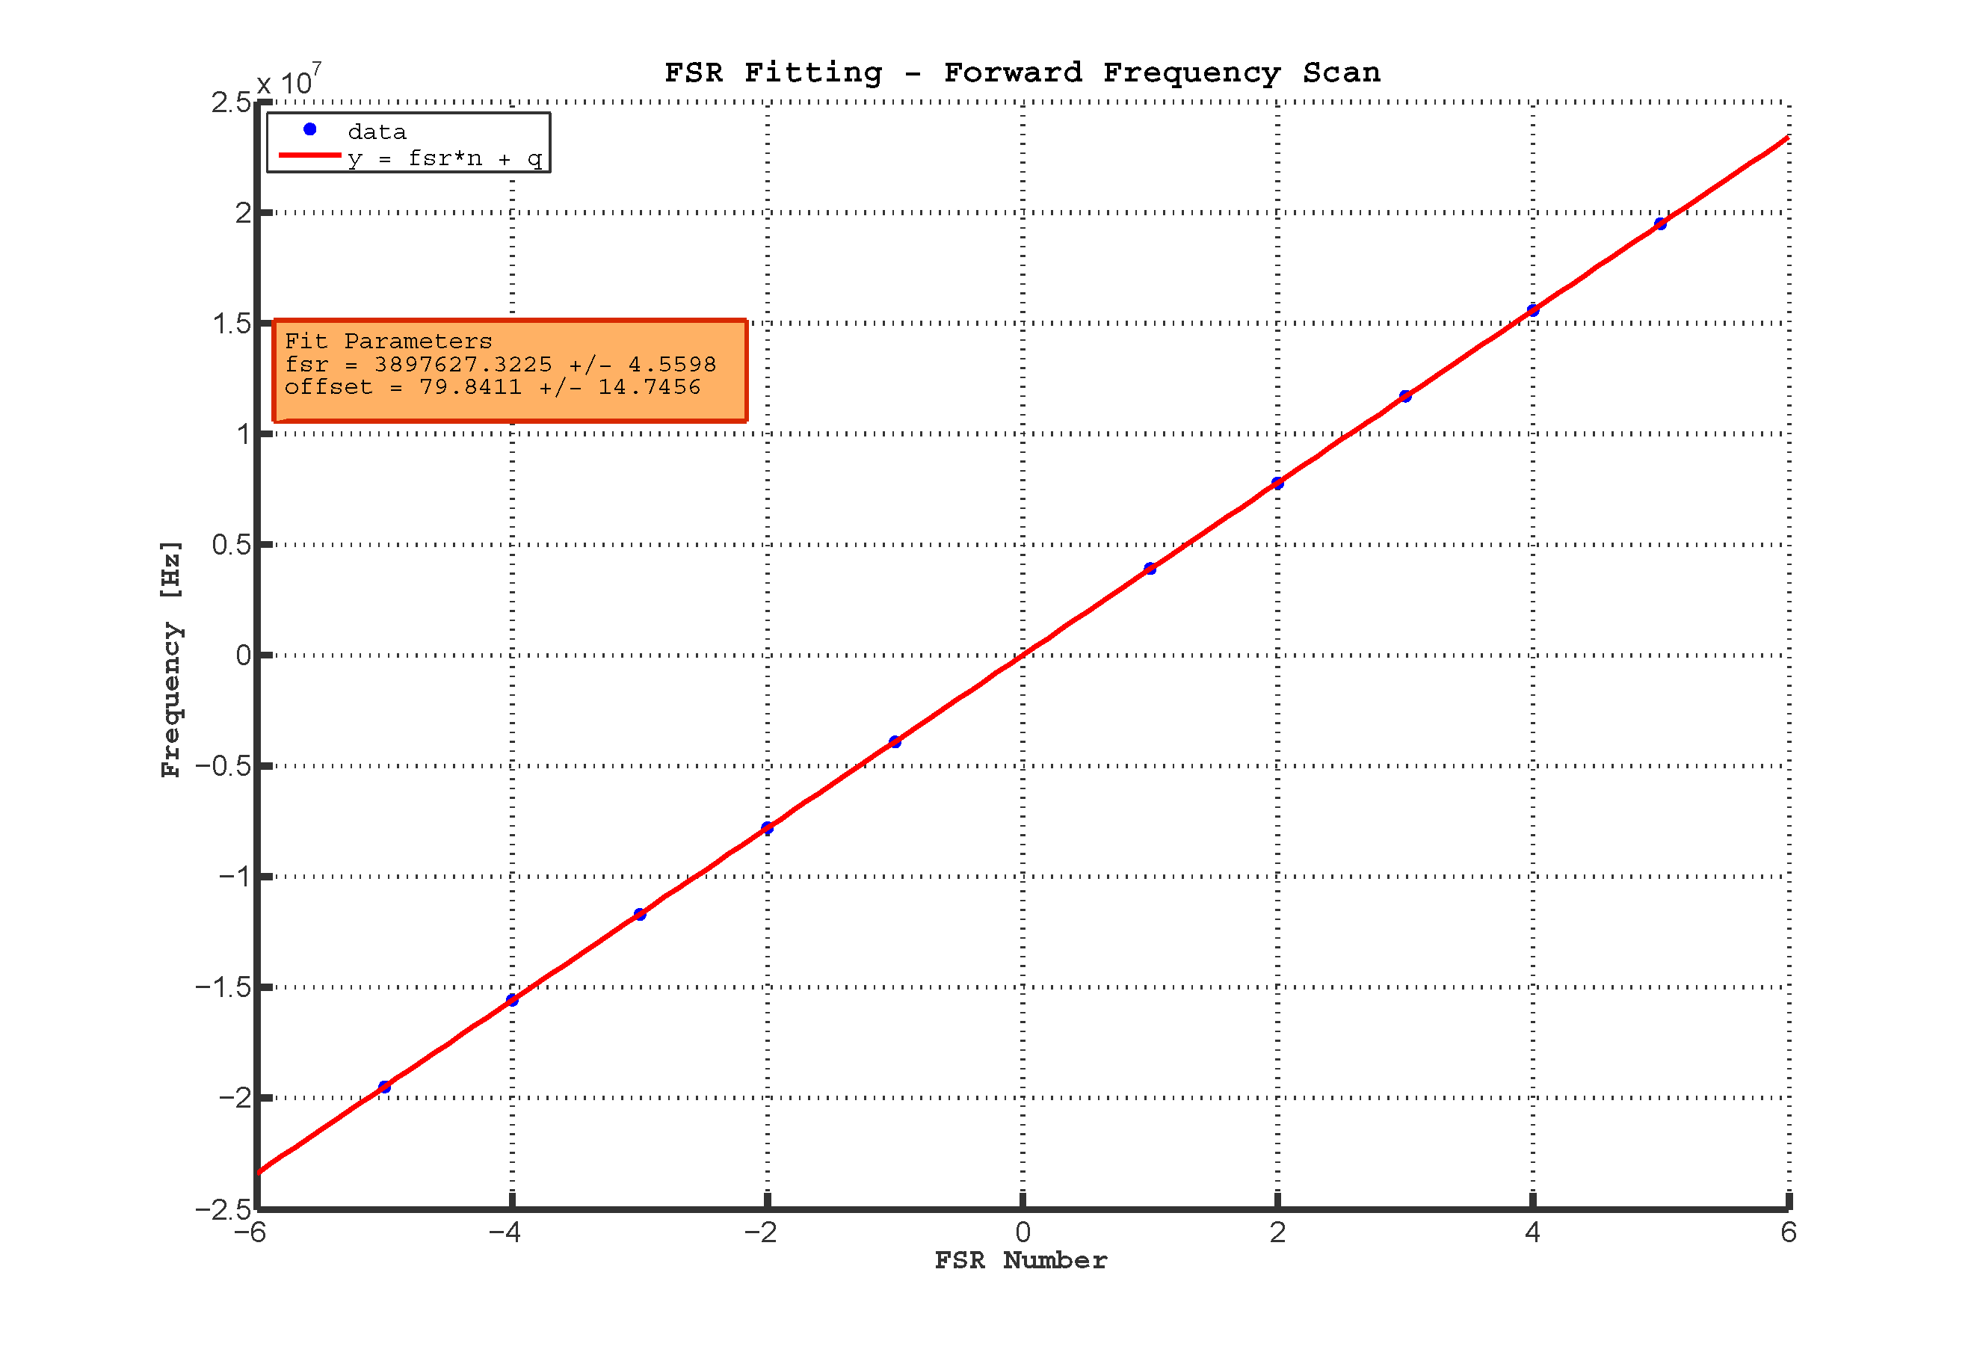
FSR Fit
Y-Arm
strange offset!

Slide 18
Mode Coupling
Mode Overlapping Ratio
If
at the transmission:
TEM₀₁ / TEM₁₀
If
at the transmission:

Slide 19
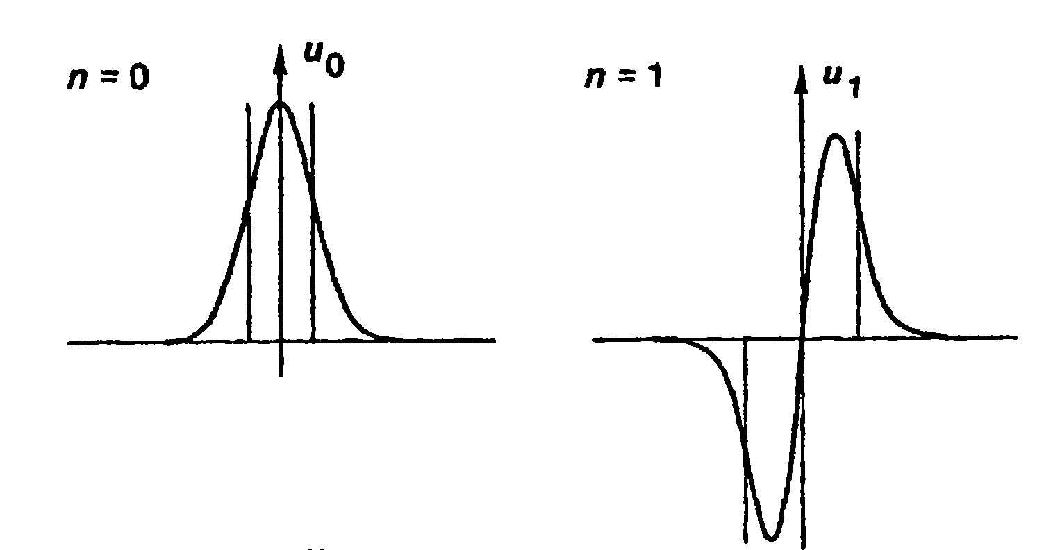
Transverse Beating Pattern
Transverse Beat
The arm cavity is locked to the TEM₀₁/TEM₁₀ of the main beam by tilting the End Mirror
The beating with the TEM₀₀ of the aux beam is visible in transmission
TEM₀₁ phase
+
-
The lobes have opposite phase and the power hitting a photodiode is constant.
The beat does is not detected by a photodiode.

Slide 20
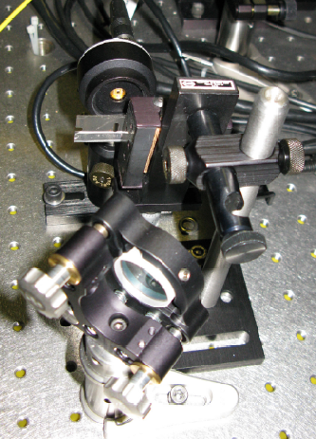
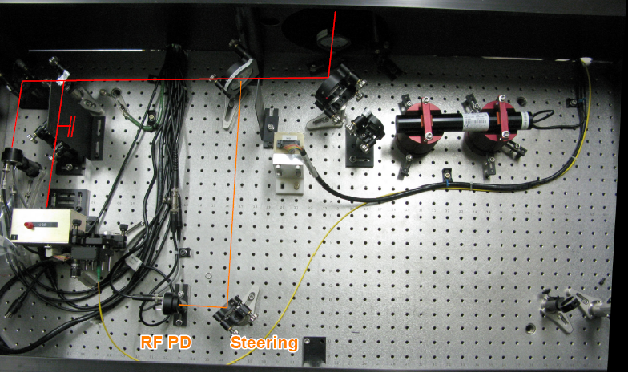
Shaving the Beam
Optics Setup on the End Table
Knife edge place right in front of the PD to avoid diffraction

Slide 21
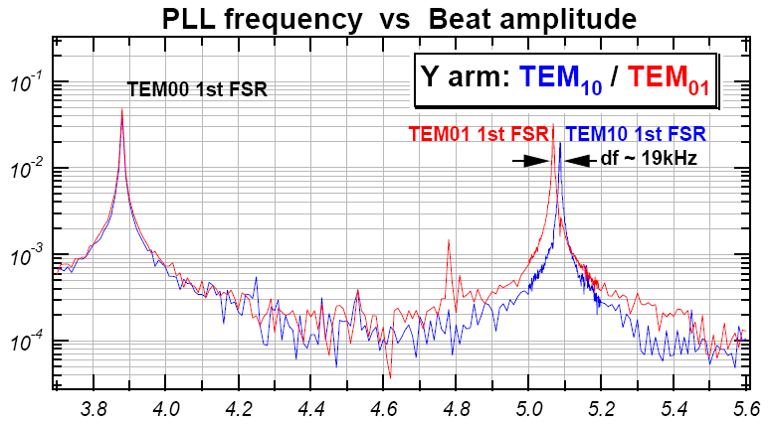
Astigmatic Mirrors
Y Arm Transverse Mode Spacing
The End Mirror’s Astigmatism brakes the degeneracy of the 10 and 01 modes

Slide 22
Summary of Measurements on the Arm Cavities
X Arm
FSR = (3897627 +/- 5 ) Hz
L = (38.45833 +/- 0.00005) m
g_{2x} = 0.31197 +/- 0.00004
g_{2y} = 0.32283 +/- 0.00004
R_{ETM,x} = (55.8957 +/- 0.0045) m
R_{ETM,y} = (56.7937 +/- 0.0038) m
Y Arm
FSR = ( 3879252 +/- 30 ) Hz
L = (38.6462 +/- 0.0003) m
g_{2x} = 0.31188 +/- 0.00004
g_{2y} = 0.32601 +/- 0.00004
R_{ETM,x} = (56.1620 +/- 0.0013) m
R_{ETM,y} = (57.3395 +/- 0.0011) m
LIGO’s Metrology
(57.37 +/- 0.6) m

Slide 23
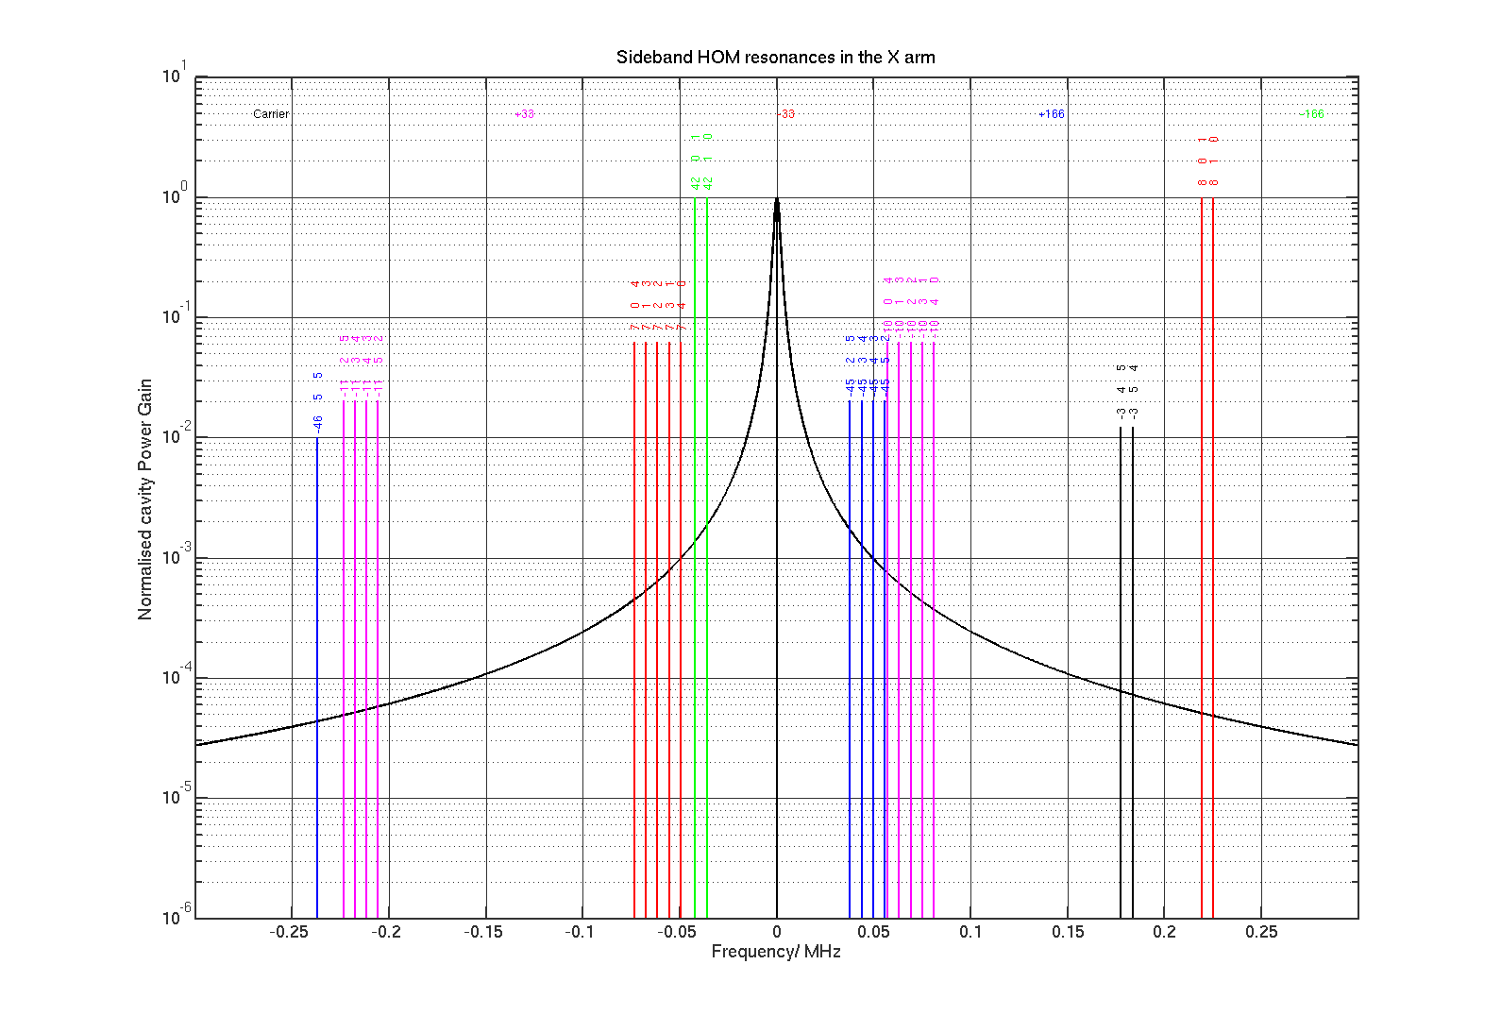
Mode Resonances at the 40m
No evidence of sidebands’ HOM Resonance
(Matlab code by J. Miller)

Slide 24
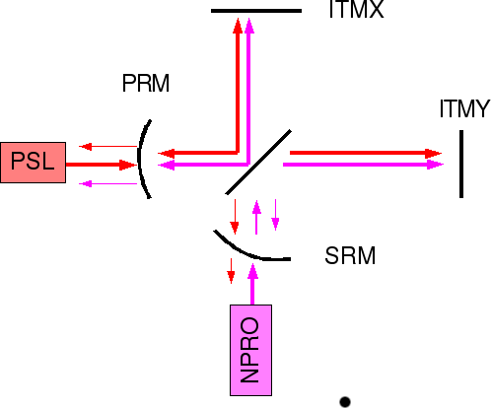
Recycling Cavities
The finesse is lower (<80) and frequency dependent
Cavity modeling necessary
But it is easier to make the aux beam go through
Where to inject the aux beam? The Schnupp Asymmetry makes things harder
Maybe not to much since it is frequency dependent
Doable for the PRC with current 40m configuration
SRC?
Effective Michelson Mirror

Slide 25
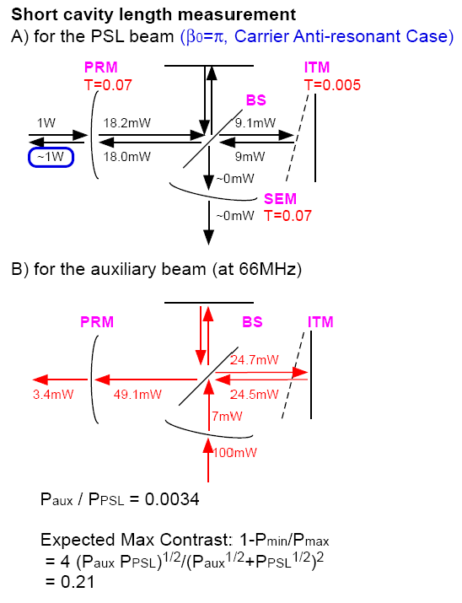
PRC Model
Intracavity Power
SRM

Slide 26
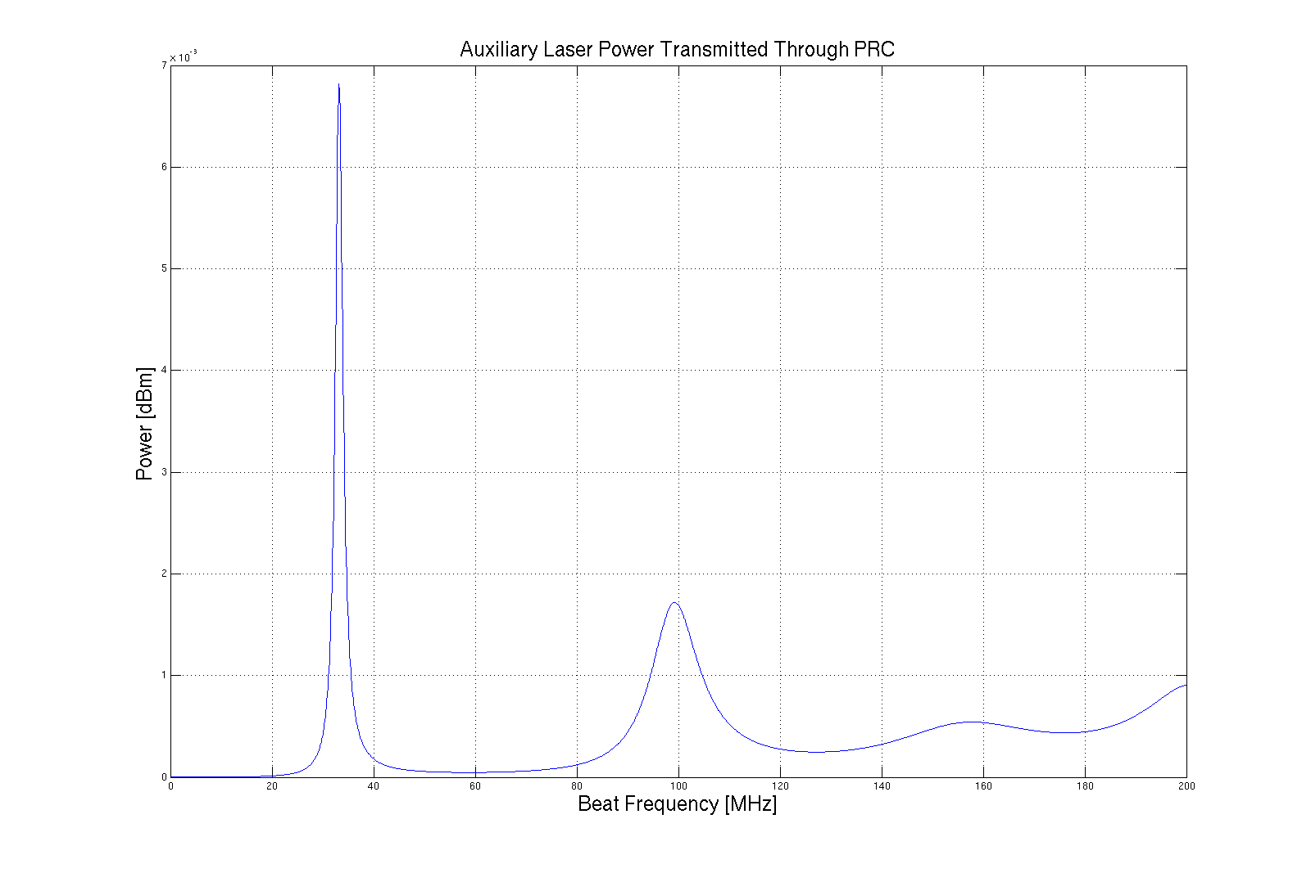
PRC Expected Intra-cavity Power
Carrier Anti-resonant, nominal Schnupp Asymmetry
First Resonance 33MHz
(sideband frequency)
Second Resonance 99MHz
NPRO Relative Frequency

Slide 27
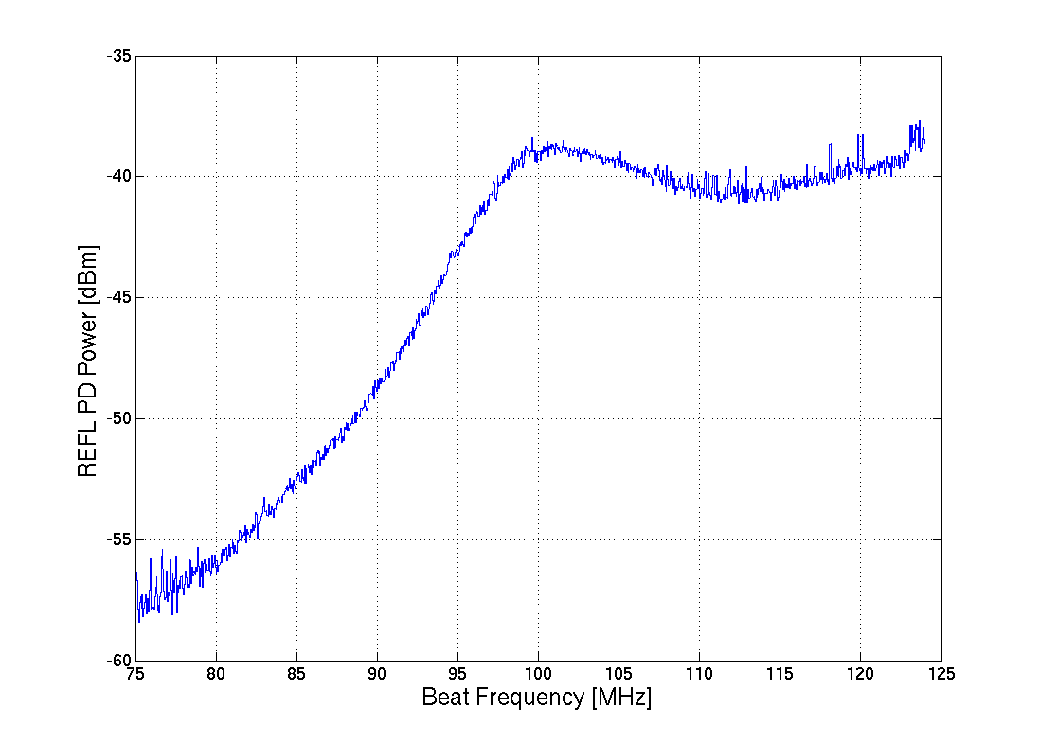
PRC Preliminary Results
PRM Reflection PD
99 MHz
Adjustment of the model parameters necessary to extract the length from the measurement

Slide 28
Future Work
Continue the measurements on PRC
Get a new faster PD (no filter, larger bandwidth)
Turn off f2
Fit data with model
Measure SRC
how to go through MC?
Phase detection instead of power detection?
The aux beam is not stable enough because the low gain/bandwidth of the PLL servo
The phase of the NPRO is locked, but not its frequency. The beam has arbitrary phase
Study effect on Advanced LIGO Sensitivity
Modeling Frequency and Amplitude noise on DARM

