Slide 1
Dissipation processes in Metal springs
Arianna Di Cintio
University of Rome “Sapienza”
Caltech 2008, LIGO project
Riccardo DeSalvo Maria Ascione Caltech University of Sannio
Pisa November 24, 2008
LIGO-G0810032-x0

Slide 2
Abstract
We studied the dissipation properties of the Maraging springs used in the seismic isolation system of Advanced LIGO, Virgo, TAMA, et c., with emphasis on mechanical hysteresis, which seems to play a more important role than expected. The Monolithic Geometric Anti Spring vertical attenuation filter at very low frequency presented an anomalous transfer function of 1/f instead of the expected 1/f², static hysteresis and eventually instability.
While characterizing these effects we discovered a new dissipation mechanism and an unexpected facet of elasticity. Not all elasticity comes from the rigid crystalline structure. A non-negligible fraction of elasticity is contributed by a changing medium, probably entangled dislocations. Oscillation amplitude (or other external disturbances) can disentangle some of these dislocations thus reducing the available restoring force of a spring. The disentangled dislocations temporarily provide boosted viscous like dissipation, then they lock back providing elasticity with a different equilibrium point. A stable oscillator can be made unstable by small external perturbation and fall over, or can be re-stabilized by externally providing temporary restoring forces while the dislocations re-entangle. The process likely explains the anomalous transfer function.
We may be getting closer to solve the old dilemma if dissipation in metals is better described by viscous losses or by a loss angle.

Slide 3
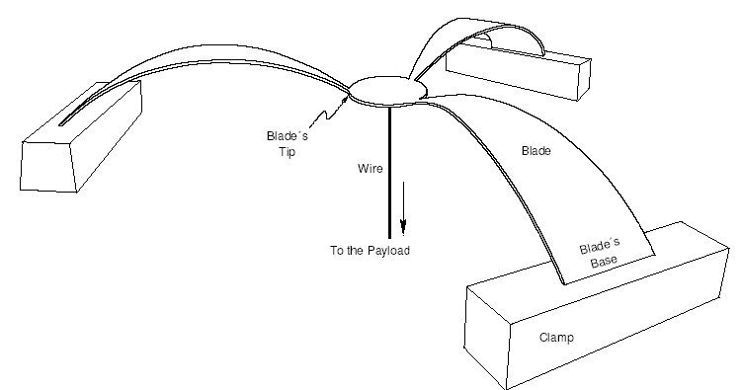
The GAS mechanism
The GAS filter consists of a set of radially-arranged cantilever springs, clamped at the base to a common frame ring.
Moving away from the working point the compression of the springs results in a vertical component, proportional to the displacement, the Anti-Spring force.
The Anti-spring effect is
proportional to the radial
compression.
The GAS mechanism is used to null the restoring forces of a spring.
This exposes hysteresis, thermal effects and any other underlying effect.

Slide 4
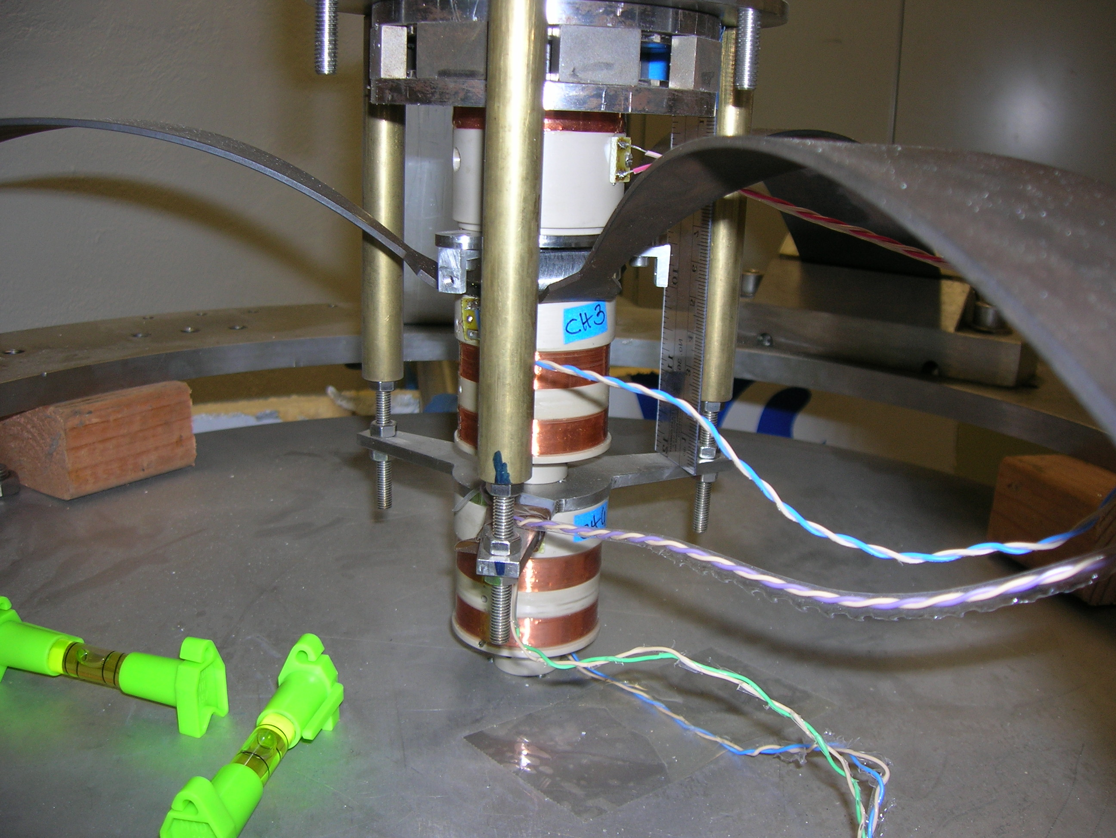
The experiment: EMAS mechanism
The SAS seismic attenuation system for the Advanced LIGO Gravitational Wave Interferometric Detectors. A.Stochino et al., 2008
The GAS is tuned to obtain a low mechanical resonant frequency (typically 200 mHz) at the working point
Remote control
Non contacting actuator
LVDT position sensors
Box around the filter to prevent air turbulence
IIR integrator for thermal compensation: keeps the system at the working point
EMAS with variable gain: further reduces the resonant frequency

Slide 5
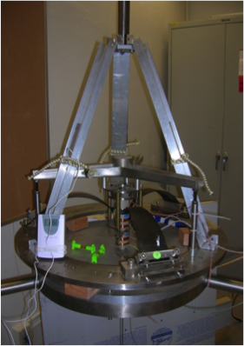
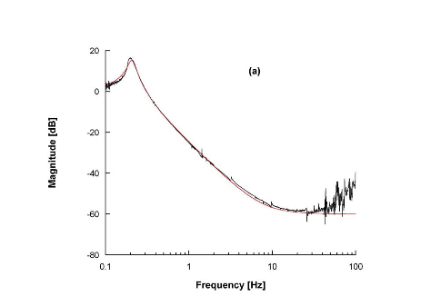
Theoretical transfer function of a GAS-filter

Slide 6
Depressing transfer function with Electro-Magnetic Anti Springs and counterweights
Instead we found….
Moves down
With tune
Stationary and
Unexpected 1/f
Transfer Function
Hysteresis is likely responsible for the unexpected 1/f attenuation behavior observed in the GAS-filter transfer function, when the system is tuned at very low frequency,
at or below 100 mHz

Slide 7
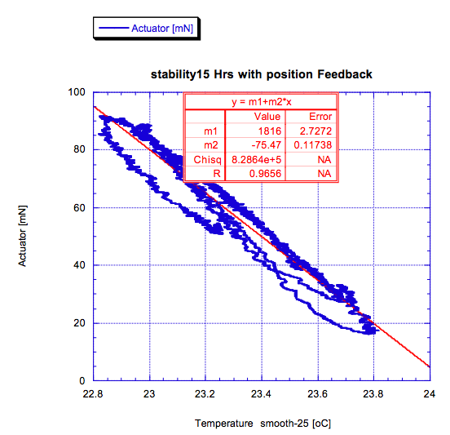
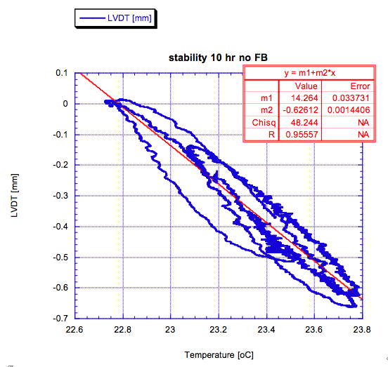
Evidence of hysteresis in the thermal feedback
Filter movement under overnight lab thermal variations
Without feedback
The movement shows Thermal hysteresis
Switching on the feedback, that means no system movement, we expected no hysteresis
But hysteresis shifted to the control current ! !
Hysteresis does not originate from the actual movement…
Hysteresis derives from evolving stresses inside the materials! Obvious if you think that metal grains can only “see” internal stresses

Slide 8
In order to explore the effects of hysteresis at various tunes, we applied excitations of different amplitude and shape.
Thermal feedback time constant much longer than experiment duration
EMAS gain 0, frequency 0.21 Hz
We apply a force lifting the spring to a certain height,
then cut the force and let the system oscillate freely:
NO HYSTERESIS OBSERVED
Subjecting the system to the same force, but
slowly returning the lifting force to zero, thus generating no oscillations:
HYSTERESIS OBSERVED FOR ALTERNATE SIGN EXCITATION
NO HYSTERESIS FOR SAME SIGN EXCITATION

Slide 9
Hysteresis amplitude grows with low frequency tune
EMAS gain -2, frequency 0.15 Hz
Applying a slow oscillatory force, whose amplitude reduces with an exponential profile,
we observe a thermal drift but no hysteresis
OSCILLATIONS APPEAR TO WASH-OUT HYSTERESIS:
not at very low frequencies, where there are not enough oscillations to delete hysteresis
Large initial hysteresis due to previously integrated stresses

Slide 10
Quality factor measurement
For each EMAS setting we excited the spring applying a short voltage pulse on the actuator, monitored the ringdown and extracted the spring’s height, frequency and lifetime using a damped sinus fit. We repeated the analysis with different tuning (resonant freq. 0.24 and 0.21 Hz)
the expected quadratic behavior
Deviation from quadratic above 0.27 Hz, confirmed after changing the radial compression of the blades
The deviation of Q from the f² function seems to be material dependent, not tune dependent.

Slide 11
Low frequency instability
System scanned with increasing negative EMAS gain and no excitation
Mechanical noise triggers the runoffs
[V]
Mathematical instability
instability region
starting from ~
0.2-0.15 Hz

Slide 12
The initial runoff is slow, much slower than the spring time constant (~4 sec, for runoff starting at 40 mHz), and then accelerate progressively faster
The same runoff is observed in IP
(Saulson et al., The IP as a probe of anelasticity, 1993)
~20-30 sec
An external perturbation triggers run-off, as runoff is detected EMAS gain backs-off and ramps back to nominal value.
The process can be stopped by providing temporary stiffness to the system.

Slide 13
Dissipation and stiffness dependence from amplitude
We studied the behavior of the resonant peaks, for swept sine excitation of different amplitudes.
The experiment was repeated for EMAS gain 0 and -2
We divide the total elastic constant of the system into :
movement of dislocations inside the material, when the material is subjected to stress + crystal lattice elasticity
We consider = oscillation amplitude
usual spring constant amplitude dependence variation of the spring elastic constant
due to progressive mobilization of the dislocations
We are assuming here that the entangled dislocations inside the material contribute to the elasticity constant and that, changing the stress, some of them can be disentangled, thus reducing the effective Young modulus .

Slide 14
The frequency becomes amplitude dependent if the number of disentangled dislocation is function of the excitation amplitude according to:
Fitting in the frequency domain..
EMAS=0
EMAS=-2
The fit is compatible with an amplitude exponent of 0.5
Fit forced to 0.5

Slide 15
Cross checking it in the time domain, again the best fit is obtained for exponent 0.5:

Slide 16
Remarkably, the same thing happens with the lifetime of the ring down oscillation… the fit requires a o.5 exponent for the changing losses

Slide 17
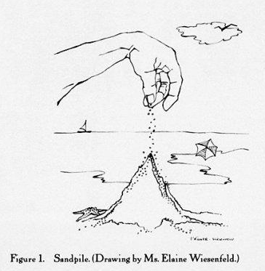
Which theory we like
We observe a static effect, viscosity is not adequate to explain it, we need a different model.
The theoretical bases that comes closer to our observation is Marchesoni’s On dislocation damping at low frequencies, based on Self Organized Criticality (Bak, Tang and Wiesenfeld)
Dislocations entangle forming a rigid lattice which contribute to elasticity
Dislocations can disentangle, move and produce viscous like effects, when subjected to varying stress
They eventually re-entangle, thus
producing static hysteresis
Cagnoli G, et al.
1993 Phil. Mag. A 68 865
Per Bak 1996
How nature works: The Science
of Self-Organized Criticality

Slide 18
Self organized criticality could explain transition from highly predictive to an almost random oscillator in LIGO-Ips
Transition from “gaussian” to full-blown-avalanche dominated statistics at LF
500mHz
30mHz

Slide 19
CONCLUSIONS summary
Disentanglement and re-entanglement of dislocations inside the material can explain
Appearance of hysteresis in the GAS filter, : dislocation can disentangle and mobilize, thus re-entangle, generating hysteresis. The effect is more evident at low frequencies
The quadratic law of the Q-factor, followed if the system is slow enough. A fixed amount of loss per period is reached, corresponding to disentangled dislocations regime
The departure from the quadratic law: at higher frequencies dislocations don’t have time to fully mobilize and less losses are observed
Run-off interpreted as a temporary loss of restoring forces due to mobilization of dislocations (triggered by an external or internal excitation). That’s proved by the switch-off mechanism, attributed to re-entanglement
Reduction of the spring’s elastic constant due to the progressive mobilization of the dislocations: larger stress variations, more dislocations disentangled, thus reducing the effective K _{spring}
Corresponding increase of pseudo-viscosity from mobilized dislocations, thus reducing the damping time constant

Slide 20
…and more
Entanglement and disentanglement of dislocations is an intrinsically fractal behavior
The observed 1/f Filter Transfer Function would be explainable
Excess 1/f noise could be expected as well, as aspect of Self-Organized Criticality
The excess noise found in tiltmeters could be explained
The loss of predictability of the ringdown decay in the LIGO-SAS Inverted pendula
The very low coherence and apparent random walk of the Virgo [Ruggi, private comm.] and TAMA [Koji Arai private comm.] Inverted Pendula equilibrium point
Excess noise in suspended mirrors?

Slide 23
Thermoelastic peak
The heat diffusion produces a contribution to the elastic energy dissipation given by equation
where is the relaxation time.
For Maraging blades with h= 3.44 mm of thickness and an heat-diffusion coefficient
we obtain a peak frequency of 0.73 Hz.
The peak height is not into the 1/f range of the GAS filter transfer function.

Slide 24
CLAMPING PROBLEM...

Slide 25
DECAY OF THE LIGO IP PROTOTYPE

Slide 26
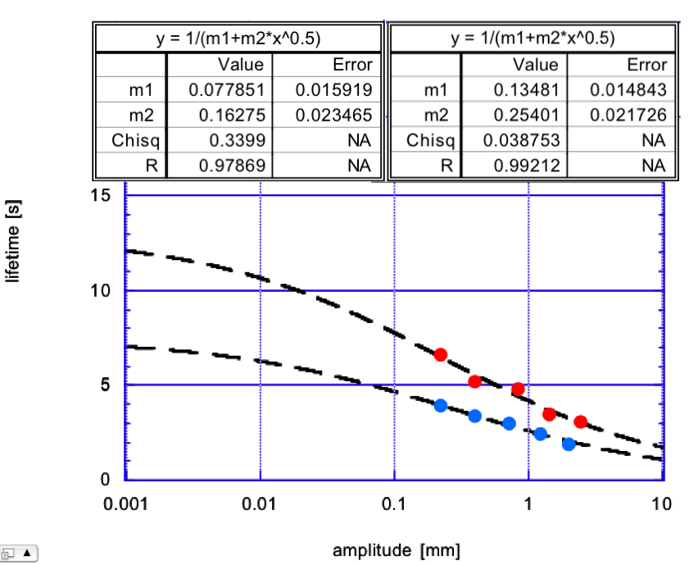
From the frequency domain data we extracted the damping constant from the swept sine FWHM response. We fitted the data with the same function, but fixing the exponent to 0.5.

